Slide 1
CSE 538
Instructor: Roch Guerin (guerin@wustl.edu)
Office hours: Mon & Wed 4:00-5:00pm in Bryan 509
Classes: Tuesday & Thursday 10:00-11:30am in Lopata 103
Textbook: M. Harchol-Balter, "Performance Modeling and Design of Computer Systems." Cambridge University Press (2013), ISBN: 978-1-107-02750-3
Class wiki: http://classes.engineering.wustl.edu/cse538

Slide 2
What Are We Going To Be Looking At?
Jobs arrive
How often, with what patterns?
Each job brings a certain amount of work (service time)
How much, with what variations?
System has resources
CPU, memory, bandwidth, etc.
Basic questions
What is the system response time
How much better will it be if I increase CPU speed, bandwidth, memory, etc.?
How should I assign jobs to servers?
Should I pool jobs together, or split them apart across servers?

Slide 3
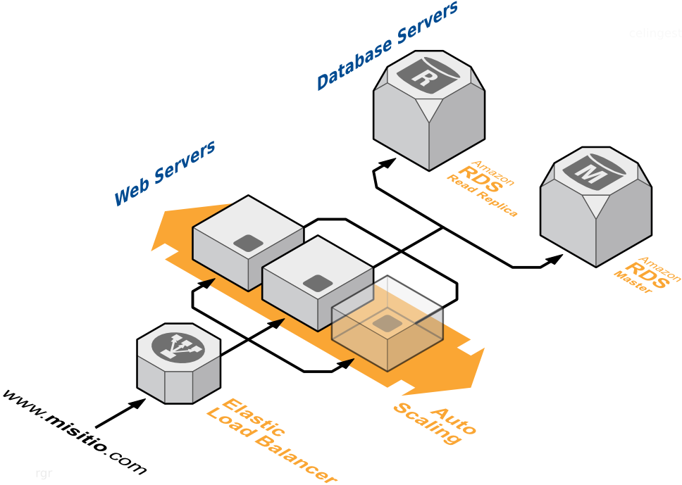

Slide 4
Formalizing a Conceptual Approach Queueing Nomenclature
Waiting facility
Server(s)
λ
μ
Arrivals
Departures
Service discipline
Arrival rate (λ), average (mean) inter-arrival time (1/λ)
Service rate (μ), average (mean) service time (1/μ)
Service disciplines:
First-in-first-out (FIFO) or fist-come-first-served (FCFS)
Last-in-first-out (LIFO)
Random-in-random-out (RIRO)
Processor sharing (PS)
Work conserving (or not)
Queueing system notation: A/B/c/d, e.g., M/M/1/∞ or M/M/1
A: type of arrival process
B: service time distribution
c: number of servers
d: maximum number of jobs

Slide 5
Queueing Metrics
Waiting time or queueing time or delay: T_{Q} or W
Time spent in queue (from arrival to access to server)
Response time or sojourn time or time in system: T
How long a job spends in the system from arrival to departure
Equal to waiting time + service time
Number in the system: N
Number of jobs in the queue and server(s)
Number in the queue: N_{Q}
Number of jobs waiting to access server
Server/device utilization or load: ρ
Fraction of time the server is busy (at least one job in it)
Server/device throughput: X
Rate of (service) completions at server, i.e., jobs/sec

Slide 6
More on Utilization & Throughput
Server utilization = Average # jobs in service: ρ = E[N_{S}]
Utilization = fraction of time server is busy ~ probability server is busy: ρ = P(N_{S} = 1)
When server is busy: One job in server (N_{S} = 1)
When server is not busy: Zero job in server (N_{S} = 0)
E[N_{S}] = P(N_{S} = 1) × 1+ P(N_{S} = 0) × 0 = ρ × 1 = ρ
S₁
S₂
S₃
S₄
S₅
S₆
S₇
S₈
…
S_{i}
…
S_{C-1}
S_{C-2}
S_{C}
τ
C(τ) jobs in τ for a total service time of B(τ) = S₁+S₂+S₃+…+S_{C-1}+S_{C}
We know
Utilization ρ ~ B(τ)/τ
Throughput X ~ C(τ)/τ
So that X ~ [C(τ)/B(τ)] . [B(τ)/τ] = [C(τ)/B(τ)] . ρ, but B(τ)/C(τ) ~ E[S] = 1/μ
Hence: X = ρ . μ

Slide 7
Alternative Derivation (Conditional Expectation)
X = Mean rate of job completion at server
= E[Rate of completion at server | server is busy]. P{server is busy} + E[Rate of completion at server | server is idle]. P{server is idle}
= μ . P{server is busy} + 0
= μ . ρ

Slide 8
A Simple Throughput Example
Infinite waiting facility
Single server
λ
μ
FCFS
Assume λ = 1/6 and μ = 1/3
Throughput is X = ρ . μ, but what is ρ?
Rough intuition
ρ = fraction of time server is busy
= (average service time)/(average time between arrivals)
= (1/μ)/(1/λ) = λ/μ
So X = λ, and does not depend on service rate!

Slide 9
Single Server Stability
Infinite waiting facility
Single server
λ
μ
Arrival rate of λ and service rate of μ
N(t) is number of jobs in system at time t
A(t) and D(t) are numbers of arrivals and departures by time t
We have: E[N(t)] = E[A(t)] – E[D(t)] ≥ λt – μt = t(λ-μ)
Hence we need λ < μ for the system to be stable
Service rate must exceed arrival rate…

Slide 10
Queueing Networks
A system with multiple connected queues and servers
Open networks: external arrivals and jobs eventually leave the system
Closed networks: No external arrivals or departures (departure rate = arrival rate)
Batch systems and interactive systems (main difference is how fast new jobs are submitted once a job completes a “cycle”)

Slide 11
Open Networks
r₂
CPU
Disk 1
p_{2,out}
λ
μ₂
p₂₃
2x around
Disks 1,2,1,2,1
p₁₂
r₁
p₁₃
μ₁
μ₃
p_{1,out}
p₃₁ = 1
r₃
Disk 2
Probabilistic routing
“Probabilities” determine where jobs go next
Note that p_{1,out} + p₁₂ + p₁₃ = 1
Deterministic routing
Every jobs follows a fixed path, possibly visiting each server more than once

Slide 12
Open Networks Throughput
r₂
p_{2,out}
μ₂
p₂₃
p₁₂
r₁
p₁₃
μ₁
μ₃
p_{1,out}
p₃₁ = 1
r₃
System throughput: X = Σ_{i} r_{i}
Single server throughput X_{i} = λ_{i}, but what is λ_{i}?
λ_{i} = r_{i} + Σ_{i} p_{ji} λ_{j} (a system of equations)
Note that the r_{i}’s are constrained by the fact that we need λ_{i} < μ_{i}

Slide 13
Closed Networks
Interactive
Batch
μ₁
μ₂
μ₁
μ₂
μ₃
μ₃
…
N “users”
Fixed number of jobs “circulate” in the system
Often called the system load
Interactive
A fixed number of users submit jobs
A user can only submit a new job after her previous job completes
A user has a “think time” before submitting her new job
Batch
Same as interactive with a think time of 0

Slide 14
Closed Networks Throughput
Single server batch network
X = μ (depends on service rate!)
Multiple servers
A bit more complicated. We’ll explore this later

