Slide 1
M/G/1 Busy Period & Power Optimization

Slide 2
Power Optimization Problem
Given an M/G/1/FCFS server with the following power consumption profile
P_{on} when serving jobs
P_{idle} ≤ P_{on} when idle waiting for work
0 when off
P_{setup} ≈ P_{on} when starting up (setup time has general distribution
jobs arriving according to a Poisson process of rate λ, and with a general service time distribution
What is the optimal policy that maximizes performance/watt, i.e., 1/(E[Power]⋅E[T])?

Slide 3
Two Sample Policies
ON/OFF policy: Server is immediately turned OFF when it becomes idle (end of busy period)
Zero power consumed while OFF, but SETUP time affects both response time and power consumption (power is consumed but no work is performed during setup)
ON/IDLE policy: Server is never turned OFF
No setup overhead, but power is consumed all the time
Question: Which policy is better when?
Answer depends on ρ, as well as service time and setup time distribution

Slide 4
M/G/1 Busy Period Analysis – (1)
Busy period distribution plays a major role in the performance of both sample policies
We’ll first derive the Laplace transform B_{x}(s) of the duration B(x) of a busy period started by an amount of work x, i.e.,
B(x) = x +Σ_{{i=1 to Ax}}B_{i} where the B_{i}’s are independent busy periods (each started by an arrival) with the same distribution
We then have
B_{x}(s) = e^{–sx}⋅L_{f}(Σ_{{i=1 to Ax}}B_{i}) = e^{–sx}⋅A_{x}(B(s)) = e^{–sx}⋅e^{–λx(1–B(s))}
= e^{–x(s+λ–λB(s))}
Unconditioning then yields the following expression
B(s) = ∫_{{x=0 to ∞}}B_{x}(s)f_{S}(x)dx = ∫_{{x=0 to ∞}} e^{–x(s+λ–λB(s))} f_{S}(x)dx
= S(s+λ–λB(s)) – a recursive expression from which we can derive all moments, including E[B] = E[S]/(1–ρ)

Slide 5
Busy Period Moments
Recall that ρ = E[B]/(E[B]+E[I]), so that E[B](1–ρ)=ρ/λ ⇒ E[B]=E[S]/(1–ρ)

Slide 6
Busy Period vs. Response Time
Comparing E[B] to E[T], we see that
E[B] = E[S]/(1–ρ) and E[T] = λE[S²]/2(1–ρ) + E[S]
In other words, E[B] is not affected by variability in S, while E[T] is
This because Busy periods start with no jobs in the system, i.e., they do not depend on S_{e}
In general, the i^{th} moment of B depends on the i^{th} moment of S, while the i^{th} moment of T depends on the (i+1)^{th} moment of S

Slide 7
More on M/G/1 Busy Period Analysis
Recall the Laplace transform B_{x}(s) of the duration of a busy period started by an amount of work x
B_{x}(s) = e^{–x(s+λ–λB(s))}
Assume next that x is a r.v. with p.d.f. f_{W}(⋅)
B_{W}(s) = ∫_{{x=0 to ∞}}B_{x}(s)f_{W}(x)dx
= ∫_{{x=0 to ∞}} e^{–x(s+λ–λB(s))} f_{W}(x)dx
= W(s+λ–λB(s))
Differentiating and evaluating –B′_{W}(s) at s = 0 gives
E[B_{W}] = E[W]/(1–ρ)

Slide 8
M/G/1 With Setup – (1)
Each busy period starts with a setup time I
Can we characterize E[B^{setup}] and E[T_{q}^{setup}]?
From our previous result E[B_{W}] = E[W]/(1–ρ)
E[B^{setup}] = (E[I]+E[S])/(1–ρ) = E[B]+E[I]/(1–ρ), where ρ = λE[S]
The Renewal-Reward Theorem tells us that ρ^{setup}, the fraction of time server is busy including setup, is the fraction of time the server is busy during one cycle, which yields
ρ^{setup} = E[B^{setup}]/(E[B^{setup}]+1/λ) = (λE[I]+ρ)/(λE[I]+1)
Next, we will approach deriving N^{setup}(z) as for the M/G/1 system without setup, except for the transitions out of state 0 that need to account for the setup
We will then obtain T^{setup}(s) from N^{setup}(z)

Slide 9
M/G/1 With Setup – (2)
Let a_{j} = P{j arrivals in S} – in service time
a'_{j} = P{j arrivals in S+I} – in service+setup time
Then P_{ij} = a_{j-i+1} for i>0 and P_{0j} = a'_{j}
Thus π_{j} = π₀a'_{j} + Σ_{{i=1 to j+1}}π_{i}a_{j-i+1} and
N^{setup}(z) = π₀A_{S+I}(z) + 1/z[N^{setup}(z) – π₀]A_{S}(z)
N^{setup}(z) = π₀[zA_{S}(z) A_{I}(z) – A_{S}(z)]/[z – A_{S}(z)]
where π₀ = 1–ρ^{setup} = (1–λE[S])/(1+λE[I])
We can now obtain T^{setup}(s) from N^{setup}(z) as before

Slide 10
M/G/1 With Setup – (3)
Recall that we have A_{S}(z) = S(λ(1–z)) for any S
This implies A_{Tsetup} (z) = T^{setup}(λ(1–z)), an hence
N^{setup}(z) = T^{setup}(λ(1–z)) since A_{Tsetup} (z) = N^{setup}(z)
From our previous result, we have
T^{setup}(λ(1–z)) = π₀[zA_{S}(z) A_{I}(z) – A_{S}(z)]/[z – A_{S}(z)]
= π₀[zS(λ(1–z))I(λ(1–z))–S(λ(1–z))]/[z–S(λ(1–z))]
with π₀ = 1–ρ^{setup} = (1–λE[S])/(1+λE[I]) = (1–ρ)/(1+λE[I])
T^{setup}(s) = π₀[(λ–s)S(s)I(s) – λS(s)]/[λ–s–λS(s)], where again s=λ(1–z)
This also gives T_{Q}^{setup}(s) = T^{setup}(s)/S(s) and therefore
T_{Q}^{setup}(s) = π₀[λ–(λ–s)I(s)]/[s –λ+λS(s)], from which we derive
T_{Q}^{setup}(s) = T_{Q}^{M/G/1}(s)⋅[λ–(λ–s)I(s)]/[s(1+λE[I])] – recall T_{Q}^{M/G/1}(s)=(1–ρ)s/[s –λ+λS(s)]
Differentiating yields E[T_{Q}^{setup}] = λE[S²]/2(1–ρ)+(2E[I]+λE[I²])/2(1+λE[I])
If I is exponential E[I²]=2E[I]² so that E[T_{Q}^{setup}] = E[T_{Q}] + E[I]

Slide 11
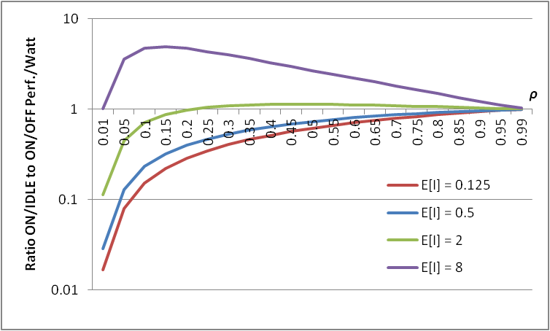
Comparing ON/IDLE vs. ON/OFF
ON/IDLE
E[Power]^{ON/IDLE} = ρP_{on}+(1–ρ)P_{idle}
E[T]^{ON/IDLE} = λE[S²]/2(1–ρ)+E[S], where ρ = λE[S]
ON/OFF
E[Power]^{ON/OFF} = ρ^{setup}⋅P_{on}= P_{on}(λE[I]+ρ)/(λE[I]+1)
E[T]^{ON/OFF} = λE[S²]/2(1–ρ)+(2E[I]+λE[I²])/2(1+λE[I])+E[S]
Performance metric: 1/(E[Power]⋅E[T]) – performance per Watt
EXAMPLE
P_{on} = 240W and P_{idle} = 180W
E[S] = 1 and E[S²] = 20
E[I] varies from 0.125 to 8
E[I²] = 5⋅E[I]
ρ varies from 0.01 to 0.99
At low load ON/OFF is clearly much better when the setup time is low, but this quickly reverses when the setup increases
At high load, both policies are equivalent as the server is busy most of the time

