Slide 1
Scheduling Preemptive Policies
Sized Based

Slide 2
Preemptive Size-Based Policies
Jobs in service can be interrupted, and job “priority” is a function of its size
Jobs resume service where they had stopped
Sample policies
Preemptive-SJF (PSJF), Shortest-Remaining-Processing-Time (SRPT)

Slide 3
PSJF Policy Analysis
At any point in time, the job in service, if any, is the one with the shortest (original) job size
Analyzing PJSF
Limit analysis of preemptive priority policy
Number of priority classes goes to infinity
Transform analysis

Slide 4
PSJF Policy Analysis – (1)
Recall response time of k^{th} priority class in preemptive priority policy
Assume that jobs of size x are in their own priority class, we then have
where is load of jobs of size ≤ x
First term is busy period of jobs of size < x that interrupt service of job of size x
Second term is waiting time before job of size x gets in service

Slide 5
PSJF Transform Analysis – (1)
Notation
T = Response time
T_{x} = Response time of job of size x
T(s) = ∫_{x}T_{x}(s)f_{S}(x)dx – transform of response time
T_{x}(s) = Wait_{x}(s)⋅Res_{x}(s) – (T_{x} = Wait_{x} + Res_{x})
Wait_{x} = waiting time of job of size x
Res_{x} = residence time of job of size x
λ_{x} = λF(x) – arrival rate of jobs of size ≤ x
S_{x} = size (arbitrary) of job of size ≤ x
ρ_{x} = λ_{x}E[S_{x}] = λ ∫_{{t=0 to x}}t f_{S}(t)dt – load from jobs of size ≤ x
W_{x} = work in system from jobs of size ≤ x
B_{x} = duration of busy period from jobs of size ≤ x – (they don’t see bigger jobs)
Note that B_{x}(s) = S_{x}(s+λ_{x}–B_{x}(s)) – from derivation of busy period of M/G/1
A_{y}^{x} = number of arrivals of size ≤ x during time y
Our goal is to derive an expression for T_{x}(s) – from which T(s) can be derived

Slide 6
PSJF Transform Analysis – (2)
We will derive expression for Wait_{x}(s) and Res_{x}(s)
Res_{x} = x + Σ_{{i=1 to Ax}^{x}} B_{x}^{(i)}
B_{x}^{(i)} is i^{th} busy period from jobs of size ≤ x
Res_{x}(s) = e^{–sx}⋅A_{x}^{x}(B_{x}(s)) = e^{–sx}⋅e^{–(λx)x(1–Bx(s))} = e^{–x(s+λx–λxBx(s))}
Wait_{x}(s) = W_{x}(s+λ_{x}–λ_{x}B_{x}(s)) – busy period started by W_{x}
W_{x} = work in PSJF (and FCFS) from jobs of size ≤ x
= queueing time in FCFS with only jobs of size ≤ x
Recall T_{Q}(s)^{FCFS} = s(1 – ρ)/[λS(s)–λ+s]
W_{x}(s) = s(1 – ρ_{x})/[λ_{x}S_{x}(s)–λ_{x}+s] and
Wait_{x}(s) = (s+λ_{x}–λ_{x}B_{x}(s))(1 – ρ_{x})/[λ_{x}S_{x}(s+λ_{x}–λ_{x}B_{x}(s))–λ_{x}+(s+λ_{x}–λ_{x}B_{x}(s))]
This then implies

Slide 7
Shortest Remaining Processing Time
SRPT is known to be optimal under any arrival sequence
Jobs in service are preempted only by arrivals that have a shorter service time than their residual service time
The main challenge of SRPT is that jobs priorities are dynamic, i.e., change as job is in service
As with PSJF, we can write
E[T_{x}] = E[Wait_{x}] + E[Res_{x}]

Slide 8
SRPT Analysis Outline – (1)
E[Res_{x}] = ∫_{{t=0 to x}}dt/(1–ρ_{t})
A job’s priority increases as it ages once it has started service
Once its remaining service reaches t, the job is affected only by the load from jobs of size < t
The time for a job’s remaining service time going from t+dt to t is a busy period started by dt work with only jobs of size < t
The expected length of such a busy period is dt/(1–ρ_{t})
As the job’s residual service time decreases, so does the length of the corresponding busy period
Job’s residence time = sum/integral of those busy periods

Slide 9
SRPT Analysis Outline – (2)
First term is identical to mean waiting time in PSJF
Duration of busy period started by W_{x}, work in the system from jobs of size < x, with only arrivals of size < x
In SRPT, work starting busy period includes an additional term:
λx²(1–F(x))/2
Contributions from jobs of size > x [occur with probability(1–F(x))], which each contribute x² (those jobs contribute only if their residual service time reaches x)
Numerator is also similar to that of the waiting time in FB, i.e., λ/2E[S_{x̄}²], where jobs of size > x are transformed into jobs of size x
However, in SRPT the denominator involves ρ_{x} (as opposed to ρ̵_{x}) because only jobs of size < x are allowed to enter the busy period

Slide 10
Evaluating SRPT
Response time is affected only by
Variance of job size distribution up to x
Load from jobs of size up to x
Once its service, only jobs that are smaller than its remaining service time
Waiting time is longer than with PSJF, but residence time is shorter, and the latter dominates when weighed over jobs of all sizes
SRPT outperforms FB for all x and loads

Slide 11
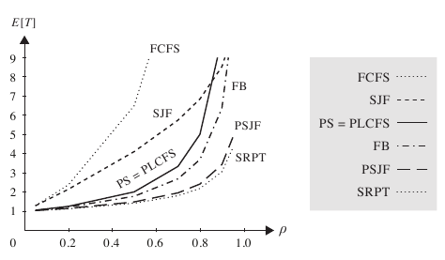
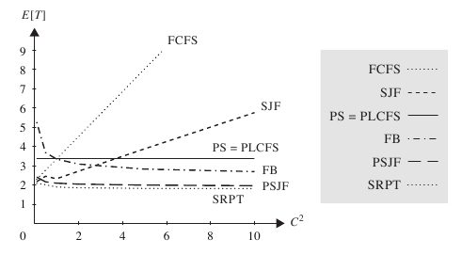
Comparing Scheduling Policies
SRPT offers the best overall response time across all scheduling policies
SRPT is mostly insensitive to job size variability
SRPT is also best for all jobs when ρ < ½ for any job size distribution (and for much higher ρ values for many distributions)

