Slide 1
System Provisioning

Slide 2
Provisioning a Multi-Server System
Consider and M/M/k system with a load R =λ/μ
How big should k be to ensure a queueing probability less than α?
Square-root staffing rule states
k_{α} ≈ R + c ⋅ R^{½}
where c is the solution of the equation αcΦ(c) = (1-α)φ(c), with Φ(c) the c.d.f. of the standard Normal distribution and φ(c) its p.d.f.
Derivation relies on relationship between blocking in an M/M/k/k system and queueing in the corresponding M/M/k system, and the fact that the Normal distribution is a good approximation for the Poisson distribution when the mean of the Poisson distribution is large

Slide 3
Blocking in Overflow Systems M/M/m/m
1
Consider a system with m1 primary servers and m2 secondary servers
Arrivals are Poisson with rate λ, and service times are exponentially distributed with parameter μ (a= λ/ μ)
The secondary servers are used only when the primary servers are all full
If all servers are full, job is blocked
Arrivals to secondary system are NOT POISSON
What is the blocking probability of the jobs sent to the secondary servers?
λ
2
primary
λ * P_{full}
m₁
1
2
secondary
m₂

Slide 4
Blocking in Overflow Systems
1
Blocking in overall system is B(a,m₁+m₂)
Blocked traffic intensity is
aB(a,m₁+m₂)
Overflow traffic intensity is
a’ = aB(a,m₁)
Blocking of overflow traffic is B_{o}=[aB(a,m₁+m₂)]/aB(a,m₁)
= B(a,m₁+m₂))/B(a,m₁)
Can show that B_{o}>B(a’,m₂)
a
2
primary
m₁
aB(a,m₁)
1
2
secondary
m₂

Slide 5
Example
Total traffic a =50
Primary system: m₁ = 50 servers
Secondary system: m₂ = 5 servers
Overflow traffic: a’ = 50 * B(50,50) = 5.24
Overall blocked traffic: b = 50 * B(50,55) = 2.69
Blocking of overflow traffic: B_{o} = 0.513
Blocking if Poisson: B_{P} = B(5.24,5) = 0.304 < 0.513

Slide 6
Approximating Blocking in Non-Poisson Systems (including Overflow)
Two main approaches
Hayward approximation
Wilkinson Equivalent Random Theory (ERT) Method
Both rely on the notion of traffic “peakedness”
Consider offering traffic to an infinite server system
The peakedness, z, is the ratio of the variance of the number of servers occupied by the traffic to the mean number of servers occupied by the traffic: z = Var[N]/E[N]
For Poisson traffic, z = 1 (the distribution of the number of busy server in an M/M/∞ queue is Poisson)
For overflow traffic of system of m₁ servers offered a units of traffic z = 1-a’+a/(m₁+1- a+a’), where a’=B(a,m₁)

Slide 7
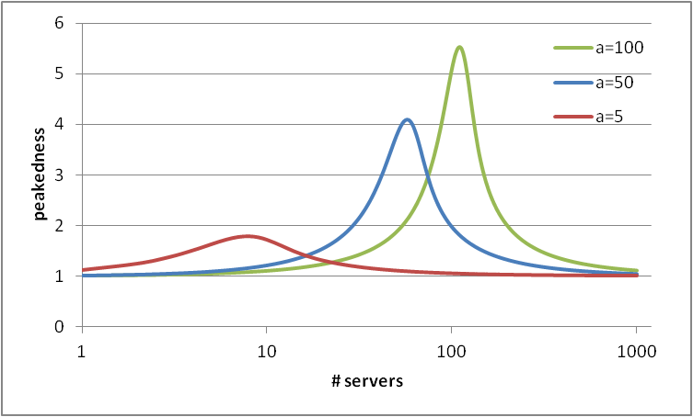
Peakedness

Slide 8
Hayward’s Approximation
Let c be capacity (# servers) for a single job
R = N⋅c is total capacity used by N jobs
Poisson: E[N] = a and Var[N] = a
E[R] = E[c⋅N] = c ⋅ a; Var[R] = Var[c ⋅ N] = c² ⋅ a
Non-Poisson: E[N] = a and Var[N] = v
E[R] = c ⋅ a; Var[R] = c² ⋅ v
Replace non-Poisson traffic by an “equivalent” Poisson traffic (a',c‘)
E[R] = E[R'] ⇒ a' ⋅ c' = a ⋅ c
Var[R] = Var[R'] ⇒ a' ⋅ c'²= v ⋅ c²
This yields
a' = a²/v (equivalent intensity)
c' = c ⋅ v/a (equivalent per job capacity)
Note: a' c' = ac (same traffic intensity)
Non-Poisson system with m servers and traffic intensity a is modeled as an equivalent system with
m' = (m ⋅ c)/c' = m ⋅ a/v servers
a' = a²/v (input traffic)
Blocking probability approximation
B_{NP}(a,m) = B(a',m’) = B(a²/v,m ⋅ a/v)
⇒ B_{NP}(a,m) = B(a/z,m/z)
where z = v/a, the overflow traffic peakedness
As peakedness increases, the system size decreases while keeping the load constant, and blocking increases

Slide 9
ERT Method
Similar premises as Hayward’s approximation
Non-Poisson traffic of intensity a and peakedness z = v/a
Model non-Poisson traffic (a,v) as overflow from Poisson traffic of intensity a* offered to m* servers
a = a* ⋅ B(a*,m*)
v = a[1-a+a*/(m*+1-a*+a)]
Solving for a* and m* is numerical in nature
Possible approximation (inaccurate if a is small and z is large)
a* = v + 3z(z-1)
m* = [a*(a+z)]/[a+z-1] – a - 1
1
a*
2
m*
a, v
Estimate of blocking for non-Poisson traffic offered to m servers
B_{NP} = B(a*,m+m*)/B(a*,m*)

