Slide 1
Serve Assignment Policies

Slide 2
Task Assignment Problem – (1)
Task assignment: Incoming jobs need to be assigned to one of many (independent) servers, each one with its own queue
Comparison to single queue feeding multiple servers
Task assignment policy ≠ scheduling policy, which deals with the order in which a given server selects jobs for service from its own queue
Scheduling policy
M/G/k
General
General
Poisson(λ)
Task assignment policy
Scheduling policy
Poisson(λ)
vs?
General
General
Scheduling policy
General
General

Slide 3
Task Assignment Problem – (2)
Goal is typically to minimize the system response time
Best assignment policy is typically dependent on the servers’ scheduling policy, e.g., FCFS or PS
Two main settings
Optimize task assignment given a server scheduling policy
Jointly optimize task assignment and scheduling policies
Task assignment is most relevant when jobs have highly variable service time distributions

Slide 4
Task Assignment to FCFS Servers
Given
k FCFS servers
Poisson arrivals of rate λ
General service time distribution G with mean 1/μ
How do we assign jobs to servers to minimize response time?
Main parameters
Jobs sizes are known or unknown (distribution is known)
Policy is static or dynamic (based on current server states)

Slide 5
Task Assignment Policies (FCFS Servers)
Policies given unknown job sizes
Random (static): Job is sent to server i with probability 1/k (k independent M/G/1 queues with Poisson arrivals of rate λ/k)
Round-robin (static): Job j is sent to server i, job j+1 is sent to server (i+1) mod k (k independent E_{k}/G/1 queues with rate λ/k – more regular than Poisson) – equalizes expected number of jobs in each queue
Join-the-Shortest-Queue – JSQ (dynamic): Job is sent to server with smallest number of jobs in the queue (equalizes instantaneous number of jobs at each queue)
M/G/k: As JSQ, it is dynamic, but has the added advantage of deferring decisions to the last moment
Policies when job sizes are known
Least-Work-Left – LWL (dynamic): Assign job to server with the smallest amount of unfinished work (can be shown equivalent to M/G/k) – equalizes total work at each server
Size-Interval-Task-Assignment – SITA (static): Jobs of size in a given interval are all sent to the same server (reduces service time variability at individual servers)
Finding the best thresholds is hard, and often favors highly unbalanced load (bounded-Pareto with α<1 calls for a light load for the “small jobs” server, while bounded-Pareto with α>1 instead favors keeping the “large jobs” server lightly loaded)
Typically superior to other policies, including LWL, but not always (keeping servers busy, as LWL does, can yield better outcomes)

Slide 6
SITA vs. LWL
SITA typically outperforms LWL, some times by an order of magnitude when the squared coefficient of variation C² of the service time is sufficiently large
But the outcome can reverse when C² becomes extremely large (C² → ∞)
Assume a 2-server system, under any cutoff value for SITA, the first server sees a finite variance, but the second still sees infinite variance. Hence, the overall mean response time is still infinite
Under LWL and assuming that the load is light, the odds of getting two big jobs sufficiently close to each other to affect performance is very low. Hence, one server remains available to serve short jobs, which keep the variance bounded

Slide 7
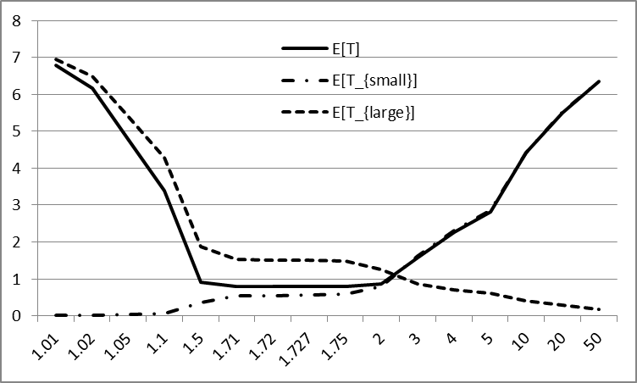
Exploring SITA (Problem 24.1)
Two-server system with Poisson arrivals of rate λ, and service times with Pareto distribution with parameter α = 2.5
SITA threshold of x (jobs with size < x go to server 1, and remaining jobs got to server 2
Initially, as x increases, more jobs are assigned to server 1(increases its load while decreasing load and service variability at server 2)
Consider scenario with
λ = 0.5, i.e., ρ ≈ 0.417
Optimal x ≈ 1.727
ρ_{(S<1.727)} ≈ 0.466
ρ_{(S≥1.727)} ≈ 0.36
t
x

Slide 8
Task Assignment to PS Servers
All policies used for FCFS are still available, but the outcome is often different
Random and SITA perform similarly, when SITA balances load (best option)
SITA’s main advantage (reducing service time variability) disappears under PS
JSQ will typically (highly variable services) outperform LWL
JSQ is greedy and assigns jobs to server that is likely to yield the lowest response time
It turns out to be close to “optimal” (within a few percent of a policy that assigns jobs to servers based on minimizing the response time of all jobs currently in the system, assuming that are no more arrivals)

