Slide 1
Device Memory Interaction
Marion Sudvarg, Chris Gill, David Ferry, Brian Kocoloski
CSE 522S – Advanced Operating Systems
Washington University in St. Louis
St. Louis, MO 63130

Slide 2
Review: Device I/O
Device I/O registers are accessed as memory addresses
(On x86, some I/O registers use a separate address space and different CPU instruction, but conceptually similar to memory)
These addresses are mapped into the kernel virtual address space using ioremap

Slide 3
Today: Device Memory Interaction
More detailed discussion of how devices interact with memory, covering:
The kernel address space in more depth
Devices with onboard memory (e.g. graphics cards)
Direct Memory Access (DMA) by devices to main memory

Slide 4
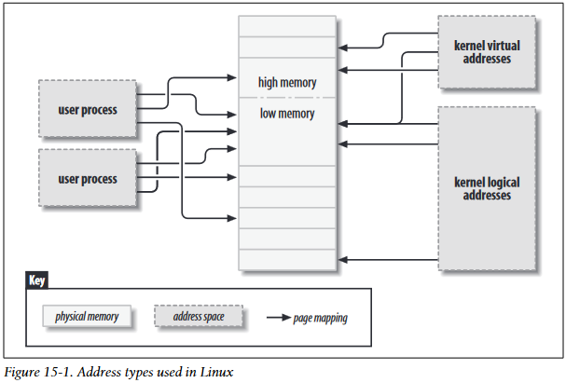
Address Types
Physical Addresses
The addresses used by the CPU to access physical memory (RAM and IO registers)
User Virtual Addresses
Give userspace processes the illusion of full access to complete, contiguous system memory
Kernel Virtual Addresses
Allow a similar mapping of virtual to physical in the kernel
Provides a way to split
Bus Addresses
The addresses used between peripheral buses and memory
The physical address used by the CPU to access a device might be converted to a bus address by the host bridge
Source: Linux Device Drivers (3rd Edition)

Slide 5
High and Low Memory
32-bit architectures limited to 4GB of virtual memory
Splits memory between kernel space and user space, allowing kernel and user space to share an address space
The kernel maps 1GB of contiguous memory into its virtual address space
The corresponding virtual addresses are called “kernel logical addresses”
The corresponding physical addresses are called “low memory”
Memory outside of this range (reserved for userspace) is called “high memory”
32-bit address extensions, and 64-bit address spaces, have largely made this split obsolete on x86
Nonetheless, the kernel still maps contiguous “logical addresses” at boot

Slide 6
Recall: Virtual Memory Areas
Pages are mapped to virtual memory
Virtual addresses require translation
A VMA is the kernel data structure that manages a region of a process’s address space
Virtual Address Translation:
Process A
Process B
Virtual Address
Page #
Offset
4KB
4KB
4KB
4KB
4KB
4KB
Physical Page
Phys.
Addr

Slide 7
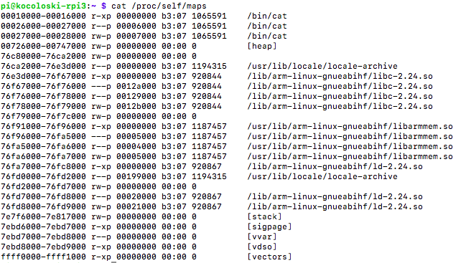
Memory Maps
Recall that a process address space has several memory maps
Each map is backed by a VMA in the kernel

Slide 8
Memory Mapped Devices
Recall that device registers can often be addressed as physical memory
This physical memory may be mapped as kernel virtual addresses
What about a device that has its own memory?
The memory can be mapped as pages in the kernel address space!

Slide 9
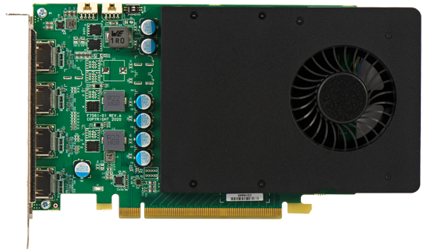
Example: Graphics
A graphics card has a frame buffer
Memory region defining the current display output
This is accessed over the bus as a physical address region
The graphics driver maps this into the kernel address space
Can be provided directly to userspace (e.g. X Window server)
Frame
Buffer
Control Registers
PCIe Bus Address
PCIe Bus
CPU

Slide 10
Object-Oriented VMA Operations
VMA is backed by a vm_area_struct
This backs a memory-mapped region
Contains a pointer to a vm_operations_struct
Recall the object-oriented operations provided by VFS!
For example, the file object has a file_operations table that allows different filesystems to define behavior for corresponding syscalls (open, read, write, etc.)
Similarly, a VMA allows a driver to define what happens when it is opened, closed, and when a page not in memory is accessed
This is especially useful for when a process with a VMA forks (the VMA is copied) or exits (the VMA is destroyed)
Think of open as a constructor (and copy constructor) and close as a destructor

Slide 11
Direct I/O
Recall: block I/O can be very slow!
The page cache allows I/O requests to be served from RAM
On cache miss or writeback, I/O scheduling performs:
Request merging
Request sorting
Read-vs-write priority
Alternatively, a driver can provide direct I/O access to userspace via mapped VMAs!

Slide 12
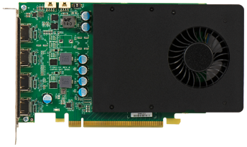
Direct Memory Access
CPU
RAM
Northbridge
DMA allows devices to access main memory directly, bypassing the CPU
Southbridge
DMA

Slide 13
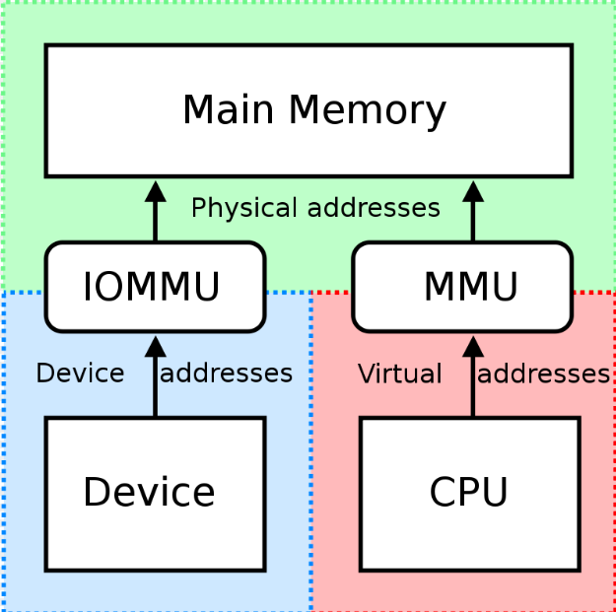
IOMMU
Connects DMA-capable I/O bus to main memory
Translates device-visible virtual addresses to physical addresses
Provides memory protection from faulty/malicious devices
Source: https://en.wikipedia.org/wiki/Input-output_memory_management_unit

Slide 14
Synchronous DMA
Process
Driver provides a read() function for the device in the VFS operations table
Process makes a read() syscall (blocking)
Driver function allocates a DMA buffer
Maps buffer into process
Driver provides hardware with buffer address
Hardware writes data to buffer
Hardware raises interrupt
Interrupt handler runs and awakens the process
Userspace
syscall(__NR_read)
Kernel
DMA buffer
Syscall Handler
Driver read()
Driver int. handler
Device
dostuff(&buffer)

Slide 15
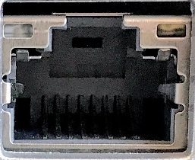
Asynchronous DMA
Some hardware should always push data
e.g. network cards
A listening socket should continue to get data even while the server process is not blocked on read()
Process
Device has data ready
Device raises interrupt
Driver interrupt handler allocates buffer (or increments ring buffer pointer)
Int. handler tells hardware where to transfer data
Hardware writes data
If processes are blocked on read(), driver will wake them as necessary
Userspace
Driver int. handler
DMA buffer
Kernel
Device
dostuff(&buffer)
recvd packet

Slide 16
DMA Buffer Allocation
Can use kmalloc or get_free_pages
What if these fail?
Kernel module cannot preallocate memory at boot time!
Use kernel boot argument:
Say you have 1024MB of RAM and want to reserve 64MB for DMA buffers
Use mem=960M kernel boot argument
To allocate buffers, ioremap the memory past 960M
What if you want less than a page of memory?
Use a DMA pool!
Similar in concept to malloc() allocating from heap (instead of using mmap() for larger allocations)

Slide 17
Bus Addresses
Bus addresses are tricky!
CPU addresses memory according to front-side bus addressing
Devices address memory according to their bus connection – may use a different address
May also be complicated by presence of IOMMU
Kernel provides virt_to_bus and bus_to_virt macro functions to portably convert physical/logical addresses to bus addresses
These are wrapper façades provided by highly platform-specific headers

Slide 18
Other Considerations
Remember to use compiler and hardware memory barriers!
Ensure cache coherency is properly managed (kernel provides wrapper functions)
Some architectures support “scatter/gather” DMA buffers
If you’re interested in more depth, read all of LDD chapter 15!

Slide 19
Today’s Reading
Review LKD pages 231-245
Selections from LDD Chapter 15, “Memory Mapping and DMA”:
Pages 412-424: Stop before “Using remap_pfn_range”
Pages 440-448: Begin at “Direct Memory Access,” stop before “Setting up streaming DMA mappings”

