Slide 1
Device I/O
Marion Sudvarg, Chris Gill, Brian Kocoloski, James Orr
CSE 522S – Advanced Operating Systems
Washington University in St. Louis
St. Louis, MO 63130

Slide 2
So Far …
We’ve discussed device interrupts
Interrupt controller multiplexes IRQ signals
Sends IRQ with line # to CPU
We’ve explored block I/O performance and control
Block devices (e.g. hard drives) are slow compared to memory/CPU
The kernel schedules reads from/writes to block devices to optimize performance (merging and sorting)
I/O cgroups constrain the reads/writes

Slide 3
Today: Device I/O
More detailed discussion of how the kernel enables I/O between CPU and devices
Device drivers provide I/O mechanisms
I/O is highly platform-dependent
Kernel provides macros that wrap architecture-specific functionality
Prerequisite to understanding I/O virtualization

Slide 4
Device Drivers
Often implemented as kernel modules
Linux driver philosophy: provide mechanism (What capabilities are provided?), not policy (How are these capabilities used?)
Example: block device driver
Mechanisms (handled by driver):
Present the block device as a continuous array of data blocks
Provide mechanisms to read from or write to these blocks
Handle interrupts from the device
Interpret interrupts and status messages
Policy (not handled by driver):
Partitions and filesystems
Access control

Slide 5
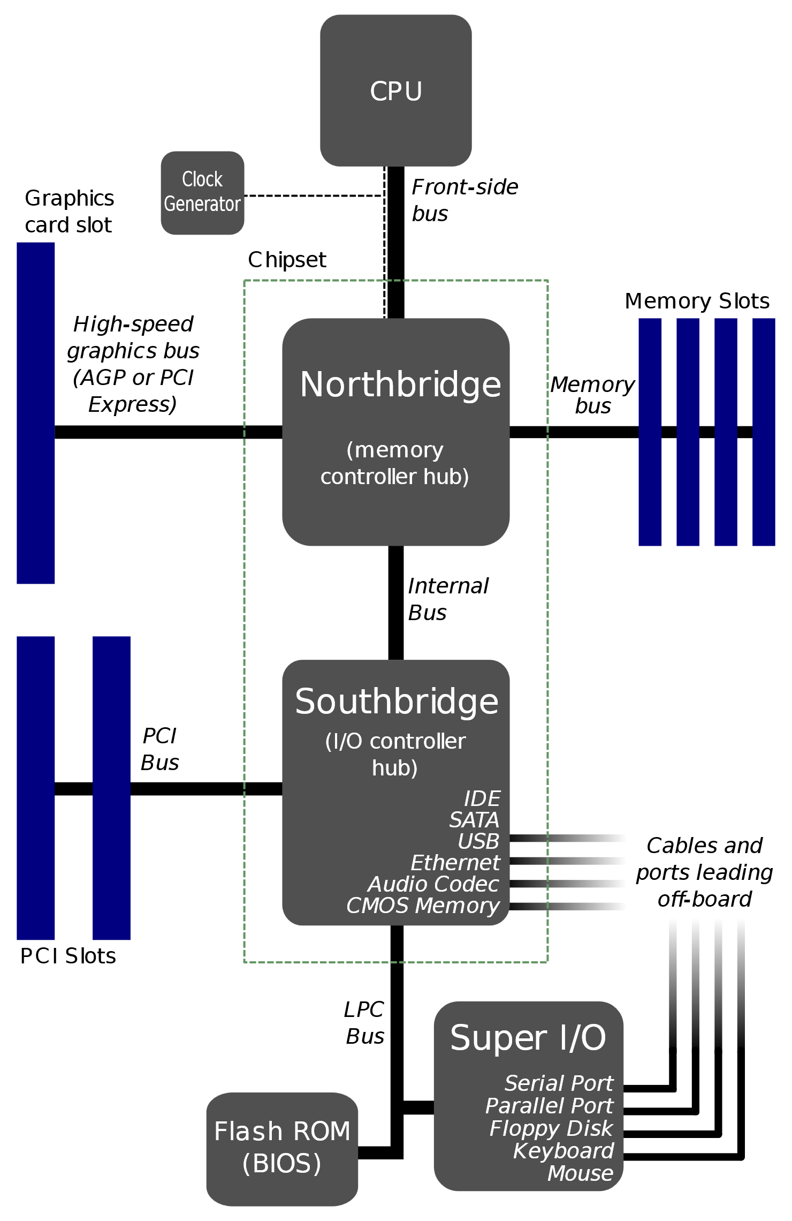
Device Access
The CPU accesses memory over the front-side bus through the Northbridge
Many I/O devices are connected through the Southbridge, which communicates to the CPU through the Northbridge
The southbridge provides multiplexing of interrupts and I/O communication to the CPU
Communication with a device typically requires the CPU to transfer data from memory to the device over the bus (and bridge)
Some devices (on Southbridge or Northbridge) can access memory directly, without the CPU.
This is called Direct Memory Access (DMA) – covered next time
(Note: many modern processors integrate Northbridge functionality directly into CPU)

Slide 6
Device I/O
Device I/O typically follows three patterns:
Communication with device registers or pins (I/O ports)
Access to device memory (e.g., memory on a graphics card, covered next time)
Device access to main memory (DMA, covered next time)
At the hardware level, device registers/pins are addressed similarly to device memory
Some architectures address these exactly as memory addresses
Other architectures (e.g., x86) use a different instruction to address I/O ports
No conceptual difference
Architecture-specific macros in the kernel provide a wrapper façade over the different instructions

Slide 7
Example: ISA Bus
CPU
Industry Standard Architecture (ISA)
A 16-bit device bus on classic x86 PCs
Now superseded by PCI, PCIe
Allowed CPU/device communication over northbridge/southbridge
Addressed directly by addresses 640KB to 1MB (0xA0000-0x100000)
0x200000
0x100000
RAM
Northbridge
Southbridge
ISA

Slide 8
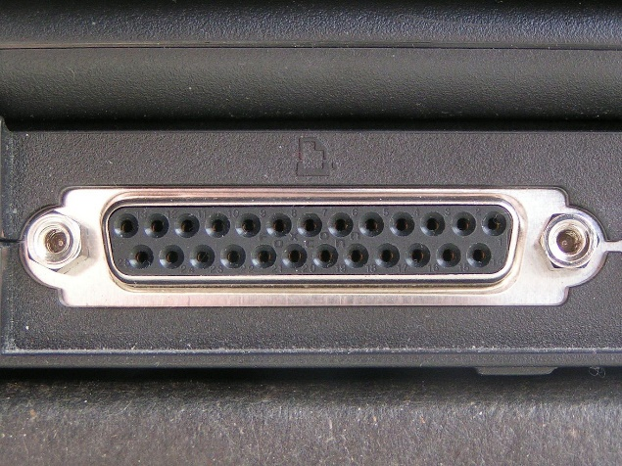
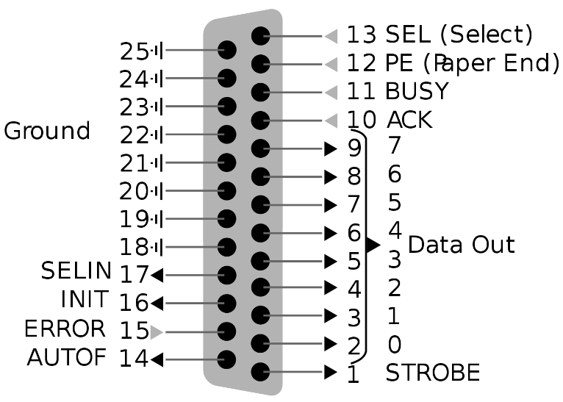
Example: Parallel Port
Used to be on almost every PC and laptop!
Most commonly used as a printer communication port
Largely replaced by USB (and networked/Wi-Fi printers)
Pins mapped to 3 8-bit I/O registers:
R/W register for data transfer
RO register for status
WO control register
Source: https://en.m.wikipedia.org/wiki/Parallel_port

Slide 9
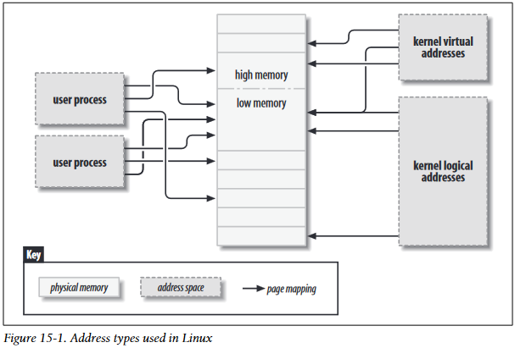
Review: Kernel Virtual Memory
Source: Linux Device Drivers (3rd Edition)
Kernel manages physical memory
Maintains its own page tables to enable a virtual address space
Logical addresses directly map main memory
Virtual addresses map main memory or device memory

Slide 10
Mapping Virtual Memory
Recall: vmalloc allocates a contiguous region of virtual memory in the kernel
Finds free physical pages of memory
Modifies kernel page tables so they are logically contiguous
For mapping I/O memory, use ioremap
void * ioremap(phys_addr, size)
Modifies page tables but does not allocate memory

Slide 11
Accessing I/O Memory
ioremap returns a pointer to virtual address of mapped I/O
Not portable to access memory directly via pointer!
Instead, use special ioread/iowrite functions:
unsigned int ioreadx(void * addr)
void iowritex(ux value, void * addr)
Note: replace x with register width (8, 16, 32, or 64 bits)
You can also read/write a sequence of values to/from a register:
ioreadx_rep(void * addr, void * buf, ulong count)
iowritex_rep(void * addr, void * buf, ulong count)

Slide 12
Claiming I/O Registers
I/O memory regions must be allocated previous to use
This ensures that two drivers do not, e.g., handle the same device registers
request_mem_region atomically checks if a memory region has already been claimed, then claims it for the driver
release_mem_region releases the region (e.g., on driver unload)

Slide 13
Special Considerations
Hardware registers are not memory!
I/O operations have side effects
Make sure the compiler writes back to memory (instead of keeping variables in CPU registers)
Declare variables volatile
Be careful to ensure the compiler does not reorder instructions
Use compiler and hardware memory barriers (functions listed on pages 237-238 of LDD)

Slide 14
Today’s Reading
LDD Chapter 1, pages 1-4: A discussion of device drivers, and mechanism/policy split
LDD Chapter 8, pages 224-226: Review of vmalloc and an introduction to ioremap
LDD Chapter 9, pages 235-252: An overview of I/O communication
Compiled into a single PDF on course website

