Slide 1
3. The Domain Name Service
Overview and high level design
Typical operation and the role of caching
Contents of DNS Resource Records
Basic message formats
Configuring/updating Resource Records
Roch Guerin
(with adaptations from Jon Turner and John DeHart, and material from Kurose and Ross)

Slide 2
Domain Name Service
Motivation
The IP protocol requires numeric addresses, BUT names are more convenient and intuitive for people (and addresses may change)
So, we need a way to convert names to addresses
DNS provides this service
Access tools: nslookup, host, dig, etc.
Key features
distributed database of name servers
organized in a hierarchical fashion
top levels owned/operated by trusted service providers
lower levels owned/operated by individuals and organizations
name servers save the results of lookup operations to improve performance, reduce query traffic
hosts also cache results to avoid unnecessary queries
name servers are accessed using application level protocol

Slide 3
Domain Name Service
Examples
guerin> nslookup onl.wustl.edu
Server: 127.0.1.1
Address: 127.0.1.1#53
onl.wustl.edu canonical name = onl100.arl.wustl.edu
Name: onl100.arl.wustl.edu
Address: 128.252.153.111
guerin> nslookup nytimes.com
Server: 127.0.1.1
Address: 127.0.1.1#53
Non-authoritative answer:
Name: nytimes.com
Address: 151.101.129.164
Name: nytimes.com
Address: 151.101.193.164
Name: nytimes.com
Address: 151.101.65.164
Name: nytimes.com
Address: 151.101.1.164
Things to note:
Canonical name: Its an alias. We’ll see CNAME records later
Non-authoritative answer
Does not come from DNS server with authority for nytimes.com
Multiple addresses for nytimes.com
And which one is listed first changes each time…
Try looking up google.com repeatedly and see what you get…

Slide 4
Components of DNS
Name servers
the systems that respond to queries
Resource records (RRs)
form the database used to respond to queries
Hosts (clients)
Run software to interact with DNS servers and possibly store lookup results
Library software (resolvers) help client programs generate queries to DNS servers
DNS protocol
defines application-level messages used to request services and receive responses
Operates on well-known port 53 and relies primarily on UDP (TCP used for large responses and tasks such as zone transfers)
Registrars (e.g. GoDaddy.com)
control allocation of “top-level” domain names (e.g. wustl.edu)
inserting resource records in upper level name servers
List of registrars can be found here: http://www.internic.net/
ICANN – Internet Corporation for Assigned Numbers and Names – is responsible for managing the Internet Assigned Numbers Authority (IANA) functions, which include the administration of domain names, i.e., managing DNS

Slide 5
Hierarchical Organization
“top level domain”
servers
Root DNS Servers
organizational
servers
.com DNS servers
.org DNS servers
.edu DNS servers
yahoo.com
DNS servers
amazon.com
DNS servers
pbs.org
DNS servers
wustl.edu
DNS servers
umass.edu
DNS servers
local
servers
DNS servers organized in hierarchy of “zones”
each zone has one or more “authoritative servers”
Root zone servers and top level domain servers are authorized by ICANN
Organizational servers owned/operated by organizations
seas
artsci
hosts

Slide 6
Why Distribute DNS Like This?
Technical reasons
to distribute query processing load among many servers
allows DNS to scale as the number of internet users and internet-connected organizations grows
Management reasons
distributes ownership and cost
ICANN oversees DNS, but owns no DNS servers
individual organizations control and pay for their own servers
so, as organizations receive more web traffic, they add more DNS servers to handle the associated DNS query load
Why distribute hierarchically?
natural match for domain names and distributed ownership
Drawbacks of distribution?
operational inconsistencies, security vulnerabilities

Slide 7
Query Types
Two types of queries
Recursive query: The querying client requires that the DNS server responds with either the requested resource record or an error
The server will typically recurse until it can provide the answer or fails trying
Iterative query: The querying client allows the DNS server to respond with its “best” answer. Usually in the form of a referral to another server that can either provide the answer or a more accurate referral
A server handling a recursive query from a client will typically proceed with iterative queries to other servers
We’ll label queries r-query and i-query sometimes to distinguish between recursive and iterative.

Slide 8
Typical Name Resolution Process
target content server
local DNS server
root DNS server
.com DNS server
target DNS server
host
r-query(shop.target.com)
i-query(..)
reply (.com=1.2.3.4)
i-query(..)
reply (target.com=2.3.4.5)
i-query(..)
reply (shop.target.com =2.3.4.13)
reply (2.3.4.13)
http get
content

Slide 9
Caching of DNS Responses
DNS servers can be configured to cache responses, to reduce time for future queries
In previous example, local DNS server ends up with several mappings in its cache
.com => 1.2.3.4
target.com => 2.3.4.5
shop.target.com => 2.3.4.13
So, no query needed to find that web page again
and only one query to find a different page at target.com
only two queries to find another .com location
Speeds up subsequent searches (so, happier users) and reduces load on upper level DNS servers
Hosts also often cache DNS responses (Window & MAC)
Linux: can be provided by a separate daemon/utility.

Slide 10
Pure Recursive Resolution Process
target content server
local DNS server
root DNS server
.com DNS server
target DNS server
host
r-query
r-query
r-query
r-query
reply (2.3.4.13)
reply (2.3.4.13)
reply (2.3.4.13)
reply (2.3.4.13)
http get
content

Slide 11
Iterative vs. Recursive Queries
Typical query processing combines iterative and recursive processing methods
source DNS client (or DNS forwarder) usually makes a recursive query
Home DNS server typically issues iterative queries
why not use same method for both?
By sending out iterative queries, a server gets to see and cache all intermediate DNS responses
future requests can be resolved more efficiently
works well for local DNS servers
homogeneous user base means high cache efficiency
typically lightly loaded so they can search through cache first and handle multiple iterative queries
performance benefit for local users (and other DNS servers)
backbone servers are busier and prefer to delegate completion of individual queries to local servers

Slide 12
DNS Records
Servers store name resolution information in the form of resource records (RR)
(Name, Value, Type, TTL)
if Type=A, then Name is a hostname and Value is the IP address for that host
if Type=NS, then Name is a domain name (like foo.com) and Value is the host name of an authoritative DNS server for that domain
if Type=CNAME, then Name is an alias for a host (that is, an alternate name) and Value is its “canonical name”
if Type=MX, the Name is a domain name and the Value is the name of the mail server for that domain.
TTL: how long the record can be cached
Resource records are also returned in query results
often includes multiple RRs
“public names” are often aliases – may have several web servers reached through common alias
Notes:
Just a sampling of types…

Slide 13
DNS Message Format
16 bits | 16 bits
identification | flags
#of queries | # of answer RRs
# of authority RRs | # of additional RRs
queries
answer RRs
authority RRs
additional RRs
Most DNS messages use UDP
Request/response protocol
Id field is echoed in response
so source can match reply to request
Flags include:
query/reply flag, authoritative flag, recursive desired, recursive available
Queries messages contains zero or more queries – (Name, Type)
Answers field contains responses to queries
Authority field has records of other authoritative servers
Additional field has information such as the A record that goes with an MX record in the Answer field

Slide 14
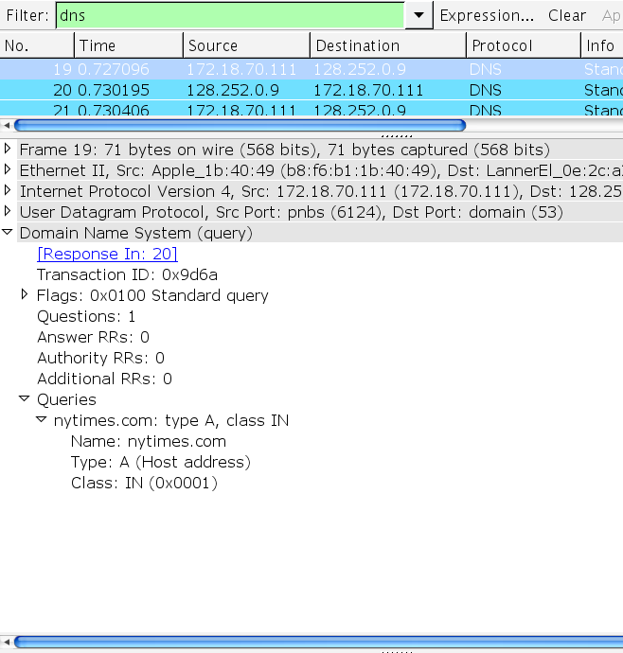
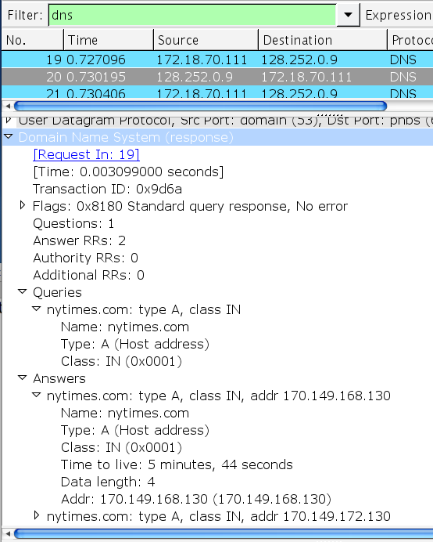
Notes:
Class IN: Internet

Slide 15
Inserting Records into DNS
First step is to register (for a fee) a domain name with a DNS registrar
If desired name is not already in use, it will be assigned to you
You setup DNS servers for your domain:
they must run DNS server software, such as bind
they must be configured with RRs for hosts within the domain
You give names and IP address of DNS servers to Registrar
NS and A records are inserted into TLD (e.g., .com) servers by registrar
“Classic” way to configure DNS records
system administrator logs into DNS server machine and adds records directly
Dynamic DNS allows records to be updated remotely via control messages – facilitates automated updates

Slide 16
Content Distribution Networks and DNS
CDNs are distributed systems used to distribute popular web content
used by major web sites to reduce load on “origin servers”
essentially, a set of web caches operated by CDN provider
CDNs use DNS re-direction to respond to web queries using servers close to user
links on origin web-site contain domain name of CDN provider plus information about requested content
formatted to look like a domain name to the DNS system, so gets included in DNS query to one of the CDN’s DNS server
CDN’s DNS servers use information in query together with user’s IP address to identify content server close to user
may also choose server based on requested content
may also do load balancing across multiple candidate servers

Slide 17
Exercises
Slide 10 shows a query being resolved using recursive processing at all servers. Assuming that each server caches the response it gets, what mappings are present in the .com server’s DNS cache after the query is processed? What mappings are present in the root server’s cache? What mappings are present in the local DNS server’s cache?
How did internet users lookup IP addresses before DNS was available?

Slide 18
Exercises
Slide 10 shows a query being resolved using recursive processing at all servers. Assuming that each server caches the response it gets, what mappings are present in the .com server’s DNS cache after the query is processed? What mappings are present in the root server’s cache? What mappings are present in the local DNS server’s cache?
The cache of all servers contains the same information, namely, the address of the target server 2.3.4.13
How did internet users lookup IP addresses before DNS was available?
They would look in the HOSTS.TXT which was maintained and distributed by NIC (Network Information Center). [RFC 1034 section 2.1]

Slide 19
Exercises
Use the ifconfig command (or on windows ipconfig) to determine the IP address of your laptop. Use the hostname command to determine the domain name of your laptop. Use nslookup to get the IP address associated with your domain name.

Slide 20
Exercises
Use the ifconfig command (or on windows ipconfig) to determine the IP address of your laptop. Use the hostname command to determine the domain name of your laptop. Use nslookup to get the IP address associated with your domain name.
[guerin@imbrium CSE473]$ ifconfig
eth0 Link encap:Ethernet HWaddr 00:50:56:B6:00:17
inet addr:128.252.202.128 Bcast:128.252.202.255 Mask:255.255.255.0
inet6 addr: fe80::250:56ff:feb6:17/64 Scope:Link
UP BROADCAST RUNNING MULTICAST MTU:1500 Metric:1
RX packets:688176811 errors:0 dropped:0 overruns:0 frame:0
TX packets:529823542 errors:0 dropped:0 overruns:0 carrier:0
collisions:0 txqueuelen:1000
RX bytes:1198233486451 (1.0 TiB) TX bytes:706035643716 (657.5 GiB)
[guerin@imbrium CSE473]$ hostname
imbrium.seas.wustl.edu
guerin@guerin-Inspiron-530:~$ nslookup wustl.edu
Server: 127.0.1.1
Address: 127.0.1.1#53
Name: wustl.edu
Address: 128.252.114.30

Slide 21
Exercises
Suppose a host sends a DNS query to a remote server with an id number of 73 and receives no reply. When it sends the packet a second time, what id number should it use?
RFC 1034 defines the domain space in terms of a tree consisting of labeled nodes. Can two nodes in the tree have the same label? Can any two nodes have the same label? Is there any limit on the length of a label? If so, what is it? How are labels represented within the DNS protocol?

Slide 22
Exercises
Suppose a host sends a DNS query to a remote server with an id number of 73 and receives no reply. When it sends the packet a second time, what id number should it use?
RFC 1035 states that a resolver should be able to use a response from any of its transmissions in case it retransmits a particular query. So in most cases, this would call for reusing ID number 73, though other alternatives may be possible.
RFC 1034 defines the domain space in terms of a tree consisting of labeled nodes. Can two nodes in the tree have the same label? Can any two nodes have the same label? Is there any limit on the length of a label? If so, what is it? How are labels represented within the DNS protocol?
As long as two nodes are not brothers (share the same parent), they can have the same label. Labels are limited in length to 63 bytes. Labels are represented using a one byte length field followed by at most 63 bytes (the first bit of the length field must be 0). They must start and end with letters and contain only letters, digits, and hyphen. They are delimited by “.” signs. [RFC 1034 Section 3.1]

Slide 23
Exercises
Identify scenarios when name resolution does not require using DNS

Slide 24
Exercises
Identify scenarios when name resolution does not require using DNS
One possible scenario is if the OS caches DNS replies and happens to already know the address of the target hostname
Another scenario is if the hostname is listed in the hosts.txt or /etc hosts local file
guerin@guerin-Inspiron-530:~/SVN_ROCH$ more /etc/hosts
127.0.0.1 localhost
127.0.1.1 guerin-Inspiron-530
# The following lines are desirable for IPv6 capable hosts
::1 ip6-localhost ip6-loopback
fe00::0 ip6-localnet
ff00::0 ip6-mcastprefix
ff02::1 ip6-allnodes
ff02::2 ip6-allrouters

