Slide 1
6. The Open Network Lab
Overview and getting started
Building a network topology
Configuring routes and filters
Monitoring traffic
John DeHart, Jyoti Parwatikar and Jon Turner

Slide 2
The Open Network Lab
Internet-accessible networking lab (onl.wustl.edu)
built around set of extensible gigabit routers
intuitive Remote Lab Interface (RLI): easy to get started
extensive facilities for performance monitoring
Variety of resources
16 five port Network Processor based Routers (NPR)
highly configurable
each has five processor cores reserved for plugins
20 SoftWare Routers
12 five port (1Gb/s per port) SWR
8 two port (10Gb/s per port ) SWRs
Configurable as 8 port (2.5 Gb/s ports) or 16 port (1 Gb/s ports)
over 100 rack-mount servers that act as end systems
including multicore servers with 8 cores and 48 cores
VMs hosted on 20 12-core rack-mount servers

Slide 3
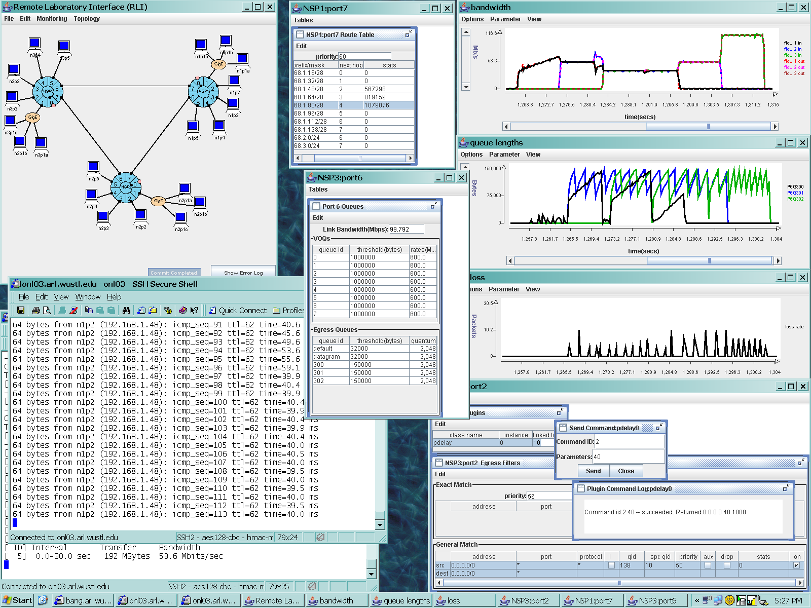
Sample ONL Session
Bandwidth Usage
Routing Table
Queue Lengths
Network Configuration
ssh window to host showing ping delays
Packet Losses
Queue Parameters
Router Plugin Commands

Slide 4
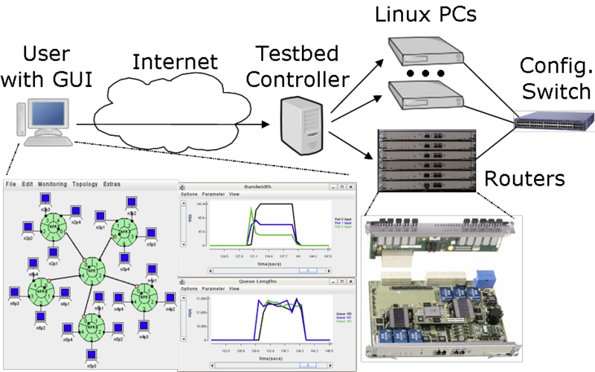
Overview of ONL
Remote access through the Internet using a graphical user interface called the RLI.
Provides access to variety of hardware resources
Experimental networks built with configuration switches

Slide 5
Getting Started
Request an account at onl.wustl.edu
read Getting Started page and look at tutorial pages
Download the RLI (version 8.4 is the latest as of 9/2015)
to run RLI you must have Java Runtime Environment installed (version 1.6 or higher)
RLI was just updated today (still version 8.4) for fix a small bug that showed up with our Lab2 configuration.
So, download a new version before doing Lab2.
Create experimental network and save to a file
details in a couple of slides

Slide 6
Getting Started (continued)
Open an SSH connection to ONL with a tunnel for RLI
on command line:
ssh –L 7070:onlsrv:7070 <username>@onl.wustl.edu
Make a reservation using RLI and wait for confirmation
note the start time in the confirmation message
After start time, select File➔Commit in RLI
open ssh connections to your ONL hosts and run applications
Unused reservations time out after 30 minutes

Slide 7
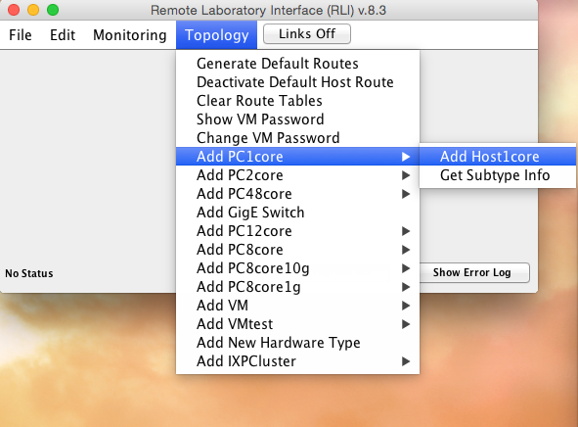
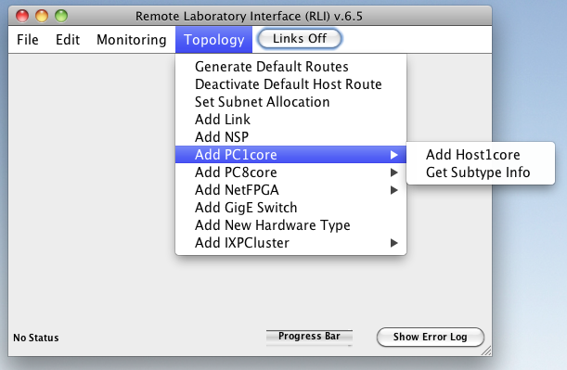
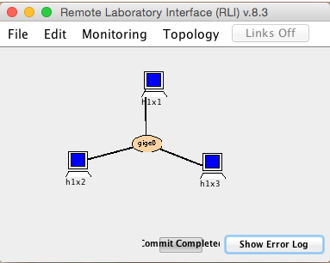
Building a Basic Configuration
Select
Topology➔Add PC1core ➔AddHost1core
and specify 3 hosts
Select
Topology➔Add GigE Switch
and specify single 1 Gb switch
Arrange hosts and switch
Select
Press “Links Off” button
Toggles it to “Links On”
and wire hosts to switch
When done, toggle to “Links Off”
Select
File➔Save As ...
File➔Make Reservation
File➔Commit (do not forget!!)

Slide 8
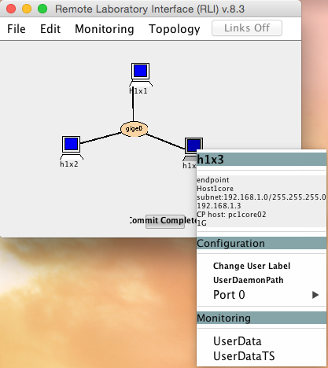
Running Applications
Open ssh connections to hosts
first ssh to onl.wustl.edu
then run:
> source ~/.topology
> ssh $h1x1
Run standard apps
on h1x1, type “ping h1x3”
on h1x2, type “iperf –s”, then on h1x1, type “iperf –c h1x2”
Run basic client/server programs
on h1x2, run java UdpEchoServer
on h1x1, run java UdpEchoClient h1x2 9876 “hello world”

Slide 9
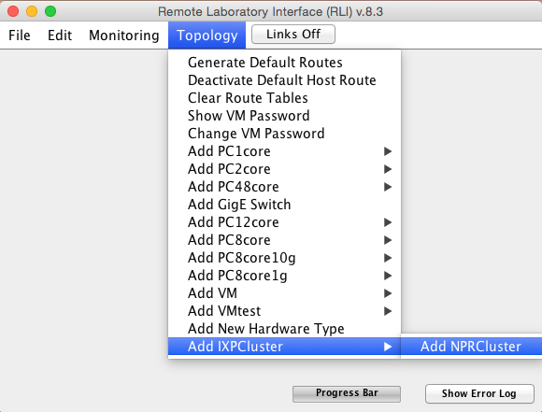
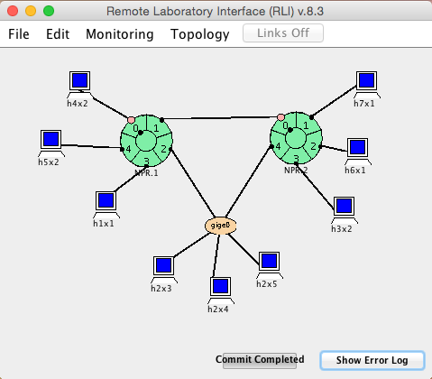
Working with Larger Configurations
Note multiple paths between routers
To include pair of NPRs (routers), select Topology ➔Add IXPCluster ➔Add NPRCluster
Note subnet numbering

Slide 10
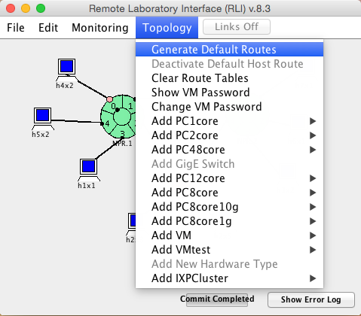
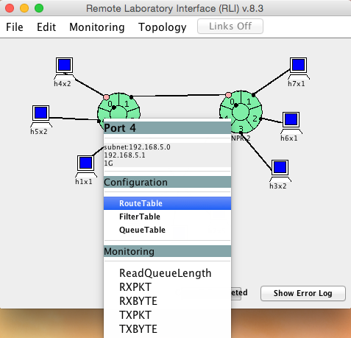
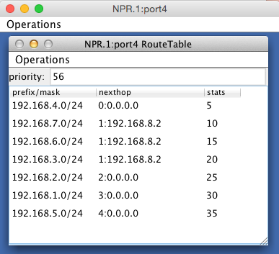
Working With Routing Tables
Change routes using Operations➔Edit
Generate default routes to configure routing tables
Click on port to access specific table
Next hop specifies output port and next hop’s IP address

Slide 11
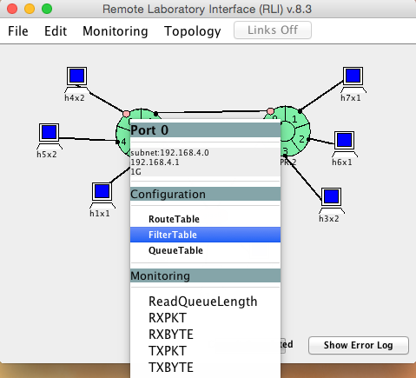
Configuring Packet Filters
Select Filter Table
address prefixes and ports
protocol and flags (TCP, UDP, … *=wildcard)
packet treatment
turn on/off

Slide 12
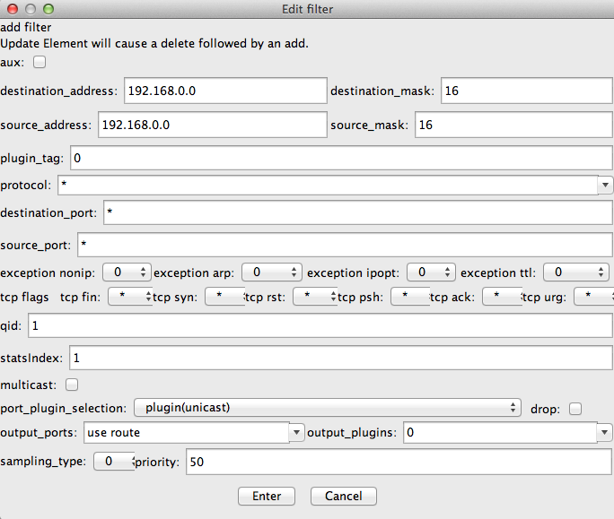
Configuring Packet Filters
address fields
protocol and ports
queue number
output link

Slide 13
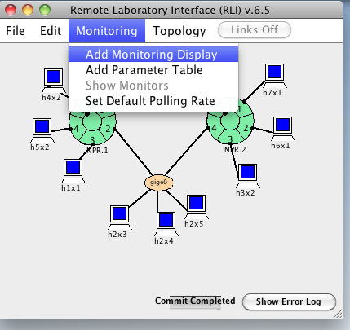
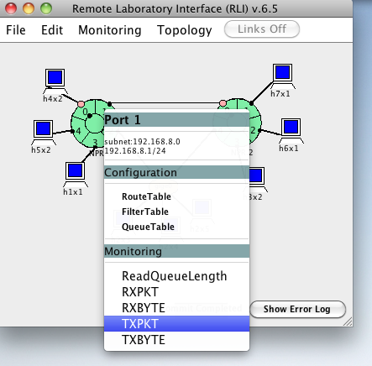
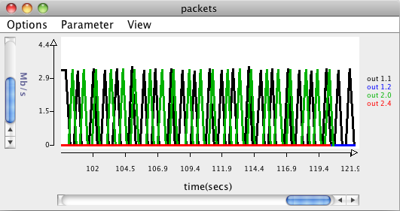
Monitoring Traffic
To add new real-time chart
STILL OLD
VERSION OF RLI
But very close to current
observing ping traffic from h4x2 to h6x1
select desired monitor variable
to select outgoing packet rate at a port

Slide 14
Hosts with Multiple Interfaces
ONL hosts have two interfaces
data interface used for experimental network
names of form hAxB. and addresses of form 192.168.A.B addresses,
control net interface used to talk to ONL servers
names of form pc1coreNN, addresses of form 10.0.x.y
File ~/.topology defines shell variables of form $hAxB that map to control net names
To force server connections to use a specific interface, bind socket to desired interface’s IP address
forces communication to server to come through specified iface
If socket left “unbound”, system uses wildcard interface
control net
10.0.x.y
192.168.1.3

Slide 15
Using the ONL Web Site
Testbed Status
My Reservations
Resource Availability
Etc.
Show examples…

Slide 16
Using the Linux Command Line
ONL hosts all run Linux
to use them effectively, need to be familiar with the command-line interface provided by the “shell” (specifically, bash)
Common commands
ls to list files in a directory (aka folder)
cd to change the current working directory
more to examine contents of a file
ssh to open an ssh connection to another computer
man to get documentation for a given command
type “man ls” to learn how to use the ls command
See http://www.ee.surrey.ac.uk/Teaching/Unix/index.html and http://www.gnu.org/software/bash/manual/bash.html
You need to invest some time up-front to learn Linux
but, you’ll be much more productive once you do

Slide 17
Using Wireshark in ONL
Wireshark is implemented using the X-windows system
ssh supports tunneling of X-windows commands, allowing you to run Wireshark in ONL with GUI running on laptop
On Urbauer lab computers
first type “startxwin” in a command prompt window
this starts new window; in this window, type
ssh –X userName@onl.wustl.edu source /users/onl/.topology ssh –X onlHostname (e.g. $h4x2) sudo wireshark
this starts Wireshark on remote machine, but your local computer acts as the display for remote instance of Wireshark
Can use this with other X-windows applications also

Slide 18
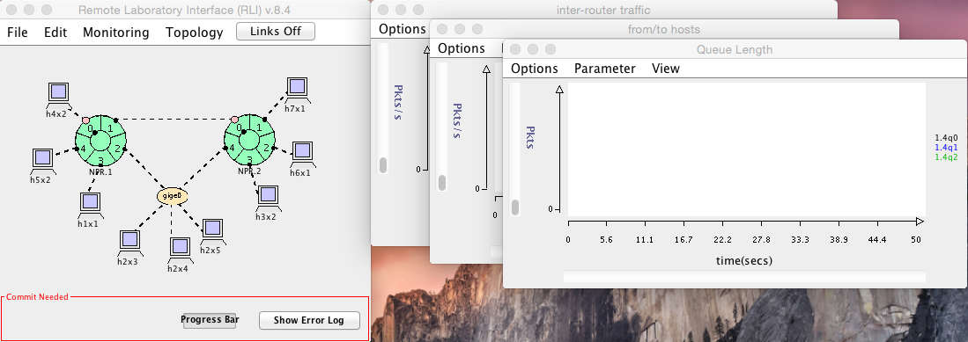
LAB2: What you will be given
For your assignments you’ll be given a topology file in your bitbucket repository:
lab2/cse473-lab2.onl

Slide 19
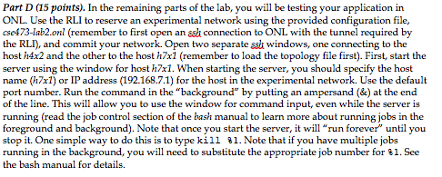
LAB2: What you will be given (continued)
You will also be given an assignment document:
lab2/lab2.pdf
And a lab report document:
lab2/lab2report.docx
Which has VERY specific directions. Follow them.

Slide 20
LAB2: What you will be given (continued)
More from lab report document:
What is a plugin?
The Network Processors used in the routers have 5 microengines allocated to hosting user specific code called plugins.
For Lab2 we are using a delay plugin we have written for simulating things like link delay. It is preconfigured in your topology.
And more from the lab report document:
Back to what we said earlier about packet filters…

Slide 21
Configuring Packet Filters
Select Filter Table
address prefixes and ports
protocol and flags (TCP, UDP, … *=wildcard)
packet treatment
turn on/off

Slide 22
LAB2: What you will be given (continued)
Show example …
Load Lab2
Reserve
Commit
Monitoring windows
Hover over labels and show different traces come to the foreground.
Etc.

