Slide 1
2. Introduction to Network Applications and the Web
Application architectures
Transport services
Browser and web server interaction
Cookies
Web caches and conditional GET
Roch Guerin
(with adaptations from Jon Turner and John DeHart, and material from Kurose and Ross)
Guerin

Slide 2
Application Architectures
Applications implemented by software on end-systems
no need to modify network components to enable new apps
Client-server
server expected to be “always-on”, has static IP address (usually)
clients may come and go and change address frequently
clients interact with other clients indirectly through servers (if at all)
Peer-to-peer (P2P)
all end systems play comparable roles
may come and go at any time
Hybrid of client-server and P2P
client-server for setup/control, p2p for direct interaction
examples: original Skype, some instant messaging

Slide 3
Communicating Processes
A process is a program running on a host
processes on same host communicate using OS-specific mechanisms
processes on different hosts communicate by exchanging messages across a network
Communicating pair of processes play distinct roles
server process waits for communication requests
client process initiates communication with waiting server
a process may act both as a client and a server (for example, in p2p applications)
Processes communicate thru sockets
standard API to network software
provides choice of transport service
allows configuration of selected parameters
Process
socket
OS network software

Slide 4
Addressing Processes
An IP address identifies a host, but not a process
IP protocol is only responsible for delivering data to the host
since host may have many communicating processes running simultaneously, we need some way to identify them
Internet transport protocols use port numbers to designate specific programs within a host
packets carry a source port# and a destination port#
operating systems map port numbers to sockets
so, packets sent through a socket are tagged with the source port# assigned to the socket
packets received with a given destination port# are delivered to the socket to which that port# was assigned
Some ports are reserved for specific applications
for example: port 80 is used by web servers, port 25 for email
allows remote client to easily connect to application

Slide 5
Exercises
What are port numbers used for?
to identify specific interfaces of a router
to identify a process running on a host
to identify physical interfaces on a host
to identify a socket belonging to an application program
What popular application uses port number 80?
email
bit torrent
web server
Skype

Slide 6
Exercises -- Solution
What are port numbers used for?
to identify specific interfaces of a router
to identify a process running on a host
to identify physical interfaces on a host
to identify a socket belonging to an application program
The answer is d)
What popular application uses port number 80?
email
bit torrent
web server
Skype
The web uses port 80 as its default port

Slide 7
Transport Services
Key transport level services
reliable data delivery
guaranteed data rate
bounded end-to-end delay
secure communication
Different applications have different needs
highly variable delay may be disruptive in a phone conversation, but not be a problem for viewing web pages
streaming HDTV requires a certain minimum data rate to ensure high quality video – and no use for much higher rates
large file transfers should be “as fast as possible”, but can live with whatever is available – elastic

Slide 8
Internet Transport Services
TCP Service
connection-oriented: setup required between client and server processes
stream-oriented: deals with byte transfers rather than packets
reliable transport between sending and receiving process
flow control: sender won’t overwhelm receiver
congestion control: throttle sender when network overloaded
does not provide: timing, minimum throughput guarantee, security
UDP Service
unreliable data transfer of individual packets between sending and receiving processes
does not provide: connection, reliability, flow control, congestion control, timing, throughput guarantee, security
No widely deployed transport service offers:
guaranteed data rate
bounded end-to-end delay
secure communication (handled at the application layer)

Slide 9
The Web and HTTP
HTTP is an application layer protocol used to transfer web pages between web servers and browsers
Typical page includes some text along with references to other pages and objects (images, applets, audio files,...)
Pages and objects are identified by URL (universal resource locator)
http://classes.engineering.wustl.edu/cse473/index.php/Main_Page
To display web page
browser requests page from server
parses page and finds URLs to referenced objects
requests objects
displays web page text and objects in browser window
identifies server
(through its name)
identifies file location

Slide 10
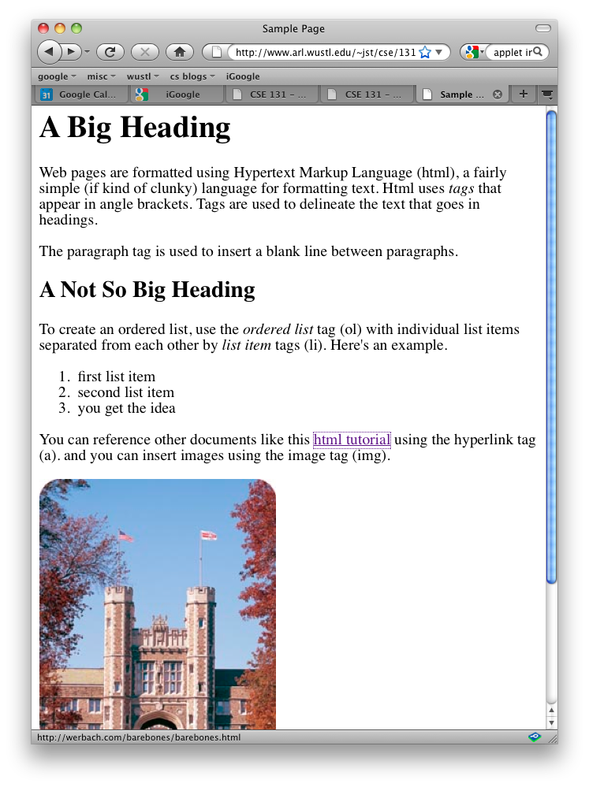
Simple Web Page Example
<html>
<head> <title>Sample Page</title> </head>
<h1>A Big Heading</h1>
Web pages are formatted using Hypertext Markup Language (html),... Html uses <i>tags</i> that appear in angle brackets. ...
<p>
The paragraph tag is used to insert a blank line between paragraphs.
<h2>A Not So Big Heading</h2>
To create an ordered list, use the <i>ordered list</i> tag (ol) with individual list items separated from each other by <i>list item</i> tags (li). Here's an example.
<ol>
<li> first list item
<li> second list item ...
</ol> You can reference other documents like this <a href=“http://werbach.com/barebones/barebones.html”>html tutorial</a> using the hyperlink tag (a). and you can insert images using the image tag (img). <p> <img src=“brookings.jpg”>
</body> </html>

Slide 11
HTTP Details
HTTP runs over TCP
web browser (client) initiates connection to server
browser and server exchange formatted text messages
Request/response protocol with no server-side state
basic requests: GET, HEAD, POST, PUT, DELETE
GET: request a page
HEAD: similar to GET but no object returned, just a header
POST: request a page based on filling out a form
PUT: upload an object to a server
DELETE: delete an object from a server

Slide 12
HTTP Details (continued)
GET Request
Page being request is /index.html
carriage return character
line-feed character
request line
GET /index.html HTTP/1.1\r\n
Host: www-net.cs.umass.edu\r\n
User-Agent: Firefox/3.6.10\r\n
Accept: text/html,application/xhtml+xml\r\n
Accept-Language: en-us,en;q=0.5\r\n
Accept-Encoding: gzip,deflate\r\n
Accept-Charset: ISO-8859-1,utf-8;q=0.7\r\n
Keep-Alive: 115\r\n
Connection: keep-alive\r\n
\r\n
header lines
blankline

Slide 13
HTTP Response Message
status code
status line
HTTP/1.1 200 OK\r\n
Date: Sun, 26 Sep 2010 20:09:20 GMT\r\n
Server: Apache/2.0.52 (CentOS)\r\n
Last-Modified: Tue, 30 Oct 2007 17:00:02 GMT\r\n
ETag: "17dc6-a5c-bf716880"\r\n
Accept-Ranges: bytes\r\n
Content-Length: 2652\r\n
Keep-Alive: timeout=10, max=100\r\n
Connection: Keep-Alive\r\n
Content-Type: text/html; charset=ISO-8859-1\r\n
\r\n
data data data data data ...
header lines
requested content
Sample status codes
200 OK
301 Moved Permanently
400 Bad Request
404 Not Found
505 HTTP Version Not Supported

Slide 14
Exercises
You may need to refer to RFC 2616 to answer some of these questions
Explain the difference between HTML and HTTP
Why does HTTP use TCP rather than UDP?
What is the difference between a URI and a URL (and a URN)?
What is the maximum length of a URI in an HTTP message?
List five HTTP “methods”. What does the TRACE method do?
What does the date in an HTTP response signify?

Slide 15
Exercises - Solution
You will need to refer to RFC 2616 to answer some of these questions
Explain the difference between HTML and HTTP
HTTP is an application-level protocol for distributed, collaborative, hypermedia information systems (From FRC 2616).
HTML (HyperText Markup Language is a markup language used to create web pages.
Why does HTTP use TCP rather than UDP?
Uses the reliability of TCP.

Slide 16
Exercises - Solution
What is the difference between a URI and a URL (and a URN)?
A Uniform Resource Identifier URI identifies a name of a resource on the Internet. It identifies the resource by name, location or both. It has two specializations, Uniform Resource Locator URL and Uniform Resource Name URN. A URL has two parts, a scheme, e.g., http or ftp, and a scheme specific part that has a specific syntax, e.g., ftp://<user>:<password>@<host>:<port>/<url-path> or http://<user>:<port>/<path>?<searchpart>. A URN provides a globally unique and persistent name for a resource (a URL would identify the location of an instance of a resource identified by an URN).
What is the maximum length of a URI in an HTTP message?
From RFC 2616: Servers MUST be able to handle the URI of any resource they serve, and SHOULD be able to handle URIs of unbounded length if they provide GET-based forms that could generate such URIs.

Slide 17
Exercises - Solution
List five HTTP “methods”. What does the TRACE method do?
OPTIONS, GET, HEAD, POST, PUT, DELETE, TRACE, CONNECT
TRACE: use to invoke a remote, application-layer loopback of the request message. The final recipient of the request SHOULD reflect the message received back to the client as the entity-body of a 200 (OK) response.
What does the date in an HTTP response signify?
Date and time at which the response was originated.

Slide 18
Persistent vs. Non-Persistent HTTP
Non-persistent (1.0)
browser opens separate TCP connection for every GET request
server closes connection after response is delivered
simpler to implement but less-than-ideal performance
Persistent (1.1)
connection is kept open so long as requests continue
browser may send GET requests for multiple objects, without waiting for responses to earlier requests
allows all objects on a web page to be retrieved in one RTT
signal by including “Connection: keep-alive” in GET header
Performance comparison for page with N objects
non-persistent: 2(N+1) RTTs plus transmission time
can improve using N parallel connections
persistent: 3 RTTs plus transmission time
Notes:
Non-persistent: Get page: 2 RTTs – one for the TCP setup and one to get the page, and then N repeats of that process for a total of 2(N+1) RTTs
Persistent: Get page: 2 RTTs –one for the TCP setup and one to get the page and then get all N objects in basically one RTT plus transmission times
the Get requests for objects can be sent without waiting for response, and hence overlap with transmission time.

Slide 19
Web Applications and Cookies
While HTTP remembers no per-client state, web apps often need to maintain state
for example: to implement “shopping cart” in e-commerce apps
A cookie is formatted text maintained by the browser at the request of a web site
typically maintained in a file on client’s computer
may include information used by application to identify a user
such as key to a database entry with account data
Cookie interaction
server sets a cookie by including Set-Cookie header in response to a request
when sending a request to a server for which it has a stored cookie, client includes Cookie: header and the associated text

Slide 20
Exercises
Consider a user with a 10 Mb/s DSL connection, requesting a web page with 10 KB of text and links to five images, each of which is 100 Kbytes long. Assume that the user is in LA and the web server is in NY, and the one way propagation delay is 25 ms.
how long does it take to download the web page + images using non-persistent HTTP, with one connection open at a time?
how long does it take if the browser opens multiple connections?
how long does it take using persistent HTTP?
how do these answers change if the images are 1 MB long?
Notes:
Changed Roch’s slide to be 10 Mb/s DSL connection and changed 10^6 to 10^7. This makes the calculated values correct.

Slide 21
Exercises
Consider a user with a 10 Mb/s DSL connection, requesting a web page with 10 KB of text and links to five images, each of which is 100 Kbytes long. Assume that the user is in LA and the web server is in NY, and the one way propagation delay is 25 ms.
how long does it take to download the web page + images using non-persistent HTTP, with one connection open at a time?
2*(5+1)*50ms+(10,000+500,000)*8/10^7=1.008 sec
1 HTTP RTT for the page
1 HTTP RTT for each of 5 images
1 TCP RTT for each of: page and 5 images
2 * (1 + 5) * 50ms = 600 ms = 0.6 sec
Transmission Time =((10KB + 5 * 100KB) * 8b/B)/10Mb/s
Transmission Time=((10000B + 500000B) * 8b/B)/10⁷ b/sec
Transmission Time=4.08 x 10⁶ b/(10⁷ b/sec) = 0.408 sec
Total Time = 0.600 sec + 0.408 sec = 1.008 sec
Notes:
Changed Roch’s slide to be 10 Mb/s DSL connection and changed 10^6 to 10^7. This makes the calculated values correct.

Slide 22
Exercises
Consider a user with a 10 Mb/s DSL connection, requesting a web page with 10 KB of text and links to five images, each of which is 100 Kbytes long. Assume that the user is in LA and the web server is in NY, and the one way propagation delay is 25 ms.
how long does it take to download the web page + images using non-persistent HTTP, with one connection open at a time?
how long does it take if the browser opens multiple connections?
how long does it take using persistent HTTP?
how do these answers change if the images are 1 MB long?
For 1MB images, change 80ms to 800ms
2*(5+1)*50ms+(10,000+500,000)*8/10^7=1.008 sec
2*(1+1)*50ms+(10,000+500,000)*8/10^7=0.608 sec
3*50ms+(10,000+500,000)*8/10^7=0.558 sec
for 1MB images, an image transmission time goes from 80ms to 800ms, so total transmission time of images is now 4 secs. With 100KB images it was 0.4 sec. So, increase all answers by 3.6 sec.
Notes:
Changed Roch’s slide to be 10 Mb/s DSL connection and changed 10^6 to 10^7. This makes the calculated values correct.
Parallel connections: 2 RTT (TCP and HTTP) for page, 2 RTT for overlapped images, Transmission time still total of all data
Persistent: 3 RTT (TCP, page HTTP, image HTTP) + Transmission time

Slide 23
Exercises
We noted that web servers do not maintain state information about clients. Is this really true for servers that support persistent html? Since such servers maintain a connection with a client, they could reasonably maintain state for a client, while a connection remains active. Could you use this to get rid of cookies?

Slide 24
Exercises
We noted that web servers do not maintain state information about clients. Is this really true for servers that support persistent html? Since such servers maintain a connection with a client, they could reasonably maintain state for a client, while a connection remains active. Could you use this to get rid of cookies?
No. Persistence only extends to the TCP connection used to retrieve information in one transactions. This is unlike cookies that extend persistence across transactions.

Slide 25
Web Caching with Proxy Servers
proxy
server
Client may configure browser to use proxy
all HTTP requests sent to proxy
if proxy has fresh copy of requested page, it returns stored copy
if not, it sends its own GET request to retrieve page from “origin server”, sends page to client and stores a copy
Two main benefits
reduces web traffic over access link
reduces response time and load on origin servers
What about pages that may change?
origin server can place limit on time object can be cached
proxy can issue conditional GET – “If-modified-since:” header
client
HTTP request
HTTP request
HTTP response
HTTP response
origin
server

Slide 26
Caching example
assumptions
avg. http get request rate from users’ browsers = 15/sec, average object size = 100,000 bits
Aggregate rate ~1.5 Mbps
Internet delay between ISP access router and any origin server ~ 200 msecs
consequences
utilization on LAN ~ 15%
utilization on access link ~ 100%
total delay = Internet delay + access delay + LAN delay
~ 200 msecs + max access queuing delay + milliseconds
origin
servers
public
Internet
1.5 Mbps
access link
institutional
network
10 Mbps LAN
Notes:
100% link utilization queuing delay can grow without bound.
LAN delay is a minimal number of microseconds, we can basically ignore.

Slide 27
Caching example
origin
servers
possible solution
increase bandwidth of access link to, say, 10 Mbps
consequences
utilization on LAN ~ 15%
utilization on access link ~ 15%
Total delay = Internet delay + access delay + LAN delay
~ 200 msecs + msecs + msecs
often a costly upgrade
public
Internet
10 Mbps
access link
institutional
network
10 Mbps LAN
Notes:
Gets rid of heavy queuing delay

Slide 28
Caching example
alternate solution
install proxy cache
consequences
suppose hit rate is 0.4
40% requests will be satisfied almost immediately
60% requests satisfied by origin server
utilization of access link reduced to 60%, resulting in negligible delays (say 10 msec)
total avg delay = .6*(remote access delay)+.4*(cache delay) ~ .6*(210) msecs + msecs < 130 msecs
origin
servers
public
Internet
1.5 Mbps
access link
institutional
network
10 Mbps LAN
institutional
cache

Slide 29
Exercises
Suppose Wash. U. has an institutional web cache used by all students and faculty and that during busy periods, the campus generates about 100 http get requests per second, with an average response size of 500 KB.
What is the average resulting traffic on the university’s internet connection if none of the requested web pages is in the cache?
How does this change if 95% of the requested pages can be retrieved from the cache?

Slide 30
Exercises
Suppose Wash. U. has an institutional web cache used by all students and faculty and that during busy periods, the campus generates about 100 http get requests per second, with an average response size of 500 KB.
What is the average resulting traffic on the university’s internet connection if none of the requested web pages is in the cache?
Total web traffic is 100*500,000*8= 400 Mbits/sec w/o caching
How does this change if 95% of the requested pages can be retrieved from the cache?
Web traffic goes down to 5% of the above value with a cache hit ratio of 95%, i.e., 20 Mbits/sec

Slide 31
Exercises
Assume the world’s web sites contain 100 TB of information, but that 5% of the stored web pages account for 90% of the requests.
How much disk space does a web cache need to ensure that roughly no more than 10% of the requests it receives must be sent to the origin server?
What fraction would approximately get sent to the origin server if the web cache could only store 500 GB? (Assume the top 5% pages are all equally popular)?
Notes:
100*4,000,000= 400 Mbits/sec w/o caching, goes down to 5% of that value with cache hit ratio of 95%, i.e., 20 Mbits/sec
5% of 100 TB (10^12 bytes) is 5 TB. You need a bit more than that to ensure that that info stays in the cache and is available to serve the 90% of the requests that target it.
If the cache is only 500 GB, i.e., one tenth of what is needed, it only stores one tenth of the most popular pages, so that only 9% of requests can now be satisfied by the cache.

Slide 32
Exercises
Assume the world’s web sites contain 100 TB of information, but that 5% of the stored web pages account for 90% of the requests.
How much disk space does a web cache need to ensure that roughly no more than 10% of the requests it receives must be sent to the origin server?
5% of 100 TB (10¹² bytes) is 5 TB. You need a bit more than that to ensure that those pages stay in the cache and are available to serve the 90% of the requests that target them.
What fraction would approximately get sent to the origin server if the web cache could only store 500 GB? (Assume the top 5% pages are all equally popular)?
If the cache is only 500 GB, i.e., one tenth of what is needed, it only stores one tenth of the most popular pages, so that only 9% of requests can now be satisfied by the cache. Hence a total of 91% of requests are sent to origin servers
Notes:
100*4,000,000= 400 Mbits/sec w/o caching, goes down to 5% of that value with cache hit ratio of 95%, i.e., 20 Mbits/sec
5% of 100 TB (10^12 bytes) is 5 TB. You need a bit more than that to ensure that that info stays in the cache and is available to serve the 90% of the requests that target it.
If the cache is only 500 GB, i.e., one tenth of what is needed, it only stores one tenth of the most popular pages, so that only 9% of requests can now be satisfied by the cache.

