Slide 1
23. IP version 6
IPv6 features, packet format & differences w/ IPv4
IPv6 transition issues (& status)
Roch Guerin
(with adaptations from Jon Turner and John DeHart, and material from Kurose and Ross)

Slide 2
IPv6
IPv4 address size limits growth of global internet
  32 bit address supports only about 4 billion addresses
Key features of IPv6 (& differences with IPv4)
  expands address size from 32 to 128 bits
  allows senders to mark packets as belonging to common “flow”
  Changes for efficient routing/forwarding:
    no support for fragmentation/reassembly by routers
    no header checksum
    options replaced with more general “extension headers”
  integrated support for mobile IP and Ipsec
Getting from here to there
  IPv4 address exhaustion is imminent
    last large block of IPv4 addresses was assigned in February 2011
    transition is now essential
  all host operating systems and routers now support both
  but large installed base of IPv4 inhibits transition

Slide 3
IPv6 Packet Format
Traffic class similar to TOS field
Flow label used by source to label stream of related packets
  no defined use, as yet
  Related RFCs:6436/7/8,6294,7098
  Flow label, Saddr, Daddr uniquely identify flow
Payload Length in bytes
Next header specifies type of next header in packet
  may specify extension header, or upper level protocol (e.g. TCP or UDP)
Hop limit similar to TTL in IPv4
Address fields
  first 64 bits are hierarchically structured, similar to IPv4 addresses
  last 64 bits form an interface identifier
    typically based on MAC address
4 | 8 | 20 bits
ver | traffic class | flow label
payload length |  |  | next header | hop limit
source address (128)
destination address (128)
transport segment

Slide 4
IPv6 Addresses
Addresses are associated with interfaces (like IPv4)
Text representation – 8 groups of 4 hex digits
  e.g. 2345:0056:0000:0000:abcd:0000:0000:ef01
RFC 5952 proposes text formatting of IPv6 addresses
  Leading zeroes in each 16-bit field are dropped
    2345:0056:0000:0000:abcd:0000:0000:ef01
    Becomes: 2345:56:0:0:abcd:0:0:ef01
  A single sequence of 0 fields shortened to “::”
    “::” is NOT used to shorten a single 0 field only sequences of 0 fields longer than one.
      2345:56:0:1:abcd:4:0:ef01 would NOT be shortened further.
    ONLY ONE such sequence is shortened in an address
    The longest sequence is chosen, if multiple longest exist, the leftmost longest is chosen for shortening.
      2345:56:0:0:abcd:0:0:ef01 becomes 2345:56::abcd:0:0:ef01

Slide 5
IPv6 Address Format
2001:0da8:e800:0000:0260:3eff:fe47:0001
Hex | 0 | 1 | 2 | 3 | 4 | 5 | 6 | 7 | 8 | 9 | a | b | c | d | e | f
Bin | 0000 | 0001 | 0010 | 0011 | 0100 | 0101 | 0110 | 0111 | 1000 | 1001 | 1010 | 1011 | 1100 | 1101 | 1110 | 1111
Dec | 0 | 1 | 2 | 3 | 4 | 5 | 6 | 7 | 8 | 9 | 10 | 11 | 12 | 13 | 14 | 15
Hex notation (0xff≡1111 1111≡255) to represent bit pattern
  Case-independent, i.e., FF ≡ ff
  Though, RFC5952 recommends that lowercase be used.
8 groups of 4 hexadecimal digits (instead of 4 groups of digits from 0 to 255 as done in IPv4)
  Each group represents 16 bits (instead of 8 bits used in IPv4)
  Separator is “:” (instead of “.” used in IPv4)

Slide 6
IPv6 Address Representation
2001:0DA8:E800:0000:0260:3EFF:FE47:0001
2001:0da8:e800:0000:0260:3eff:fe47:0001
2001:da8:e800:0:260:3eff:fe47:1
Leading 0’s can be omitted
2001:0DA8:E800:0000:0000:0000:0000:0001
2001:0da8:e800:0000:0000:0000:0000:0001
2001:da8:e800::1
Consecutive groups of 0’s can be collapsed

Slide 7
IPv6 Prefix Representation
Prefix length = 48 bits
2001:0da8:e800:0000:0260:3eff:fe47:0001/48
Address length = 128 bits
Similarly
805b:2d9d:dc28:0:0:0:0:0/48
805b:2d9d:dc28::/48
Notes:
Do we have to carry the extra fields in the top representation?

Slide 8
IPv6 Addresses (continued)
Global unicast address
  first 64 bits divided between global routing prefix and subnet id
    first hex digit of prefix in range [2,e]
    boundary between prefix and subnet id may vary
  last 64 bits are interface identifier (based on MAC address)
Link local addresses
  every interface has link-local address which is used only within its direct subnet – first 3 hex digits in {fe8,fe9,fea,feb}
Multicast address range – first 2 hex digits are ff

Slide 9
IPv6 Address Types and Scope
Unicast address: Packet delivery to a given interface or host
Anycast address: Packet delivery to the “nearest” of a group of interfaces or hosts (not distinguishable from unicast)
Multicast address (start with ff00::/8 – 1st byte of 1’s): Packet delivery to a group of interfaces or hosts
Scoping of unicast and anycast addresses
  Unicast loopback address: 0:0:0:0:0:0:0:1 (::1/128) – Similar to 127.0.0.1
  Link-local (fe80::/10): Addressing within a link – Similar to auto-config 169.254.0.0/16
  Unique Local Unicast (fc00::/7): Addressing within an organization – Similar to private addresses
    Replaces old, deprecated site-local addresses
  Global (2000::/3): as the name indicates: the IPv6 Internet
  IPv4 mapped address: ::ffff:0:0/96 (For transition)
Scoping of multicast addresses (4 least significant bits of 2nd byte)
  0x1: Node-local
  0x2: Link-local
  0x4: Admin-local
  0x5: Site-local
  0x8: Organization-local
  0xE: Global
Least significant 112 bits are Group ID (usually only 48 bits are used – Ethernet mapping)
Notes:
U/L bit: 7th bit of first byte. Indicates whether address is universally or locally administered.

Slide 10
IPv6 Address Space Overview
IPv6 Prefix | Allocation | Reference | Note
0000::/8 | Reserved by IETF | [RFC4291] | [1][5][6]
0100::/8 | Reserved by IETF | [RFC4291]
0200::/7 | Reserved by IETF | [RFC4048] | [2]
0400::/6 | Reserved by IETF | [RFC4291]
0800::/5 | Reserved by IETF | [RFC4291]
1000::/4 | Reserved by IETF | [RFC4291]
2000::/3 | Global Unicast | [RFC4291] | [3]
4000::/3 | Reserved by IETF | [RFC4291]
6000::/3 | Reserved by IETF | [RFC4291]
8000::/3 | Reserved by IETF | [RFC4291]
a000::/3 | Reserved by IETF | [RFC4291]
c000::/3 | Reserved by IETF | [RFC4291]
e000::/4 | Reserved by IETF | [RFC4291]
f000::/5 | Reserved by IETF | [RFC4291]
f800::/6 | Reserved by IETF | [RFC4291]
fc00::/7 | Unique Local Unicast | [RFC4193]
fe00::/9 | Reserved by IETF | [RFC4291]
fe80::/10 | Link Local Unicast | [RFC4291]
fec0::/10 | Reserved by IETF | [RFC3879] | [4]
ff0::/8 | Multicast | [RFC4291]
[1] | The "unspecified address", the "loopback address", and the IPv6 Addresses with Embedded IPv4 Addresses are assigned out of the 0000::/8 address block.
[2] | 0200::/7 was previously defined as an OSI NSAP-mapped prefix set [RFC4548]. This definition has been deprecated as of December 2004 [RFC4048].
[3] | The IPv6 Unicast space encompasses the entire IPv6 address range with the exception of FF00::/8. [RFC4291] IANA unicast address assignments are currently limited to the IPv6 unicast address range of 2000::/3. IANA assignments from this block are registered in the IANA registry: [IANA registry ipv6-unicast-address-assignments].
[4] | FEC0::/10 was previously defined as a Site-Local scoped address prefix. This definition has been deprecated as of September 2004 [RFC3879].
[5] | 0000::/96 was previously defined as the "IPv4-compatible IPv6 address" prefix. This definition has been deprecated by [RFC4291].
[6] | The "Well Known Prefix" 64:ff9b::/96 used in an algorithmic mapping between IPv4 to IPv6 addresses is defined out of the 0000::/8 address block, per [RFC6052].

Slide 11

“Initial” IPv6 Unicast address Structure
Field | Description
001 | Identifies the address as an IPv6 global unicast address
Top Level Aggregation Identifier (TLA ID) | Identifies the highest level in the routing hierarchy. TLA IDs are administered by IANA and allocated to local Internet registries, which allocate them to ISPs
Res | Reserved for future use
Next Level Aggregation Identifier (NLA ID) | To be allocated to customer sites of each TLA
Site Level Aggregation Identifier (SLA ID) | Allows up to 65,536 (2¹⁶) subnets within site. Assigned within a site without ISP involvement
Interface ID | Identifies an interface on a specific subnet
Removed by RFC3587
Today, left to individual registries to decide how to allocate

Slide 12
IPv6 Unicast Address
/0
/64
/128
Topological
Interface
/0
/64
/128
128 bits
Global Routing Prefix
Subnet ID
Interface
N bits
M bits

Slide 13
IPv6 Address Allocation Overview
/0
/64
/128
128 bits
Topological
Interface
Infrastructure
Site
/0
/48
/64
Up to 2⁴⁸ site addresses (across all ISPs)
  ≤ 281,474,976,710,656
2⁽⁶⁴⁻⁴⁸⁾ = 2¹⁶ “subnet” addresses/site
  = 65,536
2⁶⁴ “local” addresses per subnet
  = 18,446,744,073,709,551,616

Slide 14
Sample - IPv6 Address Allocation
/0
/48
/64
Infrastructure
Site
ISP
Infrastructure
Customer
/0
/32
/48
Current ISP allocation (min) is /32
  ISP allocation can be larger and can increase
Each site (ISP customer) address is /48
  Providing 2⁽⁴⁸⁻³²⁾ = 2¹⁶ = 65,536 site addresses
  Providing 2⁽⁶⁴⁻⁴⁸⁾ = 2¹⁶ = 65,536 internal site addresses

Slide 15
IPv6 – ISP addressing
Every ISP receives a /32 (or more)
  Providing 65,536 /48 site addresses (2⁽⁴⁸⁻³²)=65,536)
/32
/32
/32
/48
/48
/48

Slide 16
IPv6 – Site addressing
Every “site” receives a /48
  Providing 65,536 /64 (LAN) addresses (2⁽⁶⁴⁻⁴⁸⁾=65,536)
/32
/64
/48
/64
/64

Slide 17
IPv6 – LAN addressing
Every LAN segment receives a /64
  Providing 2⁶⁴ interface addresses per LAN (2¹²⁸⁻⁶⁴)
/64
/128
/48
/64
/128
/128
/64

Slide 18
IPv6 – Device addressing
Every device interface receives a /128
  May be EUI-64 (derived from interface MAC address), random number (RFC 3041), auto-configuration, or manual configuration
/128
/128
/128
/128

Slide 19
Neighbor Discovery Protocol (NDP)
Offers ARP and (optionally ) DHCP functionality for IPv6
  Uses ICMPv6 with a next header field of 58 – includes a message type and code similar to IPv4
Five ICMPv6 message types are used to implement NDP
  router advertisement – sent periodically by routers; contain configuration info including prefixes associated with subnet
  router solicitation – used by host to request an immediate router advertisement
  neighbor advertisement – used to advertise a link layer address
  neighbor solicitation – used to request a neighbor advert
    uses multicast and not broadcast: Solicited-node multicast address is specific to a given multicast address
      Last 3 bytes of unicast address pre-pended with FF02::1::FF00:0000/104
    Avoids bothering hosts that are not the target
  redirect – used by router to inform hosts of better first-hop router for reaching desired destination

Slide 20
Acquiring an IPv6 Address
Two generic/complementary options (routers messages indicate which method to use for what)
DHCPv6 (stateful – DHCP server tracks address assignments)
  Similar to DHCPv4 but with IPv6 addresses (RFC 3315)
  Extensions to allow prefix assignment (RFC 3633). Allows dynamic assignment (by user device) of addresses to its IPv6 enabled interfaces
Stateless address auto-configuration (RFC 2462) – uses NDP
  No manual configuration of hosts and no additional servers
  Hosts generate IP address based on local information and information advertised by routers
    Routers advertise prefix information for each link, and hosts generate interface identifier, e.g., from MAC address (transforms 48 bits MAC address to 64 bits EUI-64 by inserting ff:fe in the middle, and setting the MAC address “global” bit to 1)
Duplicate address detection algorithm run by all hosts to detect possible duplicate assignments of IP addresses (precedes assignment of global address)

Slide 21
Transition Mechanisms
Even if IPv6 eventually happens, it won’t happen everywhere at once, i.e., transition mechanisms are required
There are many transition mechanisms that have been defined, but they broadly fall in two categories
  Allowing IPv6 connectivity over the IPv4 Internet
  Allowing IPv6 (only) hosts to reach the IPv4 Internet
Teredo and 6to4 are examples from the first category (you need an IPv4 address to use them)
DS-Lite and XLAT (RFC 6145) fall in the second (to connect hosts that only have an IPv6 address)
- use special NAT mechanisms

Slide 22
Transitioning to IPv6
To use IPv6, sender and receiver must be IPv6-capable and both must have access to an IPv6 router
  if a host has a globally connected IPv6 router on its local network, it can use it to send and receive IPv6 packets
  if not, a host can use a “tunnel” to exchange packets with a remote IPv6 router
    put IPv6 packet inside an IPv4 packet and send it to the IPv4 address of the desired IPv6 router
    the IPv6 router extracts the packet from its IPv4 “wrapper” and then handles it like a normal IPv6 packet
  tunneling works but adds processing with no benefit to users

Slide 23
6to4 – A Sample Transition Mechanism
RFC 3056: “Connection of IPv6 Domains via IPv4 Clouds,” and RFC 3068 (anycast extension)
  Goal is to allow IPv6 connectivity over the IPv4 Internet with minimum configuration
  6to4 as a transition mechanism has been allocated the IPv6 prefix 2002::::
A 6to4 site/host needs a routable IPv4 address, e.g., 158.130.22.11, from which it derives a 48 bit IPv6 prefix of the form 2002:9e82:160b:: (9e=158, 82=130, 16=22, 0b=11)
  Within the site, the prefix can be used like a normal IPv6 prefix for automated address assignment (these are the quad-A addresses registered with DNS)

Slide 24
6to4 – A Sample Transition Mechanism
IPv6 packets from a 6to4 site are encapsulated in IPv4 packets when they leave the site over the IPv4 Internet
  IPv4 protocol type is set to 41
  Source address of IPv4 packet contains 158.130.22.11
  IPv6 packet is the payload of the IPv4 packet
Connectivity depends on whether destination is another 6to4 site or not
  Destination is in another 6to4 site (an IPv4 address can be extracted form its IPv6 addresses)
    packets are delivered using standard routing through the IPv4 Internet (destination IPv4 address is extracted from 6to4 IPv6 destination address, e.g., 2002:ac47:bb14:xxxx:xxxx:xxxx:xxxx:xxxx maps to 172.71.187.20)
    6to4 access router at destination site decapsulates packets
  Destination is native IPv6 site (no matching IPv4 address)
    6to4 relay routers need to be used (that knows how to reach the IPv6 site)
    6to4 Relay routers connect to both IPv4 and IPv6 Internet

Slide 25
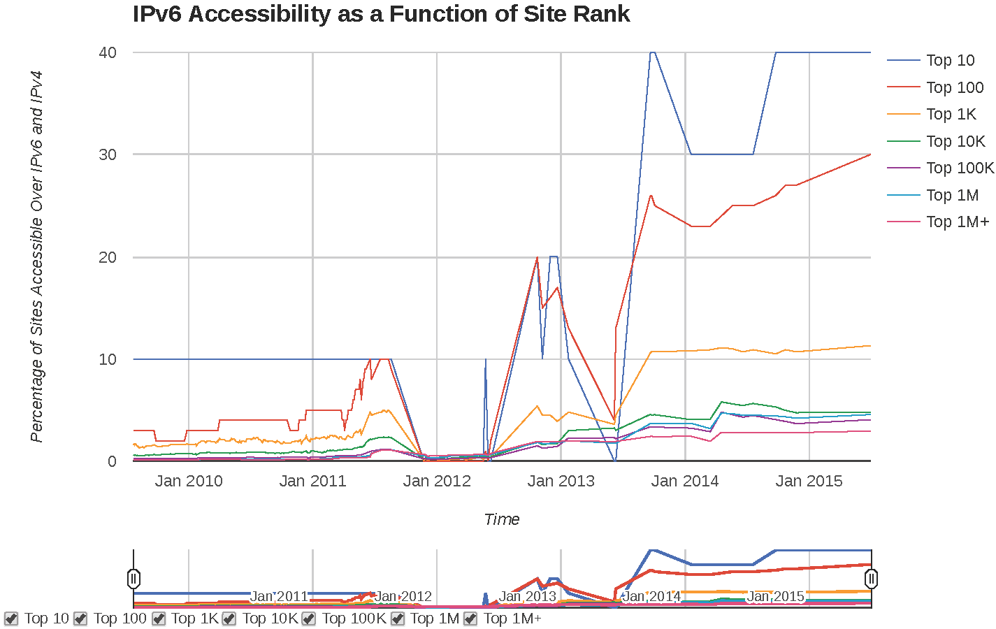
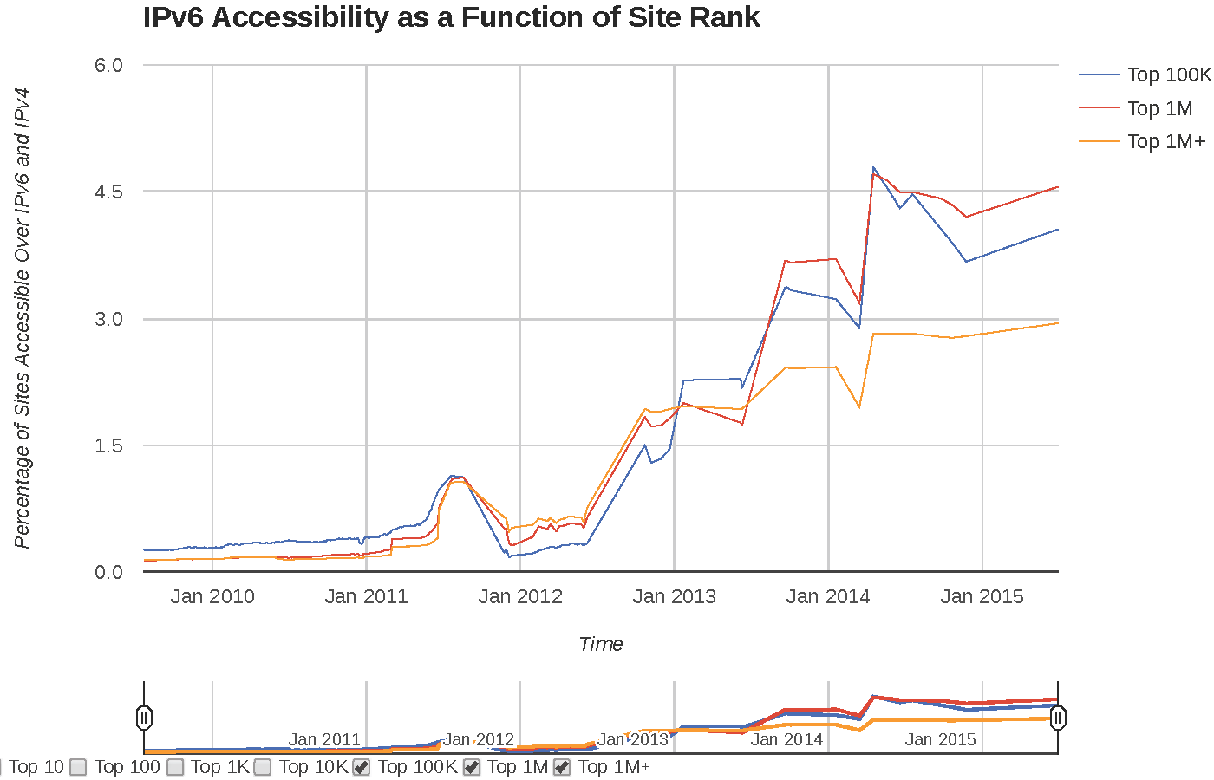
When Will Transition Happen?
Wireless providers are using IPv6 for mobile devices
  Both T-Mobile and Verizon are assigning IPv6 addresses to phones that use the latest version of Android
Popular web content is slowly becoming IPv6 accessible
  ~4.5% (2014) of sites in Alexa’s top 1M sites are IPv6 accessible today (rapid growth since end of 2012), but over 40% of the top 10
Google reports (Nov. 2017) ~21% of its users access it using IPv6 (see next page)
  ~ doubling each year; could reach over 50% in a couple of years

Slide 26
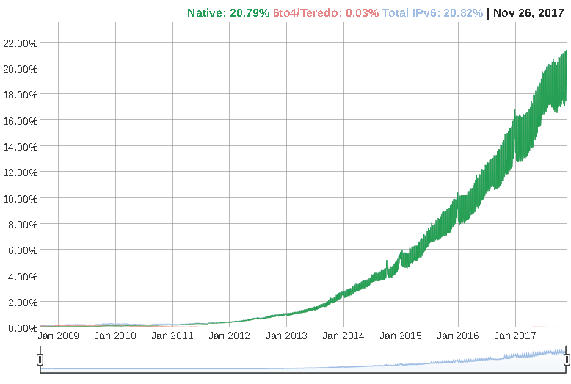
When Will Transition Happen?
https://www.google.com/intl/en/ipv6/statistics.html

Slide 27
Exercise
Simplify the representations following IPv6 Addresses:
  2001:0da8:e800:0000:0260:3eff:fe47:0001
  2001:0000:0000:1234:0260:0000:0000:1000
Expand to full length the following simplified IPv6 addresses:
  2001::bcd:123
  2001:abc::1

Slide 28
Exercise
Simplify the representations following IPv6 Addresses:
  2001:0da8:e800:0000:0260:3eff:fe47:0001
  2001:da8:e800:0:260:3eff:fe47:1
  2001:0000:0000:1234:0260:0000:0000:1000
  2001::1234:260:0:0:1000
Expand to full length the following simplified IPv6 addresses:
  2001::bcd:123
  2001:0000:0000:0000:0000:0000:0bcd:0123
  2001:abc::1:0:2
  2001:0abc:0000:0000:0000:0001:0000:0002

Slide 29
Exercise
What are the rules for getting an IPv6 Provider Independent (PI) address prefix, and what are advantages over having a prefix assigned to you by your provider? (You’ll need to go on the Internet to find the answer)

Slide 30
Exercise
What are the rules for getting an IPv6 Provider Independent (PI) address prefix, and what are advantages over having a prefix assigned to you by your provider? (You’ll need to go on the Internet to find the answer)
As was the case with IPv4, IPv6 PI address blocks are assigned by a Regional Internet Registry directly to an end-user organization (as opposed to getting them from their ISP). Those address blocks have a minimum size of /48 and are taken from the range 2001:0678::/29. An organization requesting a PI block must enter into a contractual agreement with the RIR from which it receives it, which specifies, among other things, that the addresses cannot be re-assigned to other organizations and must be returned to the RIR when not used anymore.
The main advantage of PI addresses is that they are portable so that organizations can easily change providers. They also make multi-homing much easier.

Slide 31
Exercise
Assume that an ICMPv6 router advertisement contains the prefix 2001:abf6:564d:12e0::/64, what would the IPv6 address of a host with MAC address cc:17:a5:b2:47:0a be?

Slide 32
Exercise
Assume that an ICMPv6 router advertisement contains the prefix 2001:abf6:564d:12e0::/64, what would the IPv6 address of a host with MAC address cc:17:a5:b2:47:0a be?
The host IP address would be of the form
2001:abf6:564d:12e0:ce17:a5ff:feb2:470a
cc = 1100 1100 ⇒ ce = 1100 1110
Universal/local bit

