Slide 1
21. Wireless Internet
General wireless network issues
WiFi
channels and association
CSMA/CA
packet header fields
Roch Guerin
(with adaptations from Jon Turner and John DeHart, and material from Kurose and Ross)

Slide 2
Wireless and Mobile Networks
Background:
# wireless (mobile) phone subscribers now far exceed # wired phone subscribers
# wireless Internet-connected devices surpasses # wired Internet-connected devices
laptops, Internet-enabled phones promise anytime untethered Internet access
Internet-of-Things will give this yet another boost
two important (but different) challenges
wireless: communication over wireless link
mobility: handling the mobile user who changes point of attachment to network
CSE574: Wireless and Mobile Networking
Notes:
Numbers are probably old…

Slide 3
Elements of a Wireless Network
wireless hosts
laptop, phone
run apps
may be mobile or stationary
base stations
typically connected to wired network
relay - responsible for sending packets between wired network and wireless host(s) in its “area”
e.g., cell towers, 802.11 access points
network
infrastructure
wireless links
typically used to connect mobile(s) to base station
also used as backbone link
multiple access protocol coordinates link access
various data rates, transmission distance

Slide 4
Characteristics of Wireless Links
5G (2020)
200
802.11n
54
802.11a,g
802.11a,g point-to-point
5-11
802.11b
4G: LTWE WIMAX
4
3G: UMTS/WCDMA-HSPDA, CDMA2000-1xEVDO
Data rate (Mbps)
1
802.15
.384
2.5G: UMTS/WCDMA, CDMA2000
.056
2G: IS-95, CDMA, GSM
Indoor
10-30m
Outdoor
50-200m
Mid-range
outdoor
200m – 4 Km
Long-range
outdoor
5Km – 20 Km
Notes:
What are each of these?
At least know something about the different categories.
802.11: WLAN
802.15: WPAN (Bluetooth) low power, short range, low bandwidth
More on Cellular in next lecture:
2G: 1991
3G: 1998
4G: 2008
5G: due around 2020, 1Gb/s

Slide 5
Ad hoc Operation
No base stations or “infrastructure nodes”
Nodes can only transmit to others within range
Nodes organize and among themselves
Notice each other
Find they have something to share
Cooperate to form “network” and forward packets
Notes:
WANET: Wireless Ad hoc NETwork
MANET: Mobile Ad hoc NETwork

Slide 6
Wireless Network Classification
single hop
multiple hops
host connects to
base station (WiFi,
WiMAX, cellular)
which connects to
larger Internet
host may have to
relay through several
wireless nodes to
connect to larger
Internet: mesh net
infrastructure
(e.g., APs)
no base station, no
connection to larger
Internet. May have to
relay to reach other
wireless nodes
MANET, VANET
no
infrastructure
no base station, no
connection to larger
Internet (Bluetooth,
ad hoc nets)

Slide 7
IEEE 802.11 LAN Standards
IEEE Standard | Rate | Band | Notes
802.11 | 1-2 Mbps Range ? | 2.4 GHz | 1997 Standard; FH & DSSS
802.11a | Up to 54 Mbps (usually 25Mbps) Range ~ 30m | 5-6 GHz (U.S.) | 1999 Standard; OFDM
802.11b (Wi-Fi) | Up to 11 Mbps (usually 6.5Mbps) Range ~ 30m | 2.4 GHz | 1999 Standard; DSSS CCK/QPSK
802.11g | Up to 54 Mbps (usually 25Mbps) Range ~ 30m | 2.4 GHz | 2003 Standard OFDM
802.11n | Up to 540 Mbps (usually 200Mbps) Range ~ 50m | 2.4GHz or 5-6GHz | 2009 Standard; MIMO + frame aggregation
Notes:
IEEE Wireless LAN definitions (WLAN)
Wi-Fi: 802.11
802.11b: Most widely used
802.11g: Faster version of 802.11b
802.11ac: Comes on new Apple MacBook Pros: extension of 802.11n
My Mac: Supported PHY Modes: 802.11 a/b/g/n

Slide 8
IEEE 802.11 LAN Standards
IEEE Standard | Rate | Band | Notes
802.11 | 1-2 Mbps Range ? | 2.4 GHz | 1997 Standard; FH & DSSS
802.11a | Up to 54 Mbps (usually 25Mbps) Range ~ 30m | 5-6 GHz (U.S.) | 1999 Standard; OFDM
802.11b (Wi-Fi) | Up to 11 Mbps (usually 6.5Mbps) Range ~ 30m | 2.4 GHz | 1999 Standard; DSSS CCK/QPSK
802.11g | Up to 54 Mbps (usually 25Mbps) Range ~ 30m | 2.4 GHz | 2003 Standard OFDM
802.11n | Up to 540 Mbps (usually 200Mbps) Range ~ 50m | 2.4GHz or 5-6GHz | 2009 Standard; MIMO + frame aggregation
My office: netsh wlan show interfaces
Shows that my laptop connects over 802.11n with a speed that seems to vary between 270Mbps and 300Mbps
Notes:
IEEE Wireless LAN definitions (WLAN)
Wi-Fi: 802.11
802.11b: Most widely used initially
802.11g: Faster version of 802.11b
802.11ac: Comes on new Apple MacBook Pros: extension of 802.11n
My laptop: Supported PHY Modes: 802.11 a/b/g/n

Slide 9
Basics of Spreading Gain
Sender transmits
S = 1 ≡ B
S = 0 ≡ -B
Interference, say, continuously transmits J
Receiver gets (S+J) and computes (S+J)⊗B=S⊗B+J⊗B
B⊗B = +11
-B⊗B = -11
J⊗B = +1
Computation yields
S = 1 ≡ B
(S+J)⊗B = +12 → 1
S = 0 ≡ -B
(S+J)⊗B = -10 → 0
+1
+1
+1
+1
+1
+1
-1
-1
-1
-1
-1
-1
-1
-1
-1
-1
-1
+1
+1
+1
+1
+1
+1
+1
+1
+1
+1
+1
+1
+1
+1
+1
+1

Slide 10
Wireless Link Characteristics
Differences from wired links
decreased signal strength: radio signal attenuates as it propagates (path loss) – much faster than when guided through wire
interference from other sources: standardized wireless network frequencies (e.g., 2.4 GHz) shared by other devices (e.g., wireless phones, electric motors, microwave ovens)
multipath propagation: radio signal reflects off objects and ground, arriving at destination at slightly different times
Makes communication across (even point-to-point) wireless link more challenging
Lower and variable achievable bit rates
higher error rates
limited distances without sophisticated antennas(beam-forming)
On the flip side, this ensures limited propagation delays
more vulnerable to snooping (signal is inherently broadcast)
Stronger need for encryption

Slide 11
Wireless Link Characteristics
SNR: signal-to-noise ratio
larger SNR is good
easier to separate signal from noise
measured in decibels (db)
logarithmic scale – increase of 3 db corresponds to doubling ratio
SNR versus BER tradeoffs
signal power
increased power leads to higher SNR and lower BER
alternate modulation schemes
more sophisticated methods yield higher data rate, but also higher BER
can sometimes select modulation technique based on conditions
10⁻¹
10⁻²
10⁻³
BER
10⁻⁴
10⁻⁵
10⁻⁶
10⁻⁷
10
20
30
40
SNR(dB)
QAM256 (8 Mbps)
QAM16 (4 Mbps)
BPSK (1 Mbps)

Slide 12
Wireless Network Characteristics
Multiple wireless senders and receivers create additional problems (beyond multiple access):
A
B
C
C
A’s signal
strength
C’s signal
strength
B
A
distance
Hidden terminal problem
A, B hear each other, B, C hear each other
A, C cannot hear each other, so may send simultaneously causing interference at B. A, C cannot detect collision
can be caused by obstacle or signal attenuation over distance

Slide 13
Hidden Terminal Problem Hearing No One Does Not Mean I Can Transmit
C
(a)
B senses clear medium;
A hidden from B
Data Frame
A
B
A transmits frame
(b)
C
Data Frame
Data Frame
A
Frames from A & B
collide at C
B

Slide 14
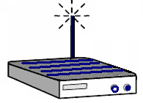
Exposed Node Problem Hearing Someone Does Not Mean I Cannot Transmit
D
C
B hears C and thinks that C’s transmissions preclude talking to D
A
B
D
C
A
B
But B can talk to D without interfering with C’s transmissions to A
Notes:
B can hear C but it can’t hear A. So, likely that A cannot hear B.
Therefore B is safe transmitting to D. B’s transmission will
not affect A’s reception of C.

Slide 15
802.11 LAN Architecture
Wireless host communicates with access point (AP)
Wireless subnet called Basic Service Set (BSS)
in infrastructure mode contains wireless hosts and access point (AP)
in ad hoc mode, just hosts
Internet
hub, switch
or router
BSS 1
BSS 2

Slide 16
802.11: Channels
802.11b: 2.4GHz-2.5 GHz spectrum (unlicensed) divided into 11 channels with overlapping frequencies
AP administrator chooses frequency for AP
interference possible: channel can be same as that chosen by neighboring AP (or may overlap)
5MHz
30db
1
2
3
4
5
6
7
8
9
10
11

Slide 17
802.11: Association
Host: must associate with an AP
scans channels, listening for beacon frames containing AP’s name (SSID) and MAC address
selects AP to associate with
may perform authentication
will typically run DHCP to get IP address in AP’s subnet

Slide 18
802.11: Passive/Active Scanning
BSS 1
BSS 2
BSS 1
BSS 2
1
AP 2
AP 1
1
1
AP 2
AP 1
2
2
2
3
3
4
H1
H1
passive scanning:
beacon frames sent from APs - periodically, every 100 ms
Association Request frame sent: H1 to selected AP
Association Response frame sent from selected AP to H1
active scanning:
Probe Request frame broadcast from H1
Probe Response frames sent from APs
Association Request frame sent: H1 to selected AP
Association Response frame sent from selected AP to H1

Slide 19
IEEE 802.11: Multiple Access
Avoid collisions: 2⁺ nodes transmitting at same time
CSMA - sense before transmitting
don’t collide with ongoing transmission by another node
No collision detection!
difficult to receive (sense collisions) when transmitting due to weak received signals (fading)
can’t sense all collisions in any case: hidden terminal, fading
goal: avoid collisions: CSMA/CA (collision avoidance)
A
B
C
C
A’s signal
strength
C’s signal
strength
B
A
space

Slide 20
IEEE 802.11 MAC Protocol: CSMA/CA
802.11 sender
if sense channel idle for DIFS then
transmit entire frame (no CD)
if sense channel busy then
start random backoff timer
timer counts down while channel idle
when channel is busy, timer stops
may start/stop multiple times
transmit when timer expires
if no ACK, increase random backoff interval, and try again
802.11 receiver
if frame received OK
return ACK after SIFS (ACK needed due to hidden terminal problem)
Timing – 11 Mb/s is 11 bits/μs, propagation time <1 μs
sender
receiver
DIFS
data
SIFS
ACK
Notes:
DCF: Distributed Coordination Function
DIFS: DCF InterFrame Space, a specified time
SIFS: Short InterFrame Space
Emphasize: We can’t rely on detecting collisions so we need ACKs for wireless layer 2.

Slide 21
Basic Transmission Procedure
DIFS
Contention
window
PIFS
DIFS
Data frame
SIFS
Busy medium
Pick transmission time randomly
Time
Defer access
Variable InterFrame Space (IFS) between transmissions
DCF IFS (DIFS) to transmit data, RTS (next slide), etc.
Followed by contention period
When channel becomes idle
“Priority” frames wait only for Short IFS (SIFS)
Completion of in-progress transfer, ACKs, CTS, etc.
PCF IFS (PIFS) to initiate Contention-Free Periods
Notes:
PCF: Point Coordination Function: Access Point hands out access permission to send frame to end hosts. Not used much.
DCF: Distributed Coordination Function
DIFS: DCF InterFrame Space, a specified time
SIFS: Short InterFrame Space

Slide 22
Avoiding Collisions
Allow sender to “reserve” channel rather than random access of data frames
avoid collisions of long data frames
optional feature
Sender first transmits small request-to-send (RTS) packets to Access Point using CSMA
RTSs may still collide with each other (but they’re short)
less than 50 bytes, vs 1500 bytes for largest Ethernet frame
AP broadcasts clear-to-send CTS in response to RTS
CTS heard by all nodes
RTS and CTS contain duration of frame time
sender transmits data frame
other stations defer transmissions for that duration even if they don’t hear anything during that time

Slide 23
Collision Avoidance: RTS-CTS Exchange
A
B
AP
RTS(B)
RTS(A)
reservation collision
RTS(A)
CTS(A)
CTS(A)
DATA (A)
defer
time
ACK(A)
ACK(A)

Slide 24
Properties of RTS/CTS Operation
Nodes that see CTS refrain from transmitting for specified duration
Addresses hidden terminal problem (I did not hear you, but I heard the receiver with which I would have interfered)
Nodes that see RTS but not CTS can proceed to transmit
Addresses exposed node problem (I heard you but not the receiver, and so I know I wont interfere with your transmission to that receiver) – only relevant in ad hoc mode
Collisions of RTS messages detected through lack of CTS response
Exponential backoff algorithm for retransmissions
RTS/CTS procedure used only for frames above a certain length
Small frames are sent “immediately” (configurable parameter) to avoid RTS/CTS overhead

Slide 25
DIFS
RTS
Data
Source
SIFS
SIFS
SIFS
CTS
ACK
Destination
DIFS
NAV (RTS)
Others
NAV (CTS)
NAV (Data)
Busy medium
NAV: Network allocation vector, specifies amount of time the sender expects to keep the medium busy (max of 32.767 ms)

Slide 26
802.11 Frame Format
2
2
6
6
6
2
6
0-2312
4
Frame
Control
Duration/
ID
Address
1
Address
2
Address
3
Sequence
control
Address
4
Frame
body
CRC
e.g. StaAP1 ← AP1 ← StaAPn
frame from DS
MAC Header (bytes)
Incl. 8 bytes WEP,
8 bytes LLC
Protocol
Version
Type
Subtype
To
DS
From
DS
More
Frag
Retry
Pwr
Mgt
More
Data
WEP
Rsvd
Additional address fields compared to standard E/N frame
ToDS and FromDS determines the content of those fields
Type/Subtype indicates type of frame: management (00), control (01), or data (10)
More fragment indicates that large frame was fragmented
Retry indicates retransmission of previous fragment
WEP means body is encrypted according to WEP alg.
Duration/ID typically specifies amount of time channel will remain busy (NAV = Xmit + ACK) NAV = Network Allocation Vector
Sequence control specifies fragment and sequence numbers to recognize duplicates

Slide 27
More Details
frame seq #
(for RDT)
duration of reserved
transmission time (RTS/CTS)
2 bytes
2
6
6
6
2
6
0 - 2312
4
frame
control
duration
address
1
address
2
address
3
seq
control
address
4
payload
CRC
2 bits
2
4
1
1
1
1
1
1
1
1
Protocol
version
Type
Subtype
To
AP
From
AP
More
frag
Retry
Power
mgt
More
data
WEP
Rsvd
frame type
(RTS, CTS, ACK, data)
Address details on next slide

Slide 28
802.11 Frame: Addressing
2B
2
6
6
6
2
6
0 - 2312
4
frame
control
duration
address
1
address
2
address
3
seq
control
address
4
payload
CRC
Address 4: used only in ad hoc mode (to support per-hop addresses)
Address 1: MAC address
of wireless host or AP
to receive this frame
Address 3: MAC address of router in switched subnet to which AP is attached
Address 2: MAC address
of wireless host or AP
transmitting this frame
Address Example on next slide

Slide 29
802.11 Addressing
Internet
H1
R1
router
R1 MAC addr H1 MAC addr
dest. address
source address
Ethernet frame
AP MAC addr H1 MAC addr R1 MAC addr
address 1
address 2
address 3
802.11 frame

Slide 30
802.11 Rate Adaptation (experimental)
Dynamically change modulation technique in response to changes in SNR
SNR decreases, BER increases as node moves away from base station
when BER becomes too high, switch to lower transmission rate but with lower BER
Simple adaptation method
if two consecutive frame transmissions fail (no ack after several retries)”down-shift”
if ten consecutive frame transmissions succeed, “up-shift”
10⁻¹
10⁻²
10⁻³
BER
10⁻⁴
10⁻⁵
10⁻⁶
10⁻⁷
10
20
30
40
SNR(dB)
11 Mbps
6 Mbps
1 Mbps

Slide 31
802.11 Power Management
Node-to-AP: “I am going to sleep until next beacon frame”
AP knows not to transmit frames to this node
node wakes up before next beacon frame
Beacon frame: contains list of mobiles with AP-to-mobile frames waiting to be sent
node will stay awake if AP-to-mobile frames to be sent; otherwise sleep again until next beacon frame

Slide 32
802.15: Personal Area Network
Less than 10 m diameter
Replacement for cables
mouse, keyboard, headphones
Ad hoc: no infrastructure
Master/slaves:
slaves request permission to send (to master)
master grants requests
802.15: evolved from Bluetooth specification
2.4-2.5 GHz, up to 4 Mb/s
TDM with 79 channels
uses “channel hopping”
up to 721 kbps
S
P
P
radius of
coverage
M
S
S
P
P
M
Master device
Slave device
Parked device (inactive)
S
P

Slide 33
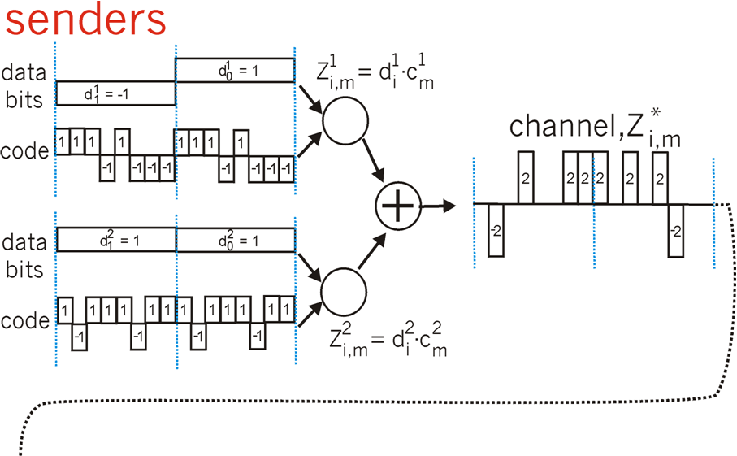
Exercise: Two CDMA senders
channel sums transmissions by senders 1 and 2
Sender 1
Sender 2
How would a receiver successfully receive the data sent by sender 1 (or 2)?

Slide 34
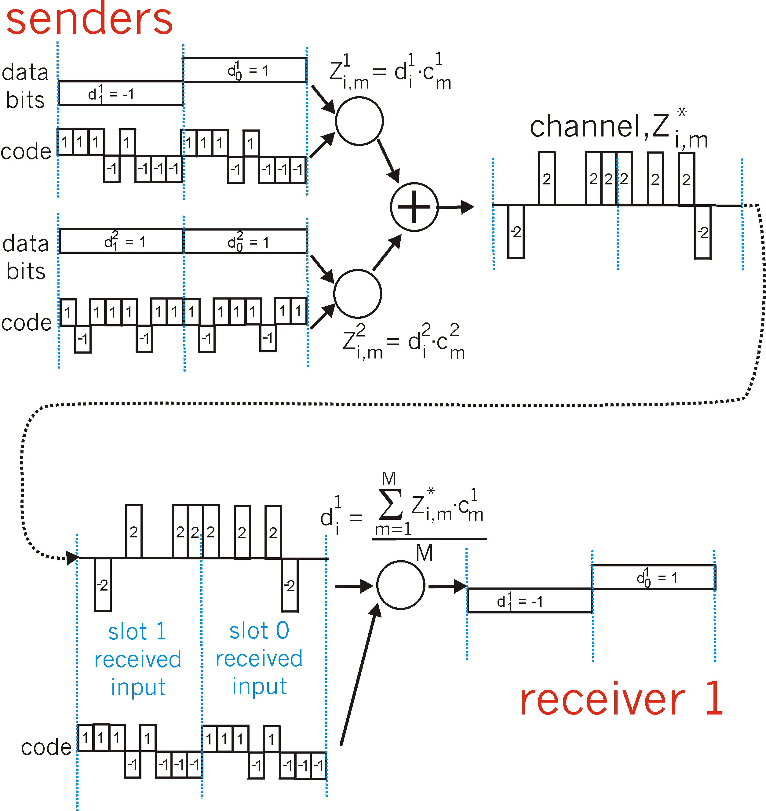
Exercise: Two CDMA senders
channel sums transmissions by senders 1 and 2
Sender 1
Sender 2
using same code as sender 1, receiver recovers sender 1’s original data from summed channel data!
1x0+1x(-2)+1x0+(-1)x2+1x0+(-1)x0+(-1)x2+(-1)x2=-8 ≡ -1
1x2+1x0+1x2+(-1)x0+1x2+(-1)x(-2)+(-1)x0+(-1)x0=+8 ≡ 1

Slide 35
Exercises
X
C
A
B
Suppose nodes A, B and C are in an 802.11 network with access point X and assume that A and B can hear each other, A and C can hear each other, but B and C cannot hear each other. Assume RTS/CTS is not turned on. Suppose that at time 0, X is sending a packet and it continues to send for 500 μs. At time 100, A gets a packet to send and initializes its backoff timer to 400 μs. At time 200, B gets a packet to send and initializes its backoff timer to 300 μs. At time 400, C gets a packet to send and initializes its backoff timer to 100 μs. Assume that it takes 200 μs to send each of the packets from A, B and C. When do each of the hosts start sending their packets. Which of them is delivered successfully, and when? You can ignore time spent on ACKs and/or *IFS.

Slide 36
Exercise
X
C
A
B
Suppose nodes A, B and C are in an 802.11 network with access point X and assume that A and B can hear each other, A and C can hear each other, but B and C cannot hear each other. Assume RTS/CTS is not turned on. Suppose that at time 0, X is sending a packet and it continues to send for 500 μs. At time 100, A gets a packet to send and initializes its backoff timer to 400 μs. At time 200, B gets a packet to send and initializes its backoff timer to 300 μs. At time 400, C gets a packet to send and initializes its backoff timer to 100 μs. Assume that it takes 200 μs to send each of the packets from A, B and C. When do each of the hosts start sending their packets. Which of them is delivered successfully, and when? You can ignore time spent on ACKs and/or *IFS.
Since X is transmitting until t=500, none of the hosts decrement their backoff timer until that point, so they all start with their original values even though they initialized them at different times. This means that C gets to transmit first at t=600, which is when its backoff timer of 100 expires. At that time, the backoff timer values of A and B are 300 and 200, respectively. Because A can hear C, its timer will be frozen for the next 200 μs while C transmits, but B continues decrementing its timer. At t=800 C completes its transmission just in time to avoid interfering with B’s transmission that starts then. Because A can hear the transmission from B, its keeps its backoff timer frozen until t= 1000, which is when B completes its transmission. A will then wait another 300 μs until its backoff timer decrements to 0, before it starts its own transmission. In this scenario all three transmissions are successful.

Slide 37
Exercises
X
C
A
B
Repeat the last problem assuming RTS/CTS is turned on. Assume that it takes just 20 μs to send an RTS or a CTS.

Slide 38
Exercises
X
C
A
B
Repeat the last problem assuming RTS/CTS is turned on. Assume that it takes 20μs to send an RTS or a CTS.
Because all three nodes (A,B,C) sense a busy channel when they first have to send a frame, they select a random backoff time (400μs, 300μs, and 100μs for A, B, and C, respectively) that determines when they will send their RTS.
C’s timer is the first to expire and it sends its RTS at t=600. The impact of the RTS depends on who can hear it (everyone hears the CTS since it comes from the AP), i.e., who realizes that the medium has become busy due to the RTS transmission. In our scenario, A hears C’s RTS but B does not. Hence, A will freeze its timer, but B continues decrementing its own until it starts receiving the CTS (destined to C) sent by X 20 μs later. At this point (t=620), A’s timer is 300, and B’s is 180. Both A’s and B’s timers stay frozen while the CTS is received and then for the duration of the value carried in C’s CTS, i.e., 200 μs, which is how long it will take C to transmit its packet and have it acknowledged. Hence, A’s and B’s timers remain frozen until t=840, at which point they both start decrementing again.
This results in B sending its RTS at t=840+180=1020 and receiving its CTS at t=1060. Note that because A can hear B, it freezes its timer at t=1020 at a value of 300-180=120. B’s CTS again carries a duration value of 200μs, which will keep A’s timer frozen until t=1260.
A eventually transmits its own RTS at t=1260+120=1380, and receives a CTS from X at t=1420, at which points it starts transmitting (and ends at t=1620).

Slide 39
Transmission Timeline under RTS/CTS
X
C
A
B
CTS
CTS
CTS
X
Transmit
0
500
620
640
1040
1060
1400
1420
300
300
120
120
0
400
RTS
A
100
timer
timer
timer
Transmit
0
500
600
840
1020
1260
1380
1420
1620
180
180
RTS
300
0
B
200
timer
timer
Transmit
0
500
620
840
1020
1060
1260
100
0
RTS
C
300
timer
Transmit
0
500
600
640
840

Slide 40
Exercises
Consider a packet going from a host A on a wireless network with access point X through an Ethernet switch to a router R. From there, it goes back to the switch to another access point Y, which delivers it to a host B. What MAC addresses appear in the three address fields of the 802.11 frame sent over A’s wireless network. What MAC addresses appear in the two address fields of the Ethernet frame sent to the router? What MAC addresses appear in the three address fields of the 802.11 packet sent over B’s wireless network?

Slide 41
Exercises
Consider a packet going from a host A on a wireless network with access point X through an Ethernet switch to a router R. From there, it goes back to the switch to another access point Y, which delivers it to a host B. What MAC addresses appear in the three address fields of the 802.11 frame sent over A’s wireless network. What MAC addresses appear in the two address fields of the Ethernet frame sent to the router? What MAC addresses appear in the three address fields of the 802.11 packet sent over B’s wireless network?
The MAC addresses in the 802.11 frame sent by A are as follows: X,A,R
The MAC addresses in the Ethernet frame forwarded by X are: R,A
The MAC addresses in the Ethernet frame forwarded by R are: B,R (B is obtained from the ARP query issued by R using the IP address of B’s host)
The MAC addresses in the 802.11 frame sent by Y are: B,Y,R

Slide 42
Exercises
Consider a host A in an 802.11 network that is using power management. Suppose that some remote host is sending an average of 20 packets per second to A and the packets have an average length of 1000 bytes. Approximately what fraction of the time can A sleep? Assume no other activity in the network.

Slide 43
Exercises
Consider a host A in an 802.11b network that is using power management. Suppose that some remote host is sending an average of 20 packets per second to A and the packets have an average length of 1000 bytes. Approximately what fraction of the time can A sleep? Assume no other activity in the network.
Host A receives on average 160,000 bits/sec. Assuming a 11 Mbps transmission speed, this translates into a transmission time of 14.55 ms.
After receiving the 20 packets, the host will notify that it will be going to sleep until the next beacon frame(sent every 100ms), and wake up at that time only to go back to sleep and repeat the process 9 more times until it receives a beacon indicating there are frames pending for A to receive.
Hence, ignoring the wake-up times spent receiving beacon frames, node A spends approximately 98.5% of its time asleep.
If we don’t ignore the wake-up times, we would need to add to the reception times of 14.55 ms, the total time consumed by the wake-up process, namely, 10*250 μs or 2.5 ms. This results in a total “non-sleeping” time of 17.05 ms, or alternatively a 98.3% fraction of time sleeping.

Slide 44
Exercises
Consider an 802.11b network that uses the simple rate adjustment scheme described on the slide titled “802.11 Rate Adaptation (experimental)” (highlights shown below) with three modulation schemes. Assuming that frames are 10,000 bits and that the SNR is 9 dB, what are the odds we can switch from the low rate modulation scheme to the middle? Is this a good idea? What other (better) rate adaptation scheme could you suggest?
10⁻¹
10⁻²
10⁻³
BER
10⁻⁴
Simple adaptation method
if two consecutive frame transmissions fail (no ack after several retries)”down-shift”
if ten consecutive frame transmissions succeed, “up-shift”
10⁻⁵
10⁻⁶
10⁻⁷
10
20
30
40
SNR(dB)
11 Mbps
6 Mbps
1 Mbps

Slide 45
Exercises
Consider an 802.11b network that uses the simple rate adjustment scheme described on the slide titled “802.11 Rate Adaptation (experimental)” with three modulation schemes. Assuming that frames are 10,000 bits and that the SNR is 9 dB, what are the odds we can switch from the low rate modulation scheme to the middle? Is this a good idea? What other (better) rate adaptation scheme could you suggest?
With an SNR of 9 dB, the BER is about 10⁻⁷ when using the low rate modulation scheme. Assuming 10,000 bit frames, receiving 10 error-free frames means receiving 100,000 bits without errors. This has a probability of (1- 10⁻⁷)^{100,000} ~ (1-100,000x10⁻⁷)=0.99. So the odds that we will switch are pretty high.
Now, with an SNR of 9 db, the BER at the middle modulation rate is now about 0.1. This means that we are most likely to experience two consecutive failed frame transmissions (the odds of at least one bit in error in a 10,000 bits frame are close to 1), and hence switch right back to the lower rate modulation. The back and forth between rates that will ensue is not a good idea.
A better rate adaptation option would rely on directly measuring the SNR and switching only when it is safe to do so, i.e., the BER at the higher rate modulation still yields an acceptable BER.

