Slide 1
22. Managing Mobility in Wireless Networks
Basic Issues
Mobile IP
Cell Phone Networks
Mobility in GSM
Roch Guerin
(with adaptations from Jon Turner and John DeHart, and material from Kurose and Ross)

Slide 2
Levels of Mobility
Stationary mobile device
  connects from different locations but does not move while communication is in progress
  “client-only” operation just requires DHCP
  to allow others to “reach you” at any location, need mechanism for them to learn your current location
    mobile IP handles this by “forwarding your calls” from home net
    application-specific solutions such as SIP registration also an option
Moving mobile
  requires mechanism to disconnect from one wireless access point and connect to another as needed (handoff)
  speed of movement, wireless communication range are key factors when engineering solutions
    WIFI networks with small cells and walking users
    cell phone networks with large cells (10 km) and driving users

Slide 3
Mobile IP (RFC 3344)
Key elements
  home agents, foreign agents
  foreign-agent registration
  care-of-addresses
  encapsulation (packet-within-a-packet)
Three components to standard:
  indirect routing of datagrams
  agent discovery
  registration with home agent
Mainly intended for communicating from different locations, not for communicating while in motion
Requires support for permanent, globally routable IP addresses from host-to-host (like your phone number)

Slide 4




Mobile IP Terminology
home network:permanent “home” of mobile device
(e.g., 128.119.40.0/24)
home agent: entity that will perform mobility functions on behalf of mobile, when mobile is remote
wide area network
permanent address: address in home network, can always be used to reach mobile
e.g., 128.119.40.186

Slide 5
Mobile IP Terminology
visited network: network in which mobile currently resides
(e.g., 79.129.13/24)
permanent address: remains constant
(e.g., 128.119.40.186)
care-of-address: address used to reach traveling host
(e.g., 79.129.13.2)
wide area network
foreign agent: entity in visited network that performs mobility functions on behalf of mobile device
correspondent: wants to communicate with mobile

Slide 6
Registration
home network
visited network
1
2
wide area network
mobile device contacts foreign agent on entering visited network
foreign agent contacts home agent home: “this mobile is resident in my network”
End result:
  foreign agent knows about mobile
  home agent knows location of mobile

Slide 7

Mobility Via Indirect Routing
home agent intercepts packets, forwards to foreign agent
using “tunnel”
foreign agent receives encapsulated packet, extracts and forwards inner packet to mobile
visited
network
home
network
3
wide area network
2
1
correspondent addresses packets using home address of mobile
4
mobile replies directly to correspondent

Slide 8



Indirect Routing Observations
Mobile uses two addresses:
  permanent address: used by
  correspondent (hence mobile location
  is transparent to correspondent)
  care-of-address: used by home agent to forward datagrams to foreign agent
    May be Foreign agent address or unique for each mobile
  correspondent sees only permanent address
Foreign agent functions may be done by mobile itself
  if no foreign agent detected, acquire local address via DHCP and use this as care-of-address
  register care-of-address with home agent
Triangle routing: correspondent-home-network-mobile
  less efficient than direct routing

Slide 9
Mobile IP: Indirect Routing
foreign-agent-to-mobile packet
packet sent by home agent to foreign agent: a packet within a packet
dest: 128.119.40.186
dest: 79.129.13.2
dest: 128.119.40.186
Permanent address: 128.119.40.186
Care-of address: 79.129.13.2
dest: 128.119.40.186
packet sent by correspondent

Slide 10
Mobile IP: Agent Discovery
Agent advertisement: foreign/home agents advertise service by broadcasting ICMP messages (type field=9)
H,F bits: home and/or foreign agent
R bit: registration required

Slide 11


Mobile IP: Registration Example
visited network:
79.129.13/24
home agent
HA: 128.119.40.7
foreign agent
COA: 79.129.13.2
mobile agent
MA: 128.119.40.186
ICMP agent adv.
COA: 79.129.13.2
registration req.
registration req.
COA: 79.129.13.2
HA: 128.119.40.7
MA: 128.119.40.186
Lifetime: 9999
identification:714
registration packets sent using UDP,
port 434
COA: 79.129.13.2
HA: 128.119.40.7
MA: 128.119.40.186
Lifetime: 9999
identification: 714
encapsulation format
registration reply
HA: 128.119.40.7
MA: 128.119.40.186
Lifetime: 4999
Identification: 714
registration reply
HA: 128.119.40.7
MA: 128.119.40.186
Lifetime: 4999
Identification: 714
time

Slide 12
Obstacles to Mobile IP Deployment
Requires widespread support in access routers
  to serve as home agents and foreign agents
Requires support in most widely used operating systems
  IOS, Android, Windows, Linux
Shortage of IPv4 addresses
  mobile IP nodes need permanent, public IP addresses
    not directly compatible with common usage of NAT
  need IPv6 before large-scale deployment of mobile IP
Competing solutions to mobility problem
  DHCP, SIP, Skype for “stationary mobile”
Chicken-and-egg problem
  little motivation to use it until there are apps that require it
Potential for cell phone carriers to support it

Slide 13
Beyond Stationary Mobile
Mobility within 802.11 networks
  moving device can disconnect from one AP, connect to another
    MAC address remains the same; switches learn new location
  if both APs in same IP subnet, no need to change IP address
    so ongoing TCP sessions not affected
Moving mobile IP hosts
  moving host detects and registers with new foreign agent after connecting to new AP
  new foreign agent registers with home network which starts forwarding packets through new foreign agent
Mobility in cell phone networks
  cell phone networks engineered for rapid mobility
  large cells reduce frequency of handoffs
    also, more powerful radios and use of licensed spectrum
    but, smaller cells required in densely populated areas

Slide 14

Cellular Network Architecture
MSC
connects cells to wired tel. net.
manages call setup
handles mobility
can cover large area (whole city)
cell
covers geographical region (≈10 km)
base station (BS) analogous to WIFI AP
mobile users attach to network thru BS
air-interface: link and physical layer protocol between mobile and BS
Mobile
Switching
Center
Public
telephone
network
Mobile
Switching
Center
wired network

Slide 15
Cellular Networks: the First Hop
Two techniques for sharing
mobile-to-BS radio spectrum
  CDMA: code division multiple access
  combined FDMA/TDMA
    divide spectrum in frequency channels
    divide each channel into time slots
  mobile devices communicate over assigned channels
Why not contention-based methods like CSMA/CA?
  poor fit for cell-phone environment
    many users and large cells (e.g., 10 km across) would require high bandwidth and frequent contention
    CSMA is inefficient unless packet transmission time is much larger than signal propagation time
  more susceptible to noise/interference

Slide 16
FDMA/TDMA: Used by 2G
time slots
frame
FDMA
  separate radio frequency bands
  “tune-in” to selected band
TDMA
  repeating pattern of timeslots
  mobile device uses assigned
  timeslot in each frame
  requires synchronization with precision that is small fraction of time slot duration (<10%)
Channel assignment controlled by cellular network
  devices request access using a special control channel
    contention for control channel can lead to collisions, but because channel rates are limited, acceptable efficiency is possible
  devices may be assigned multiple channels to enable higher data rates
frequency
bands

Slide 17
Code Division Multiple Access (CDMA)
Used by 3G inside TDMA slots across frequencies
Unique “code” assigned to each user; i.e., code set partitioning
  all users share same frequency, but each user may have own “chipping” sequence (i.e., code) to encode data
  allows multiple users to “coexist” and transmit simultaneously with minimal interference (if codes are “orthogonal”)
Encoded signal = (original data) X (chipping sequence)
Decoding: take inner-product of encoded signal and chipping sequence
Some systems use same chipping sequence for all users
  means only one sender at a time
  still useful, because more robust to interference than direct modulation

Slide 18
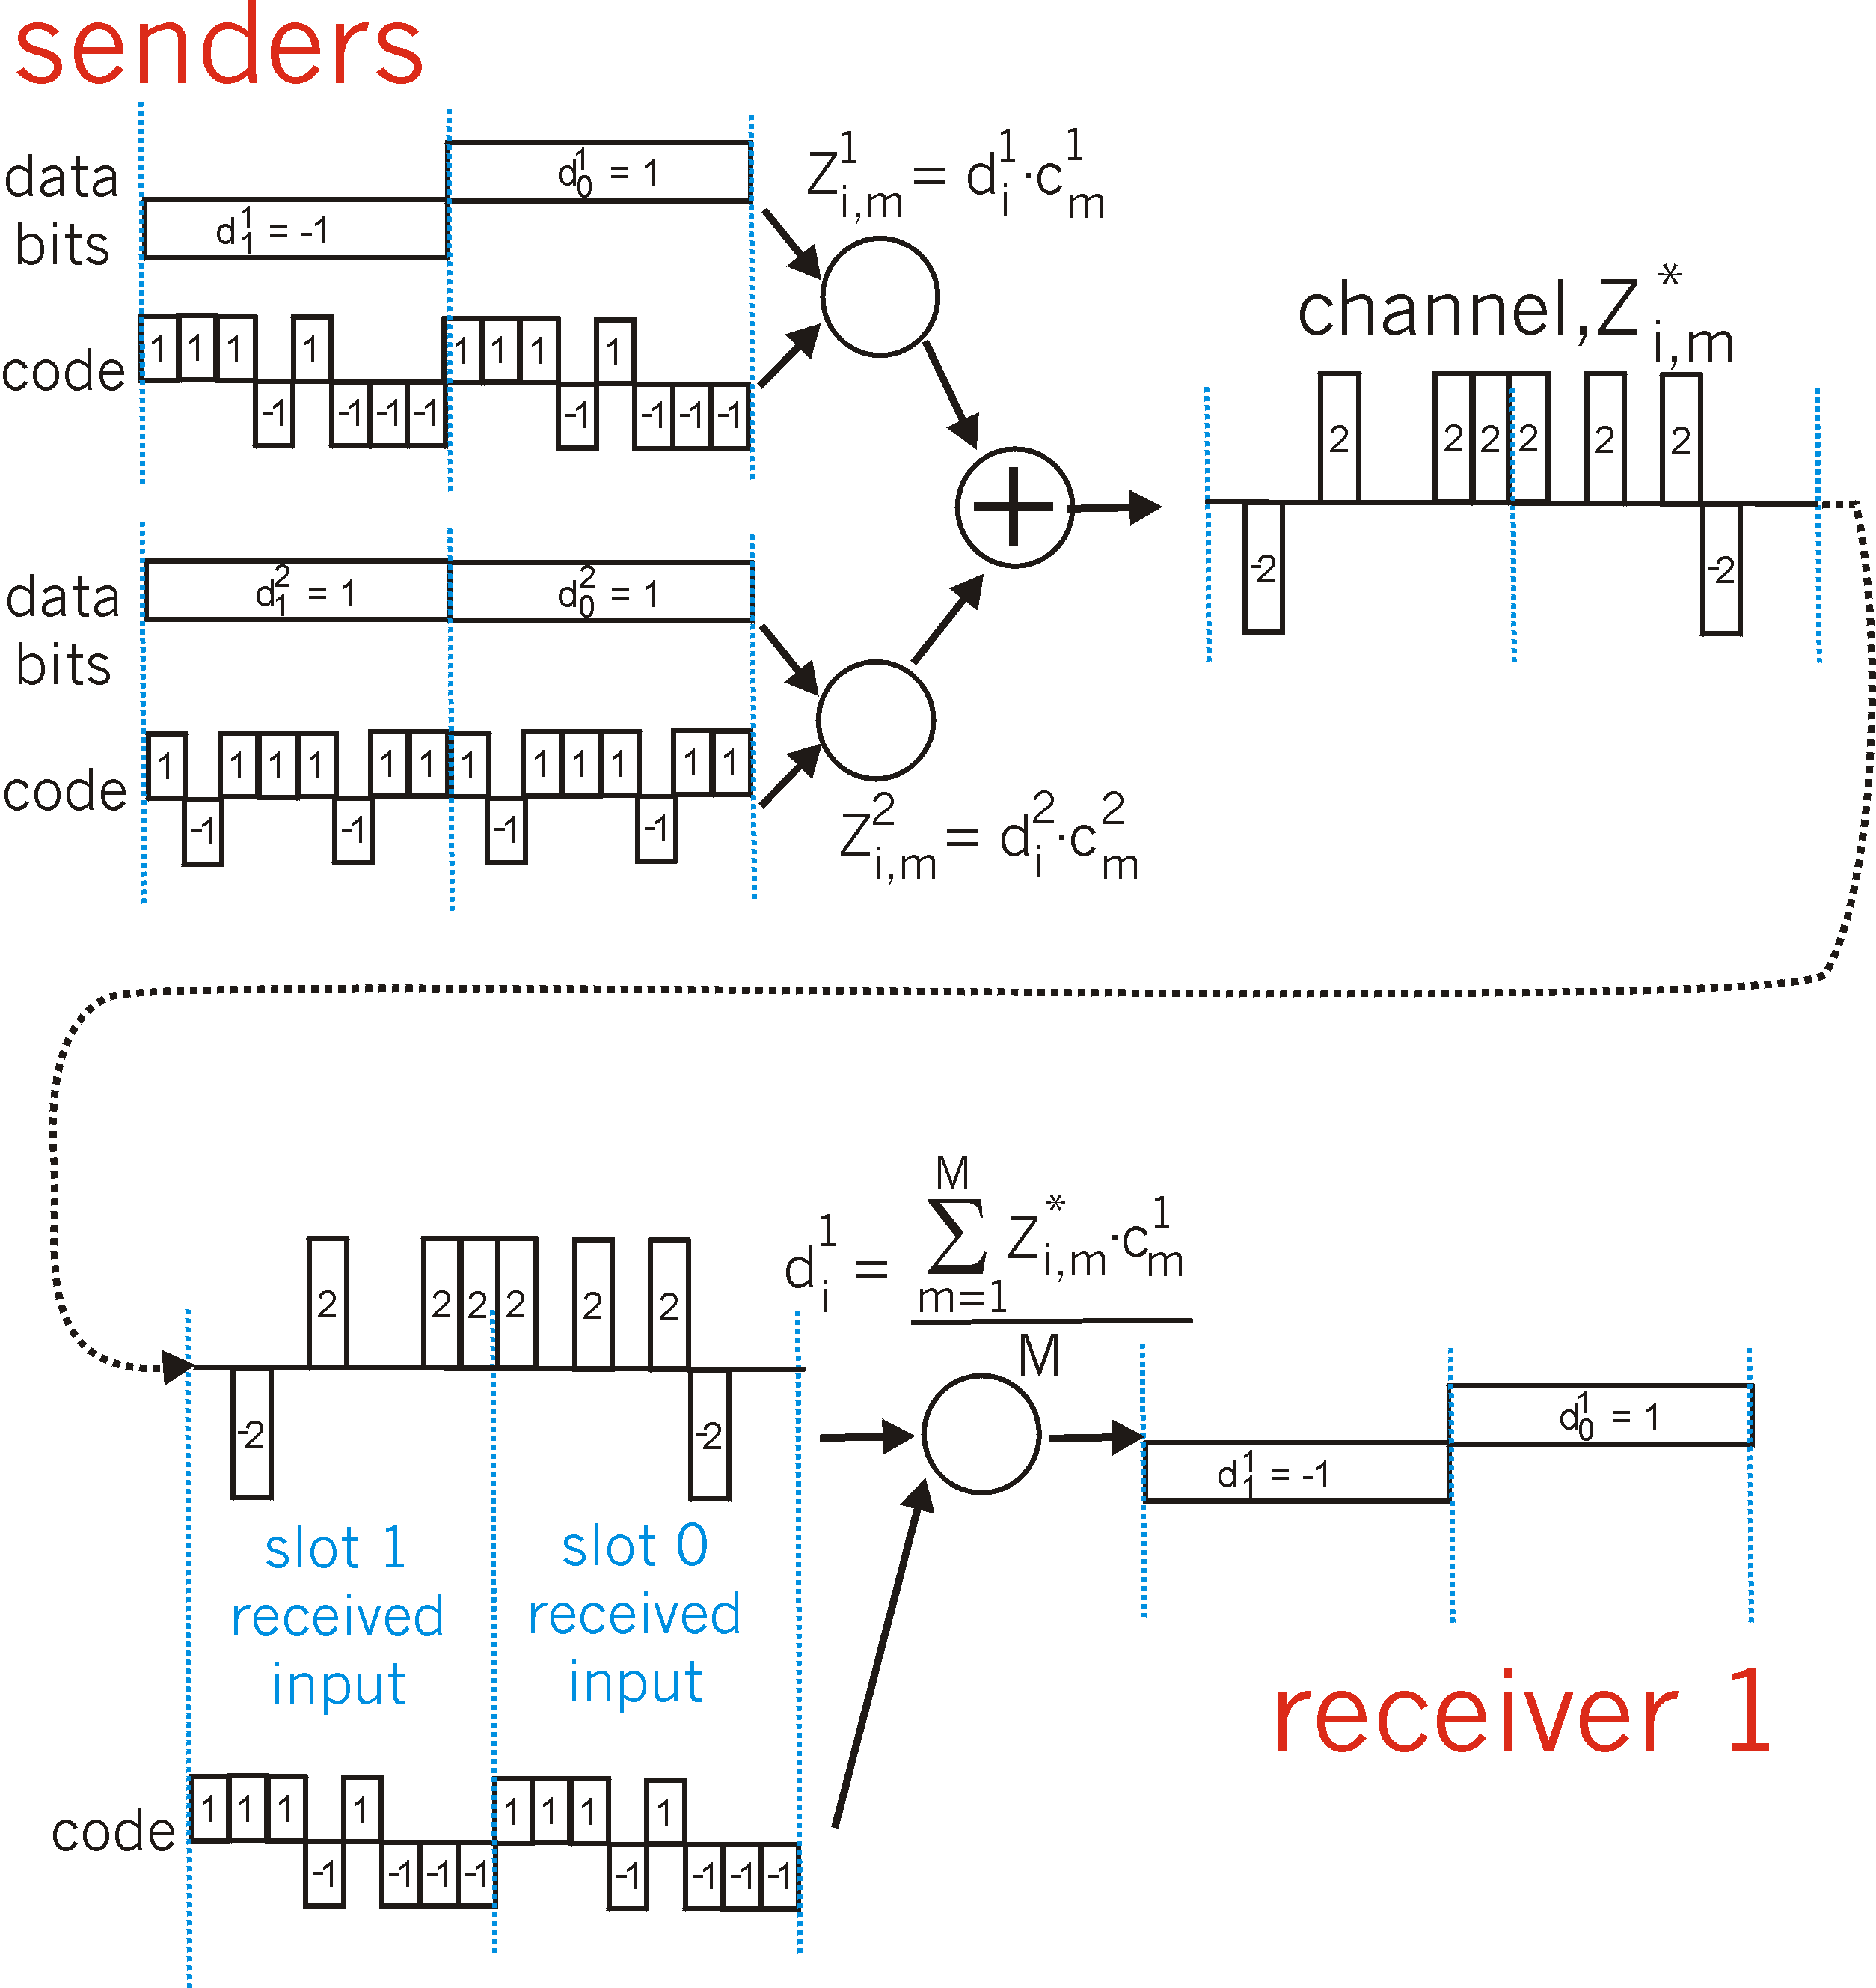
CDMA with Two Senders
channel sums together transmissions by sender 1 and 2
Sender 1
Sender 2
using same code as
sender 1, receiver recovers sender 1’s original data from summed channel data!
slot 1
received input
slot 0
received input
note: can correctly determine transmitted bits so long as competing signal does not change sign of received values

Slide 19
CDMA Coding
1
1
1
1
X 1
-1
-1
-1
-1
1
1
1
1
Sender 1 sends this for a 1 bit
-1
-1
-1
-1
Sender 1’s Code
1
1
1
1
X -1
-1
-1
-1
-1
Sender 1 sends this for a 0 bit

Slide 20
CDMA Coding
1
1
1
1
1
1
X 1
-1
-1
1
1
1
1
1
1
Sender 2 sends this for a 1 bit
-1
-1
Sender 2’s Code
1
1
X -1
-1
-1
-1
-1
-1
-1
Sender 2 sends this for a 0 bit

Slide 21
CDMA Coding
1
1
1
1
1
1
1
1
-1
-1
-1
-1
-1
-1
-1
-1
Sender 1 sends 01
2
2
2
2
2
2
+
-2
-2
1
1
1
1
1
1
1
1
1
1
1
1
-1
-1
-1
-1
Received Signal
Sender 2 sends 11

Slide 22
CDMA Coding
2
2
2
2
2
2
-2
-2
2
2
2
2
X
1
1
1
1
1
1
1
1
-2
-2
-2
-2
-1
-1
-1
-1
-1
-1
-1
-1
Σ=-8 => 0
Σ=8 => 1
Sender 1’s Code
Sender 1’s Code
Inner Product of received signal and Sender 1’s code

Slide 23
2G (Voice only) Network Architecture
Base station system (BSS)
MSC
BTS
BSC
G
Public
telephone
network
Gateway
MSC
Base transceiver station (BTS)
Base station controller (BSC)
Mobile Switching Center (MSC)
Mobile subscribers

Slide 24
3G Voice/Data Network Architecture
MSC
G
Public
telephone
network
radio
network
controller
Gateway
MSC
G
Public
Internet
SGSN
Cellular data net operates in parallel with existing cellular voice network
  only wireless access is shared
  voice network unchanged in core
GGSN
Serving GPRS Support Node
(SGSN)
Gateway GPRS Support Node
(GGSN)
GPRS: Generalized Packet Radio Service
Notes:
GGSN: Gateway Router to the Internet. More IP less mobile
SGSN: Cellular data service management. More mobile less IP

Slide 25
4G Long-Term Evolution (LTE)
Evolved Packet Core (EPC)
  objective is to transition to all IP network using standard IETF protocols (SIP, RTP, etc.)
  special handling of voice calls to ensure low delay
    separate high priority queues; possibly explicit reservation
LTE Radio Access
  increases data rates
    users can achieve up to 100 Mb/s downstream, 50 Mbp/s upstream when using 20 MHz of radio spectrum
  uses combination of FDM and TDM
    users allocated multiple timeslots across multiple frequencies
    – may change dynamically based on traffic
  also uses MIMO (multiple-input, multiple-output) antennas
    signals sent over multiple antennas, received on multiple antennas
    allows application of more sophisticated signal processing

Slide 26
Handling Mobility in Cellular Networks
Home network: network of cellular provider you subscribe to (e.g., Sprint PCS, Verizon)
  home location register (HLR): database in home network containing permanent cell phone #, profile information (services, preferences, billing), information about current location (could be in another or same network)
Visited network: network in which mobile currently resides
  visitor location register (VLR): database with entry for each user currently in network
  note: mobile could be away from home location, but still within the home network

Slide 27
Indirect Routing to Mobile
HLR
home
network
2
correspondent
home
Mobile
Switching
Center
home MSC consults HLR,
gets roaming number of
mobile (MSRN) in visited network
MSRN: Mobile Station Roaming Number
1
call routed
to home network
3
Public switched
telephone
network
VLR
Mobile
Switching
Center
4
home MSC sets up 2nd leg of call
to MSC in visited network
mobile
user
MSC in visited network completes
call through base station to mobile
visited
network

Slide 28
Handoff with Common MSC
Handoff goal
  route call via new base station
  (without interruption)
Reasons for handoff
  stronger signal to/from new BSS
  (continuing connectivity, less
  battery drain)
  load balance: free up channel in current BSS
  network operator sets policies that control when handoff occurs
Handoff initiated by old BSS
VLR
Mobile
Switching
Center
old BSS
new BSS

Slide 29
Handoff Details
1. Old BSS informs MSC of impending
handoff, provides list of possible
new BSSs
2. MSC sets up path (allocates resources)
to new BSS
3. New BSS allocates radio channel
for use by mobile
4. New BSS signals MSC, old BSS when
ready
5. Old BSS tells mobile to perform handoff to new BSS
6. Mobile, new BSS signal to activate new channel
7. Mobile informs MSC via new BSS when handoff complete
and MSC re-routes call
8. MSC-old-BSS resources released
VLR
Mobile
Switching
Center
4
2
1
8
7
3
old BSS
5
6
new BSS

Slide 30
Handoff Between MSCs
Anchor MSC: first MSC
visited during call
  call remains routed through anchor MSC
New MSCs add on to end of MSC chain as mobile moves
to new MSC
  occurs infrequently as MSCs generally cover large area
  optional path minimization step
  to shorten multi-MSC chain
    not critical issue, since long
    chains are relatively rare and extra distance is relatively short
home network
correspondent
Home MSC
anchor MSC
PSTN
MSC
MSC
MSC
before
handoff
after

Slide 31
Mobility and Higher Layer Protocols
Logically, impact of mobility should be minimal …
  for IP, best effort service model remains unchanged
  TCP and UDP can (and do) run over wireless, mobile
    BUT, for standard TCP, address used by mobile device must not change while connection is active
      mobile IP can maintain TCP connections of mobile devices if access networks support it
      Some TCP extensions allow support of multiple IP addresses, i.e., MP-TCP (RFC 6182 and 6284) and approaches such as SCTP (RFC 4960) do so natively. Native mobility extensions are also available with IPv6, e.g., the Shim6 protocol (RFC 6629)
Performance issues in wireless networks
  packet loss/delay due to bit-errors (discarded packets, delays for link-layer retransmissions), and handoff
    TCP interprets loss as congestion, will decrease congestion window unnecessarily
  delay impairments for real-time traffic (mobile IP triangular routing)
  limited bandwidth of wireless links

Slide 32
Exercise
Let A be a mobile IP host with a “permanent” address of 1.2.3.4 (pa), a home agent at 1.2.3.1 (ha) and a current “care-of” address of 2.3.4.5 (ca). Assume that host B that is on the same subnet as A, previously communicated with A when it was in its home network, and consequently cached the MAC address of A for subsequent communications. What is required to enable B to communicate with A once A has moved to a different network?

Slide 33
Exercise
Let A be a mobile IP host with a “permanent” address of 1.2.3.4 (pa), a home agent at 1.2.3.1 (ha) and a current “care-of” address of 2.3.4.5 (ca). Assume that host B that is on the same subnet as A, previously communicated with A when it was in its home network, and consequently cached the MAC address of A for subsequent communications. What is required to enable B to communicate with A once A has moved to a different network?
Upon receiving A’s registration in a foreign network, the home agent in A’s home network needs to issue a gratuitous ARP to flush A’s MAC address from the ARP caches of all devices in A’s home network, and replace it with its own MAC address.

Slide 34
Exercise
Let A be a mobile IP host with a “permanent” address of 1.2.3.4 (pa), a home agent at 1.2.3.1 (ha) and a current “care-of” address of 2.3.4.5 (ca). Let B be a host with address 3.4.5.6 (b) attempting to set up a TCP connection to a server on A. Draw a time-space diagram showing the TCP SYN packet as it travels from B to A and the resulting ACK. Your diagram should include B, the home agent for A, the foreign agent for A, and A itself. Label each arrow in the diagram with the source and destination IP addresses contained in the packets.

Slide 35
Exercise
Let A be a mobile IP host with a “permanent” address of 1.2.3.4 (pa), a home agent at 1.2.3.1 (ha) and a current “care-of” address of 2.3.4.5 (ca). Let B be a host with address 3.4.5.6 (b) attempting to set up a TCP connection to a server on A. Draw a time-space diagram showing the TCP SYN packet as it travels from B to A and the resulting ACK. Your diagram should include B, the home agent for A, the foreign agent for A, and A itself. Label each arrow in the diagram with the source and destination IP addresses contained in the packets.
B
ha
ca
A
b,pa
ha,ca<B,pa>
SYN
b,pa
pa,b
ACK

Slide 36
Exercise
What is the trade-off associated with providing the MSRN to the HLR as opposed to the address of the VLR (the first step in answering, is to make sure you remember what all the acronyms mean ;-)

Slide 37
Exercise
What is the trade-off associated with providing the MSRN to the HLR as opposed to the address of the VLR (the first step in answering, is to make sure you remember what all the acronyms mean ;-)
MSRN stands for Mobile Station Roaming Number and it is a temporary number assigned to a mobile by the network it is currently visiting. HLR stands for Home Location Register that contains the permanent profile (and number) of the mobile user. It will also contain information about the mobile user’s current location. The VLR is the Visitor Location Register that contains information about all mobile users currently in the network.
Providing the MSRN to the HLR ensures a rapid response to any request for connection to the mobile host, and also avoids a double query to the VLR after the HLR returns the VLR address. On the other hand, this comes at the cost of having to update the HLR each time the mobile moves to a different network and is assigned a new MSRN. Note that the same issue arises for the VLR, albeit less frequently assuming that VLRs serve multiple networks with different ranges of MSRNs.

