Slide 1
1. Introduction to Computer Networks
Class Intro
Overview of packet switching and the Internet
Packet switching performance
Structure of the Internet
Internet protocol layers
Internet security
Roch Guerin, with adaptations from Jon Turner and John DeHart

Slide 2
Structure of Course
Course web site (wiki):
  http://classes.engineering.wustl.edu/cse473/index.php/Main_Page
  Check out the Syllabus page
    Schedule and copies of lectures, labs, quizzes, exams, etc.
    Reading assignments: get you ready for each lecture
      Including RFCs: IETF Request For Comments
        “Standards” documents from the Internet Engineering Task Force
    Review Questions due almost every class, based on that day’s lecture’s reading assignment
    15 minute Quizzes about every two weeks
  Grades:
    10% : Review Questions (binary grades based on “effort”)
    20% : Quizzes (lowest quiz score is dropped)
    25% : Labs
    20% : Midterm
    25% : Final

Slide 3
Structure of Course (continued)
Lectures
  At the end of each lecture, time permitting, there will be some exercises to see what we have learned
Office hours: Listed on web site
TAs:
  Right now we have three:
    Jiayi Song
    Xin Yan
    Lingxin Zhao
  Office hours TBD

Slide 4
Structure of Course (continued)
Studios
  Basically warmups for the Labs
Git repository on bitbucket
  Code for studios and labs will come to you via your Git repository, and you will submit your solutions using Git as well
    See the wiki for details
Piazza
  Link to class Piazza page on course web site
  Ask questions there so everyone can benefit
    We will not respond to direct email questions.
    There are no dumb questions!
  Sign up for our class on Piazza
    https://piazza.com/wustl/fall2017/cse473

Slide 5
Some Key Course Goals
Architectural principles of the Internet (RFC 1958)
  Primary goal is connectivity
  Constant change (the network is not static)
  End-to-end argument
  Key is IP protocol
Understanding sources and causes of packet delay
Socket programming
Reliable Data Transport a.k.a. TCP:
  Connection setup
  Reliability
  Flow control
  Congestion control
IP Routing
Internet system of protocols
Some Internet security

Slide 6

Our Scope – Broadly Speaking
The mechanisms and devices behind the Internet’s ability to offer end-to-end connectivity, and their performance

Slide 7
The Internet
process
protocol
protocol
router
p₁
p₂
host
...
socket
network stack
IP
address
packet
1.2.3.4
Three main components
  Hosts or end-systems: sources and sinks of information
  Routers: responsible for information delivery through the network
  Protocols: the languages (there are many) used by hosts and routers to deliver information from end to end
A basic paradigm: a packet network, i.e., a network where information delivery relies on atomic, self-contained units

Slide 8
Internet Overview
process
router
p₁
p₂
host
...
socket
network stack
IP
address
packet
1.2.3.4
Communication between running processes in hosts
Host operating systems implement network stack
  Sockets provide interface between processes and network stack
Internet Protocol (IP)
  IP address determines where packets are to be delivered
  Best effort delivery: no reliability built in to IP
  Packets also called Datagrams

Slide 9
Packet Switching
Packets have a header and a payload
Packets carry information in their payload
Packets include a header that determines how they are handled by routers and hosts
  Internet headers are “global,” i.e., contain all the information needed to handle a packet
  Other paradigms exist that rely on “local” headers involving prior coordination with the network (e.g. MPLS)
Global address table
Global address table
Global address table
myAddress
Data
myAddress
Data
myAddress
Data
myAddress
Data
myAddress
Local
address table
Local
address table
Local
address table
myAddress
Data
L1
Data
L2
Data
L3
Data
L4

Slide 10
Internet Packet Format (Version 4)
Version
IHL
DSCP+ECN
Total Length
Identification
Flags
Fragment Offset
Time To Live
Protocol
Header Checksum
Source IP Address (32 bits): 1.2.3.4
Destination IP Address (32 bits): 5.6.7.8
Options
Padding
…. Payload ….
Version (4 bits): Value = 4 (0100) for IPv4
IHL (4 bits): Header length in 32-bit words
DSCP: Differentiated Service Code Points (6 bits), Explicit Congestion Notification (2 bits)
Total Length (16 bits): Header+payload length in bytes (min=20bytes, max=65,535bytes)
Identification (16 bits): Identifies group of fragments
Flags (3 bits): Specifies fragmentation status
Fragment offset (13 bits): Location of fragment in original packet
TTL (8 bits): Decremented by one by each router. Packet is discarded when TTL reaches 0
Protocol (8 bits): Identifies protocol used in data payload (1: ICMP, 6: TCP, 17: UDP)
Header Checksum (16 bits): Error detection field
Options: 1st byte indicates presence/absence of option, 2nd byte is option length, remaining bytes are option data
Notes:
Router alert option: 10010100 000001000 2 octets value
1: copied flag (option to be copied in all fragments)
00: Control option
10100 (20 decimal): Option number
00000100 (4 decimal): Option length
Value: 0 (Router shall examine packet)
1-65535 (Reserved)

Slide 11
Internet Packet Format (Version 6)
Version
Traffic Class
Flow Label
Payload Length
Next Header
Hop Limit
Source IP Address (128 bits)
2001:0DA8:E800:0000:0260:3EFF:FE47:0001
Destination IP Address (128 bits)
2400:DA56:FF10:AA34:100B:7BC1:D50A:0056
Version (4 bits): IPv6 (0110)
Traffic Class: 6 bits for DSCP, 2 bits for ECN (same as IPv4)
Flow Label (20 bits): For faster, more deterministic forwarding of individual “flows”
Payload Length (16 bits): Payload size in bytes, including extension headers (set to 0 for jumbo payloads – indicated in extension header)
Next Header (8 bits): Type of next header, if any, including transport headers
Hop Limit (8 bits): Equivalent to IPv4 TTL
Note: No header checksum (assumes that link layer does error detection)
Notes:
For now, highlight address differences. We’ll talk about ipv6 more in a later lecture.
Router alert option: 10010100 000001000 2 octets value
1: copied flag (option to be copied in all fragments)
00: Control option
10100 (20 decimal): Option number
00000100 (4 decimal): Option length
Value: 0 (Router shall examine packet)
1-65535 (Reserved)

Slide 12
Internet Addresses
IPv4: 32 bits (4x8) – 2³² distinct addresses
  Represented as a.b.c.d, where a, b, c, d, are 8-bit numbers in the range 0,…,255
  0 = 00000000, 1 = 00000001, 2 = 00000010, … ,
  255 = 11111111
IPv6: 128 bits (8x16) – 2¹²⁸ distinct addresses
  Represented as
W₁X₁Y₁Z₁:W₂X₂Y₂Z₂:W₃X₃Y₃Z₃:W₄X₄Y₄Z₄:W₅X₅Y₅Z₅:W₆X₆Y₆Z₆:W₇X₇Y₇Z₇:W₈X₈Y₈Z₈
  where W_{i},X_{i},Y_{i},Z_{i} are each HEX (4-bit) numbers in the range 0 to F(15)
  0=0000, 1=0001, 2=0010, … , A(10)=1010 , B(11)=1011 , C(12)=1100 , D(13)=1101 , E(14)=1110, F(15)= 1111

Slide 13
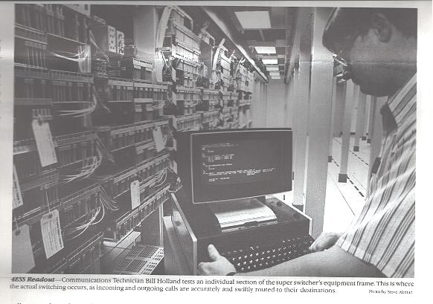
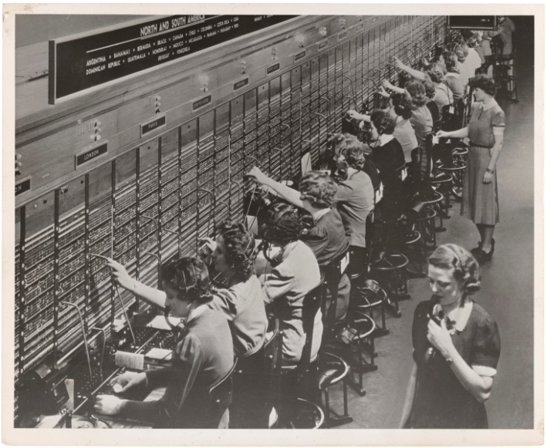
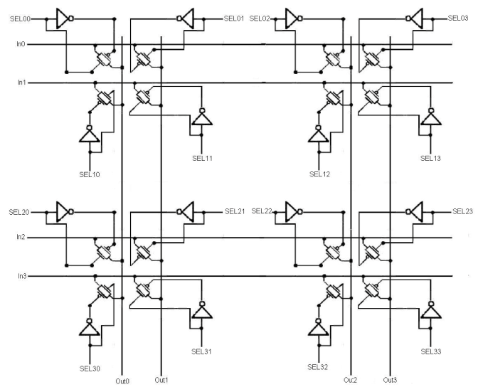
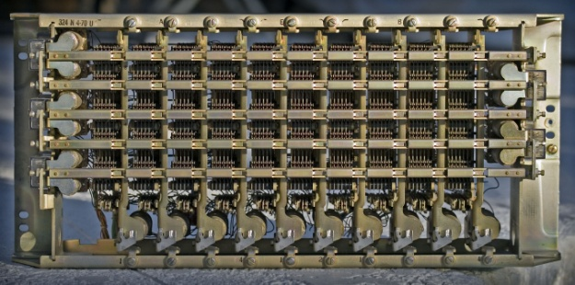
Circuit Switching
The main alternative to packet switching
  provides a dedicated communication channel (a circuit) to transmits information, not packets, from source to destination
    telephone networks have traditionally used circuit switching
  calls for an initial setup phase, but then data flows continuously and unimpeded
  relatively simple technology developed and evolved over more than 100 years

Slide 14
Packet vs. Circuit Switching
Lets compare packet and circuit switching
Two examples:
  File Transfer
  Streaming application
What are the delays involved with each?

Slide 15
Packet vs. Circuit Switching
File transfer – Packet
Sequence of n packet switches, links of speed c bits/sec, propagation delay of δ sec for each “hop”
File size M bits, packet header H bits, maximum packet payload size L bits
  Number of bits transmitted: M+⎡M/L⎤H – need to include header bits for all packets
  Last bit leaves source at t₀=(M+⎡M/L⎤H)/c – transmission of all the bits (payload+headers)
  Last bit arrives at first switch at t₁=t₀+δ =(M+⎡M/L⎤H)/c+δ – propagation time to next switch
  Last bit leaves first switch at time t₂=t₀+δ+(L+H)/c – transmission time of last packet
    Assumes that packet must be fully received before being retransmitted – no cut-through
  Last bit leaves last (nth) switch at t_{2n}=t₀ + nδ + n(L+H)/c - repeats at each switch
  Last bit arrives at destination at t_{2n+1}=t_{2n}+ δ
Total minimum download time P_{d}= (M+⎡M/L⎤H)/c + n(L+H)/c + (n+1)δ
M=10⁶ bits, H=100 bits, L=10000 bits, c=10⁶ bits/sec, δ=5 msec, n=4 T_{d}=1.075 sec
M=10⁶ bits, H=100 bits, L=10000 bits, c=10⁹ bits/sec, δ=5 msec, n=4
T_{d}=26.05 msec
M bits
c
L+H bits
c
L+H bits
c
L+H bits
c
L+H bits
c
n=4
M bits
δ
δ
δ
δ
δ
Notes:
Last bit is part of last packet. Last packet starts transmitting once last bit has arrived.
Link speed: how many bits/sec we can push onto the link
Propagation delay: once a bit is on the link how long does it take to get to the other end.
M=10⁶: 1 Mbit c=10⁶ bits/sec: 1 Mb/s c=10⁹ bits/sec: 1 Gb/s

Slide 16
Packet vs. Circuit Switching
File transfer – Circuit
Sequence of n circuit switches, circuit of speed c bits/sec, propagation delay of δ sec for each “hop”
File size M bits, setup processing time of σ at each hop
  Initiate connection at t=0
  Circuit setup time: 2(n+1)(δ+σ) - setup message from source to destination and back
  Last bit leaves source at t₀= M/c +2(n+1)(δ+σ) – transmission of all payload bits
  Last bit arrives at destination at t_{2n+1}=t₀ + (n+1)δ – end-to-end propagation
Total download time C_{d}= 2(n+1)(δ+σ) + M/c + (n+1)δ
M=10⁶ bits, c=10⁶ bits/sec, δ=5 msec, σ=1 msec, n=4 T_{d}=1.085 sec
M=10⁶ bits, c=10⁹ bits/sec, δ=5 msec, σ=1 msec, n=4
T_{d}=86 msec
M bits
c
c
c
c
c
n=4
M bits
δ
δ
δ
δ
δ

Slide 17
Packet vs. Circuit Switching
File transfer
Packet download time
P_{d}= (M+⎡M/L⎤H)/c + n(L+H)/c + (n+1)δ
Circuit download time
C_{d}= 2(n+1)(δ+σ) + M/c + (n+1)δ
Difference:
P_{d} – C_{d}= ⎡M/L⎤H/c +n[(L+H)/c – 2(n+1)(σ+δ)
  Basically header overhead + hop-by-hop retransmissions versus setup delay. As c increases, packet switching becomes more attractive (for file transfers)

Slide 18
Packet vs. Circuit Switching
Streaming application – Packet
Sequence of n packet switches, links of speed c bits/sec, propagation delay of δ sec per “hop”
Application generates bits at a rate of R bits/sec, packet header H bits, packet payload size L bits
  First bit of (new) packet payload generated at t=0
  Packet ready for transmission at t₀=L/R – L/R is the packetization delay
  Last bit arrives at first switch at t₁= L/R+ (L+H)/c + δ – transmission+propagation
  Last bit arrives at destination at t_{n+1}=t_{n}+ (L+H)/c + δ
Total minimum delay for first bit of packet: P_{S}= L/R + (n+1) [(L+H)/c + δ]
R=64,000 bits/sec, H=100 bits, L=1000 bits, c=10⁶ bits/sec, δ=5 msec, n=4 P_{S} =46.125 msec
R=64,000 bits/sec, H=100 bits, L=1000 bits, c=10⁹ bits/sec, δ=5 msec, n=4
P_{S} =40.63 msec
R bps
c
L+H bits
c
L+H bits
c
L+H bits
c
L+H bits
c
R bps
n=4
L+H bits
L+H bits
δ
δ
δ
δ
δ

Slide 19
Packet vs. Circuit Switching
Streaming application – Circuit
Sequence of n circuit switches, propagation delay of δ sec per “hop”
Application generates bits at a rate of R bits/sec (⇒ circuit of speed R bits/sec), setup processing time of σ at each hop
  Circuit setup time: T_{setup}=2(n+1)(δ+σ) - same as before
  No packetization delay!
    Bit b generated at time t₀ = 0
    Bit b leaves source at time t₀
  Bit b arrives at/leaves switch i at time t_{i} = t₀+iδ
  Bit b arrives at arrives at destination at t_{n+1} = t₀+(n+1)δ
Total bit transfer delay C_{S}= (n+1)δ (basically just propagation delay)
δ=5 msec, σ=1 msec, n=4
C_{S} =25 msec; T_{setup}=60 msec (but only relevant to first bit)
R bps
R bps
R
R
R
R
R
n=4
δ
δ
δ
δ
δ

Slide 20
Packet vs. Circuit Switching
Streaming application
Packet streaming delay
P_{S} = L/R + (n+1) [(L+H)/c + δ]
Circuit delay
C_{S} = (n+1)δ
Difference: P_{S} – C_{S} = L/R + (n+1)(L+H)/c
  Basically packetization + hop-by-hop retransmissions.
  As R and c increase, packet switching is less at a disadvantage
  But there are many other factors to consider, e.g., coding and decoding delay, etc.

Slide 21
More on Delay in Packet Networks
Three main sources of network delay
  Transmission delay:
    Time to get bits sent onto a link
  Propagation delay:
    Time for bits to travel along a path
  Queuing delay:
    Time bits spend waiting in a queue (before a link)
Notes:
That is our quick look at circuit switched networks.
Now back to what we really care about, packet networks.

Slide 22
Delays in Packet Networks
Transmission delay: time to send a given number of bits (e.g., a packet) onto a link of a given transmission rate (bits/sec)
    Function of packet size and link speed, T=L/c, L is packet size (in bits) and c is link speed (in bits/sec)
Propagation delay: time for signals to travel over a given distance (τ = l/s, l is distance, s is signal propagation speed)
    s is upper-bounded by speed of light, but typically lower in fiber, cables and atmosphere (from 180,000 km/sec to 300,000 km/sec), i.e., around 25 msec coast-to-coast in the US
    We will typically approximate this to 200,000 km/sec

Slide 23
Delays in Packet Networks
Queuing delay (waiting time): Caused by contention for transmission resources (multiple packets seeking transmission on the same link)
  Queueing delay
    N is the number of packets in the queue (when a new packet arrives)
    L_{i}, i = 1,…,N, is the size of packet i in bits
    Σ_{i=1,…,N} L_{i} is number of bits ahead of you (assumes FCFS)
    c is link speed in bits/sec
    Queueing delay is then Σ_{i=1,…,N} L_{i}/c
  Average queueing delay W
    E[N] x E[L] is the number of bits already in the queue on average when a new packet arrives
    Hence, W = (E[N] x E[L])/c is, the average time it takes to transmit bits ahead in the queue, a.k.a., average queueing delay

Slide 24
Revisiting Total Network Delay
File transfer completion
  Time until last packet is ready for transmission by the source
  Plus sum of transmission, propagation, and queueing delays at all hops for last packet
  P_{d}= (M+⎡M/L⎤H)/c + n(L+H)/c + (n+1)δ +Σ_{i=1,…,n} W_{i}
Streaming application delay
  Packetization delay (L/R)
  Plus sum of transmission, propagation, and queueing delays at all hops for each packet
  P_{S}= L/R + (n+1) [(L+H)/c + δ] + Σ_{i=1,…,n} W_{i}
Notes:
File Transfer: What we care about is the time from t0 until last packet is received.
⎡M/L⎤ : is the number of packets
(M+⎡M/L⎤H)/c : Transmission delay at source, time to get last packet out
n[(L+H)/c] : Sum of transmission delays at n routers/switches
(n+1) δ : propagation delay over the n+1 links.
Streaming application: What we care about is delay for any particular bit.

Slide 25
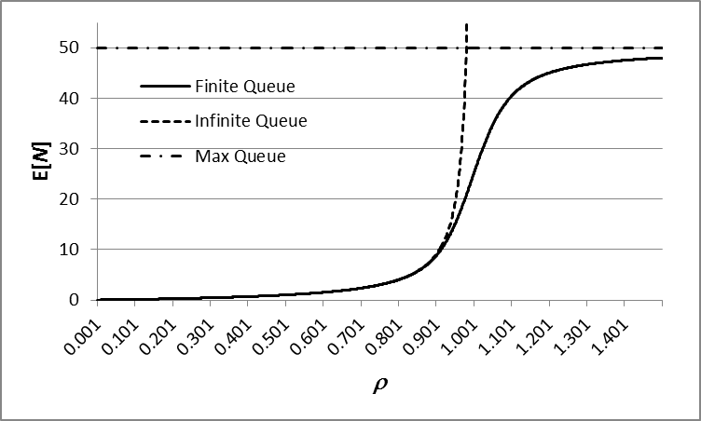
Estimating (Average) Queueing Delay
(at a single link)
Estimating average packet size E[L] is relatively easy
Link speeds c are known
The main issue is estimating average queue size E[N]
Key parameters
  Traffic load ρ=aE[L]/c, where a is packet arrival rate
  Maximum number of packets: B
Infinite queue approx.
  E[N]≈ ρ/(1-ρ)
  Assumes “random” packet arrivals and lengths
  Reasonable for ρ below 0.8
Exact finite queue expression
for ρ=0.8 E[N]=4, so that if E[L]=5,000 bits and c=10⁸ bps, W=200 μsec

Slide 26
Other Performance Metrics
Throughput: rate at which data can be transferred across the network
  In a circuit-switched network, throughput is fixed and equal to the circuit rate
  In a packet-switched network, throughput is variable (depends on interactions with other packets), but can be as high as the link rate
Packet loss: fraction of packets not properly delivered (lost or corrupted – the former is much more prevalent, except in wireless networks)
  In networks, losses depend mostly on traffic load (ρ) and queue size B
  Approximate expression for packet loss probability P_{B}
  Accurate for random packet arrivals and lengths
Notes:
Delay is important but so are some other metrics

Slide 27






The Tiered Structure of the Internet
Network edge
  hosts and applications
  application architectures
    client/server, peer-to-peer
Access network
  physical media
    wired Ethernet, wireless,
    DSL, cable networks, ...
  access network components
    DSL modems, firewalls, network address translators, ...
Network core
  interconnected routers and related services
    Domain Name Service (DNS), routing protocols
  enable communication among a “network of networks”
core
access
edge
Notes:
Shift gears now and pop back up to the top level of the Internet

Slide 28
Access Networks
First-hop – from end systems to access routers
Common types
  residential access – dial-up, DSL, cable modems, fiber-to-home
  institutional access – universities, businesses, governments
  mobile access – for cell phone, tablets
Key attributes
  network data rates
    50 Kb/s for dialup to 10 Gb/s (or more) for wired Ethernet in institutional networks and data centers
  dedicated or shared
    in shared access, must compete for access bandwidth with other users, making service more variable, e.g., WiFi
  susceptibility to interference and eavesdropping
    service quality in wireless networks can be highly variable
    encryption essential for privacy

Slide 29
Network Core
Rough hierarchy of Internet Service Providers
  Tier 1 ISPs operate at national/international scale
    large routers (Tb/s capacities) and growing
    connected by high speed links (10 to 40 Gb/s)
  Tier 2 ISPs operate on regional scale
  Tier 3 ISPs operate on local scale, provide access
  Large content providers (Google, Akamai, ...) operate partly like Tier 1 ISPs
Internet is a “network of networks”
  packets pass through many networks on their way from source to destination
  requires cooperation among providers and mechanisms to share cost and revenue
  ownership and management highly distributed
  ~12,000 ISPs today
    Exact number is hard to pin down…

Slide 30
Internet Protocol Layers
Application layer (messages)
  implements user applications
    email, web browsing
Transport layer (segments)
  concerned with moving data
  between processes on hosts
    UDP and TCP
Network layer (datagrams/packets)
  concerned with moving datagrams/packets from host to host through network of routers
    IP
Link layer (frames)
  concerned with moving frames across local network
    Ethernet
Physical Layer (bits)
  transferring bits across physical medium
Application
Transport
Network
Link
Physical
Application
Transport
Network
Link
Physical
Network
Link
Physical
host
router
host
Notes:
Data units each layer works with are listed in parens

Slide 31
Layers and Encapsulation
Layers make network design more modular
  separate functions allowing different parts of a network to be changed without affecting other parts
  “layer violations” inhibit the ability to make changes
  layer violations have become common in modern internet
    firewalls, middle-boxes, cross-layer optimizations for better wireless performance
As packets go “down the stack”, each layer adds its own packet header (encapsulation)
  UDP (alternatively TCP) adds 8 bytes (20) at transport layer
  IPv4 (alternatively IPv6) adds 20 bytes (40) at network layer
  Ethernet typically adds 26 bytes at link layer
As packets go back “up the stack”, headers are removed (decapsulation)

Slide 32
Internet Security (or Insecurity)
Internet designed with little thought for security
  designed for well-intentioned and cooperative users
    in the modern internet, reality is very different
Variety of tools at disposal of “bad guys”
  insert malware on hosts via virus, worm, Trojan horse,...
  use malware to spy on users, steal passwords
  use subverted hosts to send spam, launch DDoS attacks
  evade detection using source-address spoofing
  eavesdrop on other users as packets pass through shared networks
  record and playback encrypted passwords
Defenses
  keep up with security patches
  virus/malware detection and removal
  use strong encryption for all sensitive information

Slide 33
Exercises
Which of the following are not valid IPv4 addresses?
  a) 12.34.5.57 b) 134.25.321.44 c) 0x23fed97c
  0.0.0.0 e) 0x1435c984b f) 275.31.48.21

Slide 34
Exercises
Which of the following are not valid IPv4 addresses?
  a) 12.34.5.57 b) 134.25.321.44 c) 0x23fed97c = 35.254.217.23
  0.0.0.0 e) 0x1435c984b f) 275.31.48.21
  both b) and f) have numbers greater than 255, which is not possible given the 8-bit limitation of each number in a 32-bit IP address.
  e) involves 9 hex characters, which is too many for a 32-bit address.

Slide 35
Exercises
Suppose that 100 packets arrive at a router all at the same time, and must be sent out on the same output link. If it takes 5 μs to transmit one packet, what is the maximum delay experienced by the arriving packets? What is the minimum delay? What is the average delay?

Slide 36
Exercises
Suppose that 100 packets arrive at a router all at the same time, and must be sent out on the same output link. If it takes 5 μs to transmit one packet, what is the maximum delay experienced by the arriving packets? What is the minimum delay? What is the average delay?
If you have 100 packets waiting, the delay of the first is 5μsecs, the delay of the last is 500μsecs, and the average delay is 252.5μsecs

Slide 37


Exercises
Consider the network path shown below. What is the total end-to-end delay for a packet sent from A to B?
  Labels above the links denote their transmission rates (so the middle link has a rate of 1 Gb/s, i.e., 10⁹ bits/sec). The labels below the links are their lengths in km (signals propagate at 200,000 km/sec). Traffic intensities are shown at the left end of each link. The average packet length is 250 bytes. Assume infinite queues at each node.
10G
1G
1G
2M
10M
.1 km
200 km
1000 km
2 km
.02 km
A
ρ=.9
ρ =.98
ρ =.5
ρ =.1
B

Slide 38
Exercises
Consider the network path shown below. What is the total end-to-end delay for a packet sent from A to B?
  Labels above the links denote their transmission rates (so the middle link has a rate of 1 Gb/s, i.e., 10⁹ bits/sec). The labels below the links are their lengths in km (signals propagate at 200,000 km/sec). Traffic intensities are shown at the left end of each link. The average packet length is 250 bytes.
  First calculate average queue sizes.
  Next we need the transmission delay at each hop for 1 pkt.
  Then apply that to the queue sizes + 1. Then calculate propagation delay. Sum that all up and we have 8.35 ms.
10G
1G
1G
2M
10M
.1 km
200 km
1000 km
2 km
.02 km
A
ρ=.9
ρ =.98
ρ =.5
ρ =.1
B
 | 1 | 2 | 3 | 4 | 5 | E2E
Load ( ρ ) | 0 | 0.9 | 0.98 | 0.5 | 0.1
Link rate (b/s) | 1.00E+10 | 1.00E+09 | 1.00E+09 | 2.00E+06 | 1.00E+07
Link length (km) | 0.1 | 200 | 1000 | 2 | 0.02
Average queue length (pkts): E[N] = ρ/(1− ρ) | 0 | 9 | 49 | 1 | 0.111111
Packet transmission time (sec): T = L/c | 2.00E-07 | 2.00E-06 | 2.00E-06 | 1.00E-03 | 2.00E-04
Queueing + transmission delay (sec): (E[N]+1)*T | 2.00E-07 | 2.00E-05 | 1.00E-04 | 2.00E-03 | 2.22E-04 | 2.34E-03
Propagation delay (sec): link length/200,000 km/s | 5.00E-07 | 1.00E-03 | 5.00E-03 | 1.00E-05 | 1.00E-07 | 6.01E-03
 |  |  |  |  |  | 8.35E-03

Slide 39
Exercises
Using the previous exercise, the traffic intensity at the 2 Mb/s link increases to 1.5, so that the average queueing delay at the link increases to 200 ms, what is the capacity of the queue feeding the link? What fraction of packets are discarded?

Slide 40
Exercises
Using the previous exercise, the traffic intensity at the 2 Mb/s link increases to 1.5, so that the average queueing delay at the link increases to 200 ms, what is the capacity of the queue feeding the link? What fraction of packets are discarded?
Assuming that under a load of 1.5, the queue is nearly full all the time, the queue size or capacity is 200 packets (the transmission time of a 250 bytes = 2,000 bits packet over a 2 Mbits/sec link is 1 ms). A queue size of 200 packets translates into 200*250 = 50 kbytes.
Given a load of 1.5, about 1/3 of the packets are lost (roughly (ρ -1)/ρ : explanation on next page)

Slide 41
Exercises
Continued…
A load of ρ = 1.5 means that for a link of capacity c bits/sec, we are trying to push 1.5 x c bits/sec. Ignoring packet granularity and focusing on bits, this means that for every 2 bits we transmit, the input link brings in 3 bits. The transmission of 2 bits frees up 2 bits in the buffer that can then accommodate 2 of the 3 arriving bits, but the 3rd is lost. Hence the fraction of bits we lose is 1/3rd or in other words, a loss probability of 1/3rd, which is indeed equal to (ρ -1)/ρ = 0.5/1.5 = 1/3rd

