Slide 1
7. Auxiliary Internet Protocols
Internet Control Message Protocol (ICMP)
Dynamic Host Configuration Protocol (DHCP)
Network Address Translation (NAT)
Roch Guerin
(with adaptations from Jon Turner and John DeHart, and material from Kurose and Ross)

Slide 2
Internet Control Message Protocol RFC 792
Used mainly to detect or report problems
Part of IP protocol suite, but implemented “above” IP layer
Not a Transport protocol
Nothing layers on top of ICMP
IP protocol field=1 identifies ICMP packet
type and code fields specify various options
Examples
echo packet (used by ping command)
destination unreachable
Remainder varies with ICMP type
often includes IP header of original packet plus first 8 bytes of its payload
this information can often be used to determine cause of a problem
4 | 4 |  | 8 | 16 bits
ver | hlen |  | TOS | length
identification |  |  |  | flags |  | offset
TTL |  | proto =1 |  | checksum
source address
destination address
type |  | code |  |  | checksum
remainder (variable)

Slide 3
Common ICMP Messages
ICMP echo
used by ping command to verify reachability
request uses type 4, reply uses type 0
Destination unreachable (type 3)
code 0 means destination network cannot be reached
code 1 means host cannot be reached
code 2 means specified protocol not available at destination
code 3 means specified port not available at destination
code 6 means specified network does not exist
code 7 means specified host does not exist
Others
type 11 means TTL expired
type 12 means that error detected in IP header format

Slide 4
Traceroute and ICMP
R₁
R₂
Traceroute: Utility to identify routers on a path
Also gives us RTT information
Relies on ICMP TTL expired (type=11) packet
Source sends series of UDP segments to destination
first has TTL=1, second has TTL=2, etc.
Uses an unlikely port number
When TTL expires, router discards it
sends ICMP “TTL expired” packet (type 11) back to source
packet includes name of router and its IP address
Does not always work
target router or firewall on return path may drop ICMP packets

Slide 5
Traceroute and ICMP
...
ttl =1
...
R₁
R₂
...
exp ttl R₁
...
Source sends pkt with TTL=1
When it reaches R1, TTL has expired
Each Router decrements TTL and will NOT send on if TTL == 0
R1 sends back ICMP TTL expired

Slide 6
Traceroute and ICMP
...
ttl =2
...
...
ttl =1
...
R₁
R₂
...
exp ttl R₂
...
Sources sends pkt with TTL=2
R1 decrements TTL and forwards packet on.
When it reaches R2, TTL has expired
R2 sends back ICMP TTL expired

Slide 7
traceroute.org
Gives a list of traceroute servers from around the world
You can select a server and give it an address or hostname and it will perform a traceroute from that server to that host
Some appear to be not working now.
Try the Princeton server
The following slides show some examples.

Slide 8
traceroute.org A fully successful trace:
$ nslookup www.nytimes.com
Name: www.gtm.nytimes.com
Address: 170.149.168.130
Aliases: www.nytimes.com
tracing path from www.net.princeton.edu to 170.149.168.130 ...
traceroute to 170.149.168.130 (170.149.168.130), 30 hops max, 40 byte packets
1 core-87-router (128.112.128.2) 0.607 ms 0.376 ms 0.572 ms
2 border-87-router (128.112.12.142) 0.461 ms 0.351 ms 0.333 ms
3 te0-0-1-1.204.rcr12.phl03.atlas.cogentco.com (38.122.150.1) 3.356 ms 3.337 ms 3.263 ms
4 te2-8.ccr01.phl01.atlas.cogentco.com (154.54.27.117) 2.972 ms te4-3.ccr01.phl01.atlas.cogentco.com (66.28.4.233) 2.892 ms 2.806 ms
5 te0-0-0-19.mpd21.jfk02.atlas.cogentco.com (154.54.2.110) 5.810 ms te0-0-0-7.ccr22.jfk02.atlas.cogentco.com (154.54.31.53) 5.974 ms te0-0-0-19.mpd21.jfk02.atlas.cogentco.com (154.54.2.110) 5.927 ms
6 be2057.ccr21.jfk10.atlas.cogentco.com (154.54.80.178) 6.162 ms be2056.ccr21.jfk10.atlas.cogentco.com (154.54.44.218) 6.255 ms be2059.ccr21.jfk10.atlas.cogentco.com (154.54.1.222) 6.788 ms
7 level3.ord03.atlas.cogentco.com (154.54.13.10) 5.724 ms 7.982 ms 5.682 ms
8 ae2.cr1.lga5.us.above.net (64.125.31.213) 7.682 ms 6.972 ms 5.903 ms
9 xe-2-2-0.mpr1.ewr1.us.above.net (64.125.27.133) 6.468 ms 7.020 ms 6.360 ms
10 xe-0-0-0.mpr1.ewr4.us.above.net (64.125.25.246) 6.607 ms 6.565 ms 6.683 ms
11 64.125.173.70.t01646-03.above.net (64.125.173.70) 6.726 ms 6.786 ms 22.894 ms
12 170.149.168.130 (170.149.168.130) 6.902 ms 7.259 ms 9.523 ms
Done.

Slide 9
traceroute.org Example not reaching final destination. Firewall blocking ICMP?
$ nslookup www.comcast.com
Name: www-prd.g.comcast.com
Address: 68.87.29.59
Aliases: www.comcast.com
tracing path from www.net.princeton.edu to 68.87.29.59 ...
traceroute to 68.87.29.59 (68.87.29.59), 30 hops max, 40 byte packets
1 core-87-router (128.112.128.2) 0.688 ms 0.533 ms 0.459 ms
2 border-87-router (128.112.12.142) 0.558 ms 0.463 ms 0.365 ms
3 63-138-53-73.customer.static.ip.paetec.net (63.138.53.73) 3.184 ms 3.077 ms 3.029 ms
4 TE-0-1-0-0.NYCMNYBXH71CR03.paetec.net (67.151.33.20) 4.150 ms 4.081 ms 7.660 ms
5 BE1.nycmny83iy6ig02.paetec.net (169.130.82.126) 6.055 ms 5.494 ms 3.703 ms
6 146.82.34.141 (146.82.34.141) 3.224 ms 6.536 ms 3.240 ms
7 vlan70.csw2.NewYork1.Level3.net (4.69.155.126) 3.515 ms vlan60.csw1.NewYork1.Level3.net (4.69.155.62) 3.630 ms 5.913 ms
8 * * *
9 * * *
10 ae-1-51.edge1.NewYork2.Level3.net (4.69.138.194) 3.520 ms ae-2-52.edge1.NewYork2.Level3.net (4.69.138.226) 3.454 ms 3.617 ms
11 comcast-level3.NewYork2.level3.net (4.68.127.2) 7.691 ms 7.852 ms 7.976 ms
12 he-0-2-0-0-ar02-d.westchester.pa.bo.comcast.net (68.86.91.178) 8.009 ms 11.143 ms 7.904 ms
13 te-4-1-ur08-d.westchester.pa.bo.comcast.net (68.85.215.150) 7.944 ms 7.851 ms 7.625 ms
14 * * *
15 * * *
16 * * *
17 * * *

Slide 10
traceroute.org Example when akamai is used (CDN usage)
$ nslookup www.comcast.net (from WUSTL)
Name: a1526.dscg.akamai.net
Addresses: 2600:1402:a::b81a:8fb3
2600:1402:a::b81a:8fb8
184.51.150.139
184.51.150.107
Aliases: www.comcast.net
www.comcast.net.edgesuite.net
From Princeton traceroute server:
Warning: multiple IP addresses found for www.comcast.net, using 204.153.49.137
tracing path from www.net.princeton.edu to 204.153.49.137 ...
traceroute to 204.153.49.137 (204.153.49.137), 30 hops max, 40 byte packets
1 gigagate2 (128.112.64.1) 0.625 ms 0.456 ms 0.436 ms
2 a204-153-49-137.deploy.akamaitechnologies.com (204.153.49.137) 0.456 ms 0.591 ms 0.418 ms
Done.

Slide 11
traceroute.org WUSTL engineering firewall blocks ICMP?
$ nslookup www.cse.wustl.edu
Name: insularum2.seas.wustl.edu
Address: 128.252.202.246
Aliases: www.cse.wustl.edu
tracing path from www.net.princeton.edu to 128.252.202.246 ...
traceroute to 128.252.202.246 (128.252.202.246), 30 hops max, 40 byte packets
1 core-87-router (128.112.128.2) 0.624 ms 0.404 ms 0.361 ms
2 border-87-router (128.112.12.142) 0.440 ms 0.435 ms 0.410 ms
3 local1.princeton.magpi.net (216.27.98.113) 3.610 ms 2.604 ms 2.609 ms
4 remote.internet2.magpi.net (216.27.100.54) 5.807 ms 4.672 ms 4.672 ms
5 et-5-0-0.102.rtr.clev.net.internet2.edu (198.71.45.2) 22.392 ms 22.587 ms 22.132 ms
6 et-10-0-0.107.rtr.chic.net.internet2.edu (198.71.45.8) 31.979 ms 33.619 ms 32.202 ms
7 ae-1.2063.rtr.ictc.indiana.gigapop.net (149.165.254.185) 36.729 ms 36.481 ms 44.426 ms 8 et-3-0-0.1.rtr.ll.indiana.gigapop.net (149.165.255.194) 36.550 ms 36.766 ms 38.435 ms
9 149.165.254.142 (149.165.254.142) 46.351 ms 46.126 ms 46.461 ms
10 commodity-te-9-1.nts.wustl.edu (128.252.100.158) 47.066 ms 47.786 ms 46.599 ms
11 eth7-2-eps-core.nts.wustl.edu (128.252.100.125) 51.867 ms 47.359 ms 47.771 ms
12 eng-epscore-p2p.nts.wustl.edu (128.252.1.50) 46.747 ms 47.081 ms 46.620 ms
13 * * *
14 * * *
15 * * *
16 * * *

Slide 12
Dynamic Host Configuration Protocol RFC 2131
A host’s IP address can be set manually by a system administrator
to do this right, need to know the subnet where the computer connects and which addresses are still available
DHCP automates this chore, allowing a host to obtain its address automatically when it joins network
allows “sequential re-use” of addresses
support for mobile users who want to join network
Client-Server protocol

Slide 13
Dynamic Host Configuration Protocol RFC 2131
DHCP overview:
Client broadcasts “DHCP discover” message [optional]
Looking for a server
DHCP server responds with “DHCP offer” message [optional]
Server offering service including address and other parameters
Many servers may respond to a Discover
Client requests IP address in “DHCP request” message
This requests the offered parameters from a DHCP Offer
Implicitly declines other offers other servers might have sent.
DHCP server sends address in “DHCP ack” message
Server commits to its offer

Slide 14
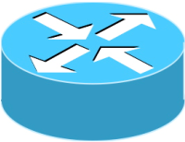
DHCP Client-Server Scenario
A
223.1.2.1
A
223.1.1.1
DHCP
server
223.1.1.2
223.1.1.4
223.1.2.9
223.1.1.3
B
223.1.2.2
arriving DHCP
client needs
address in this
network
223.1.3.27
C
223.1.3.2
223.1.3.1

Slide 15
DHCP Client-Server Scenario
DHCP server: 223.1.2.5
DHCP discover
arriving
host
src : 0.0.0.0, 68
dest.: 255.255.255.255,67
yiaddr: 0.0.0.0
transaction ID: 654
or set to 223.1.2.4
if client can receive
unicast IP messages
before having an IP
address
DHCP offer
src: 223.1.2.5, 67
dest: 255.255.255.255, 68
yiaddr: 223.1.2.4
transaction ID: 654
Lifetime: 3600 secs
stands for “your internet address”
DHCP request
src: 0.0.0.0, 68
dest:: 255.255.255.255, 67
yiaddr: 223.1.2.4
transaction ID: 654
Lifetime: 3600 secs
time
DHCP ACK
src: 223.1.2.5, 67
dest: 255.255.255.255, 68
yiaddrr: 223.1.2.4
transaction ID: 654
Lifetime: 3600 secs

Slide 16
Some Details
Assigned addresses must be “renewed” before they timeout
Client sends new DHCP request, asking for its previously assigned address
Client may release its address when finished
allows immediate reuse
server does not rely on this, since client crashes or software bugs may prevent release – example of soft-state in protocols
DHCP can return more than just allocated IP address on subnet
address of first-hop router for client
name and IP address of DNS server
network mask for client’s subnet
defining the prefix that identifies the subnet (more on this later)

Slide 17
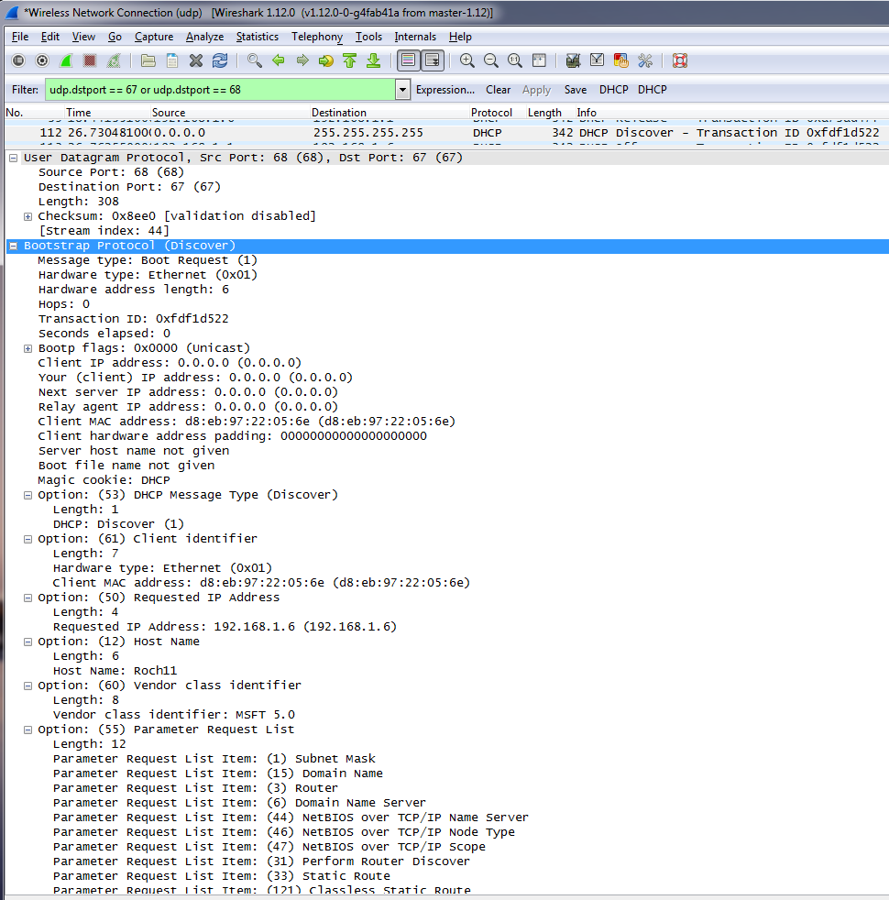
DHCP: Wireshark Output (home LAN)
DHCP Discover

Slide 18
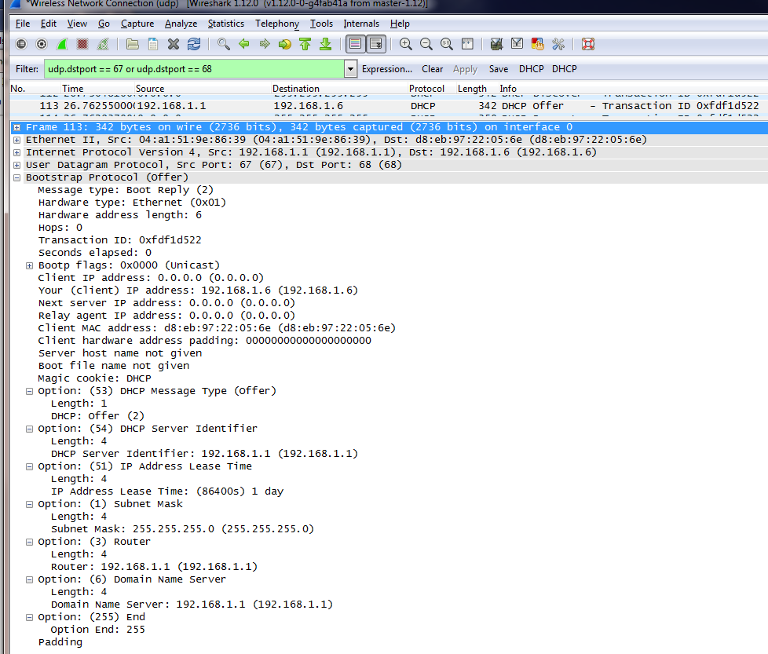
DHCP: Wireshark Output (home LAN)
DHCP Offer

Slide 19
Network Address Translation
NAT allows multiple hosts in a local network (most often a home net) to share a single public IP address
this conserves limited IPv4 addresses and since ISPs charge for static addresses, it allows users to save money
Other advantages
home nets can add new hosts at anytime without requiring new addresses from ISP
home nets all reuse the same set of (private) IP addresses
insulates administration of home net from outside world
devices inside local net not directly addressable from the outside, making network (a little) more secure
Drawbacks and Objections?
There are a few…

Slide 20
Network Address Translation
Drawbacks and Objections:
Uses Transport layer port numbers to address hosts instead of processes
NAT Router needs to process above layer 3
Violates end-to-end argument. Not strictly host talking to host anymore. NAT router changes headers in between.
Interferes with peer to peer applications.
What about protocols that don’t use port numbers?
NAT violates layer boundaries, making it more difficult to change internet protocols over time

Slide 21
A Closer Look At NAT
rest of
Internet
local network
(e.g., home network)
10.0.0/24
10.0.0.2
10.0.0.1
10.0.0.3
138.76.29.7
10.0.0.4
All datagrams leaving local
network have same single source NAT IP address: 138.76.29.7,
different source port numbers
Datagrams with source or
destination in this network
have 10.0.0/24 address for
source, destination (typically)

Slide 22
Implementing NAT
NAT device maintains a table that maps external port numbers to internal (IP,port) pairs
table entries are used to update IP headers of packets as they enter or leave the network
since there are >65,000 ports, can support many hosts
but, how are the entries created?
For UDP, if an outgoing packet has unknown source (IP,port) pair, NAT creates entry with new external port
this can then be used for subsequent packets and is retained until a timeout expires
note need outgoing packet to create entry
For TCP, connection created when NAT observes outgoing packet with SYN flag set
entry is retained until connection is closed

Slide 23
More Details
What about protocols other than UDP/TCP?
a robust NAT implementation must handle all of them
many don’t use port numbers, so NAT must provide protocol-specific methods to map between external and internal packets
e.g. ICMP echo request/reply (uses ID field)
What about IP addresses that appear in higher-level data?
FTP carries IP addresses of connected hosts in the application layer byte-stream (recall, FTP runs over TCP)
NAT must recognize FTP packets, find IP addresses in byte streams and re-map them
NAT is dependent on details of many higher level protocols
changing those protocols has potential to break NAT
this inhibits making changes to protocols or adding new ones

Slide 24
NAT Traversal
NAT requires an outgoing packet to trigger creation of a table entry
works fine, so long as inside hosts talk only to “public” servers (can find its public address by talking to DNS)
but how does host behind a NAT talk to host behind another NAT?
option 1: statically configure “port map” in NAT device and somehow let the remote host know the port number (and IP address) to use
option 2: communicate through a non-NAT-ed intermediary
intermediary can relay packets between two NAT-ed hosts
NAT-ed host connect to external intermediary first
UDP mappings can then be “handed-off” to enable direct communication
common solution used in p2p applications

Slide 25
Using Intermediary for NAT Traversal
S
2.3.4.5
A
N1
N2
B
10.0.1.8
1.2.3.4
5.6.7.8
10.0.1.9
A & B connect to S using src ports a1 and b1, respectively, and tell S that they want to talk to each other
N1 creates mapping <10.0.1.8,a1:X>; N2 creates mapping <10.0.1.9,b1:Y>
S receives packets <1.2.3.4,X;2.3.4.5,P1> from A and <5.6.7.8,Y;2.3.4.5,P2> from B
S “passes” <5.6.7.8,Y> to A and <1.2.3.4,X> to B
S packet header to A is <2.3.4.5,P1;1.2.3.4,X> and <2.3.4.5,P2;5.6.7.8,Y> to B
A sends packets to <10.0.1.8,a1;5.6.7.8,Y>
N1 converts it to <1.2.3.4,X;5.6.7.8,Y> - Note that this assumes that N1 is oblivious to the fact that A is sending to different IP address and port number, i.e., <5.6.7.8,Y> as opposed to <1.2.3.4,P1> in the original exchange with S – not all routers do that
N2 receives packet <1.2.3.4,X;5.6.7.8,Y> and converts it to <1.2.3.4,X;10.0.1.9,b1>
Packets are delivered to B
Symmetric process for responses from B

Slide 26
NAT Traversal
option 3: using Universal Plug and Play NAT device (UPnP)
host behind NAT can discover existence of UPnP-capable NAT device and automatically install port maps
allows applications to create port maps as needed
requires UPnP-capable NAT device and UPnP-aware hosts & app
UPnP somewhat controversial due to security vulnerabilities
option 4: SOCKS v5 protocol (RFC 1928)
Requires availability of SOCKS server at remote site and SOCKS client in the local host (to redirect application network calls to the SOCK server)
Used mostly in corporate settings
Basically a “shim layer” between the application and transport layers

Slide 27
Exercises
Suppose host A sends a packet, and a short time later gets back an ICMP message with type=3 and code=2. Which of the following is the most likely explanation for the problem?
packet too large for some network, but do not fragment bit is set
the header checksum does not match the header contents
the TTL expired before the packet reached the destination
the value of the protocol field is not valid
the destination port number does not match an open socket at the destination host

Slide 28
Exercises
Suppose host A sends a packet, and a short time later gets back an ICMP message with type=3 and code=2. Which of the following is the most likely explanation for the problem?
packet too large for some network, but do not fragment bit is set
the header checksum does not match the header contents
the TTL expired before the packet reached the destination
the value of the protocol field is not valid
the destination port number does not match an open socket at the destination host
Type 3 indicates destination unreachable, while code 2 corresponds to protocol unreachable.
So the most likely cause from the above five listed reasons is d).

Slide 29
Exercises
Repeat the previous question, assuming that the returned ICMP packet has type=3 and code=3.
packet too large for some network, but do not fragment bit is set
the header checksum does not match the header contents
the TTL expired before the packet reached the destination
the value of the protocol field is not valid
the destination port number does not match an open socket at the destination host

Slide 30
Exercises
Repeat the previous question, assuming that the returned ICMP packet has type=3 and code=3.
packet too large for some network, but do not fragment bit is set
the header checksum does not match the header contents
the TTL expired before the packet reached the destination
the value of the protocol field is not valid
the destination port number does not match an open socket at the destination host
Code 3 corresponds to port unreachable. In this case, the most likely reason is e).

Slide 31
Exercises
Repeat the previous question, assuming that the returned ICMP packet has type=3 and code=4.
packet too large for some network, but do not fragment bit is set
the header checksum does not match the header contents
the TTL expired before the packet reached the destination
the value of the protocol field is not valid
the destination port number does not match an open socket at the destination host

Slide 32
Exercises
Repeat the previous question, assuming that the returned ICMP packet has type=3 and code=4.
packet too large for some network, but do not fragment bit is set
the header checksum does not match the header contents
the TTL expired before the packet reached the destination
the value of the protocol field is not valid
the destination port number does not match an open socket at the destination host
Code 4 indicates that fragmentation was needed (packet was too large for the link’s MTU) and the DF (don’t fragment) bit had been set in the packet header, which prevented fragmentation and led to the packet being dropped. This points to reason a).

Slide 33
Exercises
Suppose the received packet has type=11 and code=1. Who sent this packet?

Slide 34
Exercises
Suppose the received packet has type=11 and code=1. Who sent this packet?
Type 11 is a “Time Exceeded” message, while code 1 corresponds to “fragment reassembly time exceeded”. The likely sender of this packet is the destination host for the original packet, as code 1 indicates that reassembly of the original packet had been started (it must have been fragmented somewhere on the way), but that a fragment failed to arrive in time. The destination host is the only one who would be performing reassembly of fragments. Hence, the ICMP message must have originated with it.

Slide 35
Exercises
What is the purpose of the DHCP transaction id?
Consider a network in which there are two DHCP servers. If both send offer packets in response to a DHCP discover packet, what should the host do?
Why do you think that DHCP request packets are sent as broadcast packets, rather than unicast?

Slide 36
Exercises
What is the purpose of the DHCP transaction id?
To match DHCP offers to the original request
Consider a network in which there are two DHCP servers. If both send offer packets in response to a DHCP discover packet, what should the host do?
Why do you think that DHCP request packets are sent as broadcast packets, rather than unicast?

Slide 37
Exercises
What is the purpose of the DHCP transaction id?
To match DHCP offers to the original request
Consider a network in which there are two DHCP servers. If both send offer packets in response to a DHCP discover packet, what should the host do?
Select one server, e.g., the first to reply or the one it previously used, and extracts the selected server address form the server identifier option of the offer message. It then includes that address in the server identifier field of the subsequent request.
Why do you think that DHCP request packets are sent as broadcast packets, rather than unicast?

Slide 38
Exercises
What is the purpose of the DHCP transaction id?
To match DHCP offers to the original request
Consider a network in which there are two DHCP servers. If both send offer packets in response to a DHCP discover packet, what should the host do?
Select one server, e.g., the first to reply or the one it previously used, and extracts the selected server address form the server identifier option of the offer message. It then includes that address in the server identifier field of the subsequent request.
Why do you think that DHCP request packets are sent as broadcast packets, rather than unicast?
So that all servers that responded with an offer are aware of which one the user selected, and don’t wait for a request message that would never come.

Slide 39
Exercises
In the example of slide 19 (see below), if the new host arrived in the left-hand subnet (223.1.1.*), rather the right-hand subnet, how would it communicate with the DHCP server? (Recall that the discover packets are broadcast at the link rather than network layer).
A
223.1.2.1
A
223.1.1.1
DHCP
server
223.1.1.2
223.1.1.4
223.1.2.9
223.1.1.3
B
223.1.2.2
arriving DHCP
client needs
address in this
network
223.1.3.27
C
223.1.3.2
223.1.3.1

Slide 40
Exercises
In the example of slide 18, if the new host arrived in the left-hand subnet (223.1.1.*), rather the right-hand subnet, how would it communicate with the DHCP server? (Recall that the discover packets are broadcast at the link rather than network layer).
Assuming that the router on this network is configured to act as a BOOTP/DHCP relay agent (both protocols are sent on port 67), it will “forward” DHCP messages to DHCP servers on other subnets (see RFC 1542 for details)

Slide 41
Exercises
Consider two home networks A and B with public IP addresses 1.2.3.4 and 5.6.7.8 respectively. Suppose host a in network A wants to send a packet to host b in network B. Assume that a has local IP address 10.0.1.2 and that b has local IP 10.0.3.4. Suppose that the NAT box at A has the UDP mapping 10.0.1.2,12345 => 34567 and that B has the UDP mapping 10.0.3.4,43210 => 32156.
Consider a UDP packet from a to b that uses these mappings.
What are the values of the src addr, src port, dest addr and dest port fields when the packet is inside network A?
What are they when the packet goes through the public Internet?
What are they when the packet is inside network B?
Answer the above questions again for a reply packet from b to a.

Slide 42
Exercises
Consider two home networks A and B with public IP addresses 1.2.3.4 and 5.6.7.8 respectively. Suppose host a in network A wants to send a packet to host b in network B. Assume that a has local IP address 10.0.1.2 and that b has local IP 10.0.3.4. Suppose that the NAT box at A has the UDP mapping 10.0.1.2,12345 => 34567 and that B has the UDP mapping 10.0.3.4,43210 => 32156.
Consider a UDP packet from a to b that uses these mappings.
What are the values of the src addr, src port, dest addr and dest port fields when the packet is inside network A?
10.0.1.2,12345;5.6.7.8,32156
What are they when the packet goes through the public Internet?
What are they when the packet is inside network B?
Answer the above questions again for a reply packet from b to a.

Slide 43
Exercises
Consider two home networks A and B with public IP addresses 1.2.3.4 and 5.6.7.8 respectively. Suppose host a in network A wants to send a packet to host b in network B. Assume that a has local IP address 10.0.1.2 and that b has local IP 10.0.3.4. Suppose that the NAT box at A has the UDP mapping 10.0.1.2,12345 => 34567 and that B has the UDP mapping 10.0.3.4,43210 => 32156.
Consider a UDP packet from a to b that uses these mappings.
What are the values of the src addr, src port, dest addr and dest port fields when the packet is inside network A?
10.0.1.2,12345;5.6.7.8,32156
What are they when the packet goes through the public Internet?
1.2.3.4,34567; 5.6.7.8,32156
What are they when the packet is inside network B?
Answer the above questions again for a reply packet from b to a.

Slide 44
Exercises
Consider two home networks A and B with public IP addresses 1.2.3.4 and 5.6.7.8 respectively. Suppose host a in network A wants to send a packet to host b in network B. Assume that a has local IP address 10.0.1.2 and that b has local IP 10.0.3.4. Suppose that the NAT box at A has the UDP mapping 10.0.1.2,12345 => 34567 and that B has the UDP mapping 10.0.3.4,43210 => 32156.
Consider a UDP packet from a to b that uses these mappings.
What are the values of the src addr, src port, dest addr and dest port fields when the packet is inside network A?
10.0.1.2,12345;5.6.7.8,32156
What are they when the packet goes through the public Internet?
1.2.3.4,34567; 5.6.7.8,32156
What are they when the packet is inside network B?
1.2.3.4,34567;10.0.3.4,43210
Answer the above questions again for a reply packet from b to a.

Slide 45
Exercises
Consider two home networks A and B with public IP addresses 1.2.3.4 and 5.6.7.8 respectively. Suppose host a in network A wants to send a packet to host b in network B. Assume that a has local IP address 10.0.1.2 and that b has local IP 10.0.3.4. Suppose that the NAT box at A has the UDP mapping 10.0.1.2,12345 => 34567 and that B has the UDP mapping 10.0.3.4,43210 => 32156.
Consider now a UDP packet from b to a that uses these mappings.
What are the values of the src address, src port, dest address and dest port fields when the packet is inside network B?
What are they when the packet goes through the public internet?
What are they when the packet is inside network A?

Slide 46
Exercises
Consider two home networks A and B with public IP addresses 1.2.3.4 and 5.6.7.8 respectively. Suppose host a in network A wants to send a packet to host b in network B. Assume that a has local IP address 10.0.1.2 and that b has local IP 10.0.3.4. Suppose that the NAT box at A has the UDP mapping 10.0.1.2,12345 => 34567 and that B has the UDP mapping 10.0.3.4,43210 => 32156.
Consider now a UDP packet from b to a that uses these mappings.
What are the values of the src address, src port, dest address and dest port fields when the packet is inside network B?
10.0.3.4, 43210; 1.2.3.4, 34567
What are they when the packet goes through the public internet?
What are they when the packet is inside network A?

Slide 47
Exercises
Consider two home networks A and B with public IP addresses 1.2.3.4 and 5.6.7.8 respectively. Suppose host a in network A wants to send a packet to host b in network B. Assume that a has local IP address 10.0.1.2 and that b has local IP 10.0.3.4. Suppose that the NAT box at A has the UDP mapping 10.0.1.2,12345 => 34567 and that B has the UDP mapping 10.0.3.4,43210 => 32156.
Consider now a UDP packet from b to a that uses these mappings.
What are the values of the src address, src port, dest address and dest port fields when the packet is inside network B?
10.0.3.4, 43210; 1.2.3.4, 34567
What are they when the packet goes through the public internet?
5.6.7.8,32156;1.2.3.4,34567
What are they when the packet is inside network A?

Slide 48
Exercises
Consider two home networks A and B with public IP addresses 1.2.3.4 and 5.6.7.8 respectively. Suppose host a in network A wants to send a packet to host b in network B. Assume that a has local IP address 10.0.1.2 and that b has local IP 10.0.3.4. Suppose that the NAT box at A has the UDP mapping 10.0.1.2,12345 => 34567 and that B has the UDP mapping 10.0.3.4,43210 => 32156.
Consider now a UDP packet from b to a that uses these mappings.
What are the values of the src address, src port, dest address and dest port fields when the packet is inside network B?
10.0.3.4,43210;1.2.3.4,34567
What are they when the packet goes through the public internet?
5.6.7.8,32156;1.2.3.4,34567
What are they when the packet is inside network A?
5.6.7.8,32156;10.0.1.2,12345

