Slide 1
11. A Closer Look at TCP
TCP connection management
Reliable data transport in TCP (simplified)
How TCP selects a timeout value
Roch Guerin
(with adaptations from Jon Turner and John DeHart, and material from Kurose and Ross)

Slide 2
Reminder - TCP Segment Format
16 bits |  |  | 16 bits
src port |  |  | dst port
sequence #
acknowledgment #
hdr leng | - | flags | recv window
checksum |  |  | urgent data
options
application data
Sequence number is sequence number of first byte in payload
Ack number is sequence number of next expected byte
Receive window specifies amount of buffer space available at rcvr
used for flow control
Flags – next slide

Slide 3
Reminder - TCP Segment Format
Flags include
SYN and FIN bits used to setup and teardown connections
RST used to reset connection
Immediate close of connection
ACK flag indicates valid ack #
URG flag
generally not used
Tells receiving process that there is “urgent” data in the stream.
PSH flag
generally not available to apps
Tells receiver to deliver all received data to application.
16 bits |  |  | 16 bits
src port |  |  | dst port
sequence #
acknowledgment #
hdr leng | - | flags | recv window
checksum |  |  | urgent data
options
application data

Slide 4
TCP Connection Establishment
open socket and configure as “listening” socket
accept (and wait)
connection socket opened source address, port associated with socket
now connected
a 3-way handshake
also used to negotiate connection parameters
open Socket and connect
connection established
SYN(J)
SYN-ACK(K,J+1)
ACK(K+1)

Slide 5
Why A 3-Way Handshake?
choose x
choose x
req_conn(x)
req_conn(x)
ESTAB
ESTAB
retransmit
req_conn(x)
acc_conn(x)
retransmit
req_conn(x)
acc_conn(x)
ESTAB
ESTAB
data(x+1)
req_conn(x)
accept
data(x+1)
retransmit
data(x+1)
connection
x completes
connection
x completes
client terminates
server
forgets x
client terminates
server
forgets x
req_conn(x)
ESTAB
acc_conn(x)
data(x+1)
ESTAB
New connection to server
No connection to client
Half open connection!
(no client!)
accept
data(x+1)
acc_conn(x)

Slide 6
Typical Connection Close
can still send
application closes socket
all acks received
cannot send
socket closed
application closes socket
all acks received
cannot send, but can
still receive
Socket closed_
FIN(M)
ACK(M+1)
FIN(N)
ACK(N+1)
timed wait
if final ACK is lost, server re-sends FIN, client re-sends ACK
Notes:
TIME_WAIT : This end has closed
CLOSE_WAIT : other end has closed

Slide 7
TCP Server “Life Cycle”
closed
receive ACK send nothing
server application opens listening socket
last ack
LISTEN
app closes socket,
wait for pending acks, send FIN
receive SYN, send SYN & ACK
close wait
SYN received
receive FIN send ACK
receive ACK send nothing
established

Slide 8
TCP Client “Life Cycle”
closed
wait 30-120 seconds?
client application initiates TCP connection
time wait
SYN sent
receive FIN send ACK
receives SYN & ACK send ACK
FIN wait 2
established
client application initiates close wait for pending acks,
send FIN
receive ACK send nothing
FIN wait 1

Slide 9
TCP Reliable Data Transfer
TCP creates reliable service on top of (unreliable) IP
keeps track of outstanding byte segments through cumulative acks
Retransmissions are triggered by
timeout events
duplicate acks (more on this later)
TCP uses single retransmission timer per connection
controls retransmission of “oldest” unacknowledged segment
when lost segment eventually received, cumulative acks can avoid retransmission of subsequent segments
For simplicity, we will initially ignore
duplicate acks (they make retransmissions faster)
flow control and congestion control
Our focus right now is on reliability

Slide 10
TCP Sequence Numbers and ACKs
Host A
simple telnet scenario
Seq. #’s:
byte stream “number” of first byte in segment’s data
ACKs:
seq # of next byte expected from other side
cumulative ACK
Out-of-order segments
out-of-order segments are usually buffered at receiver
TCP RFC doesn’t actually specify
Host B
User
types
‘C’
Seq=42, ACK=79,
data = ‘C’
host ACKs
receipt of
‘C’, echoes
back ‘C’
Seq=79, ACK=43, data = ‘C’
host ACKs
receipt
of echoed
‘C’
Seq=43, ACK=80

Slide 11
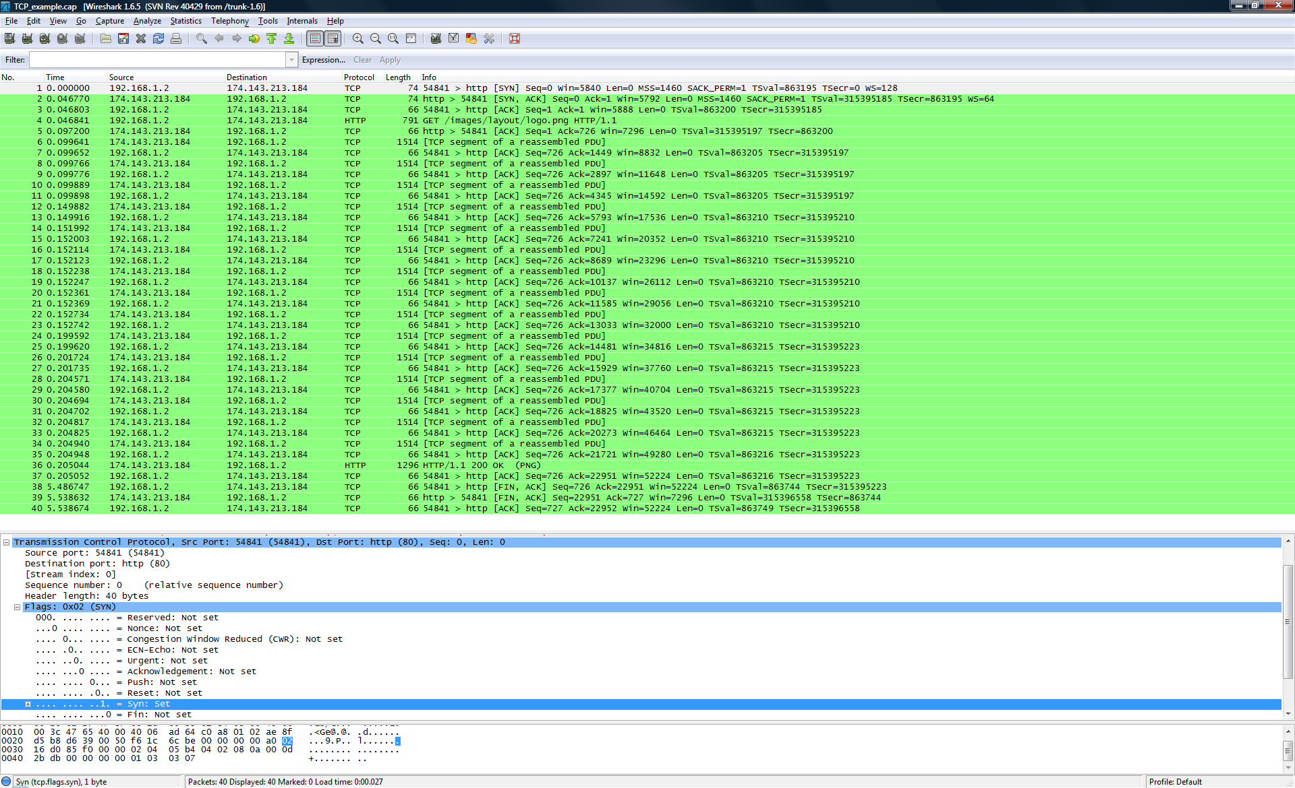
Sample TCP (HTTP) Exchange

Slide 12
Sample TCP (HTTP) Exchange

Slide 13
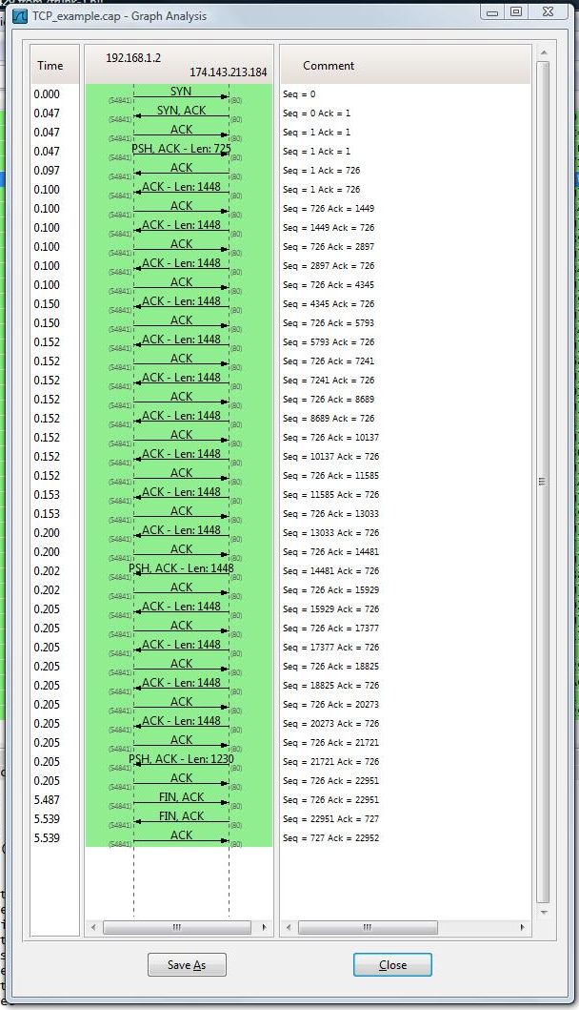
Sample TCP Flow
Run Wireshark capture.
After you have a window of TCP segments, select:
Statistics
Flow Graph
In Flow Graph pop-up
Select “All packets”
Select “TCP flow”
“OK”
Other TCP Graphs:
Statistics
TCP Stream Graphs
Don’t show much for our current lab but for more complicated TCP connections can be of interest.

Slide 14
TCP Sender Events:
data rcvd from app:
add bytes to send buffer
send segment(s), if “allowed”
seq # is byte-stream number of first data byte in segment
Start timer if not already running
timer controls retransmission of oldest un-acked segment
Expiration interval
TimeOutInterval
determined dynamically based on RTT (more on this soon)
timeout:
Retransmit segment that caused timeout
Restart timer
Ack rcvd:
If ack matches previously un-acked segment(s)
discard bytes that have been acked
re-start timer if there are still un-acked segments

Slide 15
Simplified TCP Sender
sendBase
nextSeqNum
nextSeqNum = initialSeqNum
sendBase = initialSeqNum
loop (forever) {
switch(event)
event: data received from application above
add received bytes to send buffer (as many, as will fit)
if allowed, create/send segment(s) using bytes in send buffer
if timer currently not running, start timer
pass segment to IP
nextSeqNum = nextSeqNum + length(segment)
event: timeout
retransmit not-yet-acknowledged segment with
smallest sequence number (oldest segment)
re-start timer
event: ACK received, with ACK field value of y
if (y > sendBase) {
sendBase = y (remember, cumulative ack!)
if there are currently not-yet-acknowledged segments, start timer
}
} /* end of loop forever */
un-acked bytes

Slide 16
TCP Retransmission Scenarios
lost ACK scenario
premature timeout
Host A
Host B
Host A
Host B
Seq=92, 8 bytes data
Seq=92, 8 bytes data
Seq=100, 20 bytes data
timeout
ACK=100
Seq=92 timeout
X
ACK=100
ACK=120
loss
Seq=92, 8 bytes data
sendBase
= 100
Seq=92, 8 bytes data
sendBase
= 120
ACK=100
Seq=92 timeout
ACK=120
sendBase
= 100
sendBase
= 120
time
time

Slide 17
TCP Retransmission Scenarios
Cumulative ACK scenario
Host A
Host B
Seq=92, 8 bytes data
timeout
ACK=100
X
loss
Seq=100, 20 bytes data
sendBase
= 120
ACK=120
time

Slide 18
TCP ACK Generation [RFC 1122, RFC 2581]
Event at Receiver
Arrival of in-order segment with
expected seq #. All data up to
expected seq # already ACKed
Arrival of in-order segment with
expected seq #. One other
segment has ACK pending
Arrival of out-of-order segment
higher-than-expect seq. # .
Gap detected
Arrival of segment that
partially or completely fills gap
TCP Receiver action
Delayed ACK. Wait up to 500 ms
for next segment. If no next segment,
send ACK
Immediately send single cumulative
ACK, ACKing both in-order segments
Immediately send duplicate ACK,
indicating seq. # of next expected byte
Immediately send ACK, provided that
segment starts at lower end of gap

Slide 19
TCP Round Trip Time and Timeout
How should TCP select its timeout value?
must be longer than RTT, but not too much longer
if too long, retransmissions needlessly delayed
if too short, may retransmit when not necessary
but different connections have different RTTs
and RTT varies during a connection as well
How to estimate RTT?
SampleRTT: measured time from segment transmission until ACK receipt
ignore retransmissions (just sample successful transmit/ACK)
SampleRTT will fluctuate, want estimated RTT “smoother”
average several recent measurements, not just current SampleRTT
EstimatedRTT = (1-α)*EstimatedRTT + α*SampleRTT
where α is typically 0.125; this method is called exponential weighted moving average

Slide 20
Exponential Averaging

Slide 21
Computing the Timeout
Timeout should be EstimatedRTT plus “safety margin”
if large variation in EstimatedRTT need larger safety margin
Calculate how much SampleRTT deviates from EstimatedRTT
DevRTT = (1-β)*DevRTT + β*|SampleRTT-EstimatedRTT|
typically, β = 0.25
Then set timeout interval
TimeoutInterval = EstimatedRTT + 4*DevRTT

Slide 22
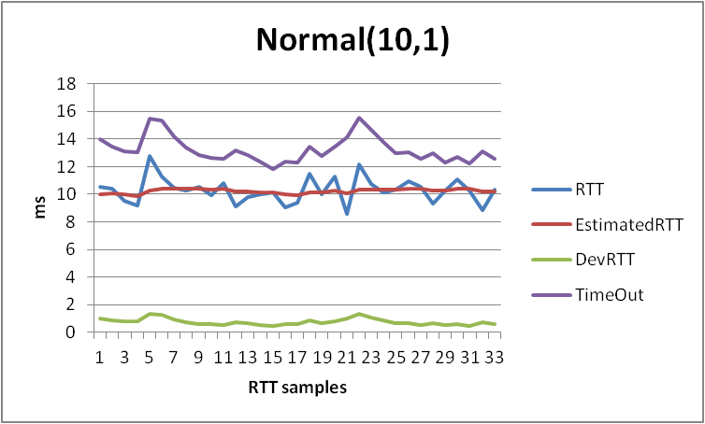
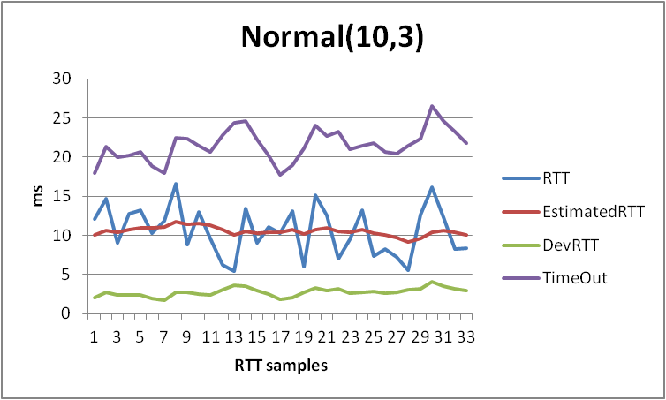
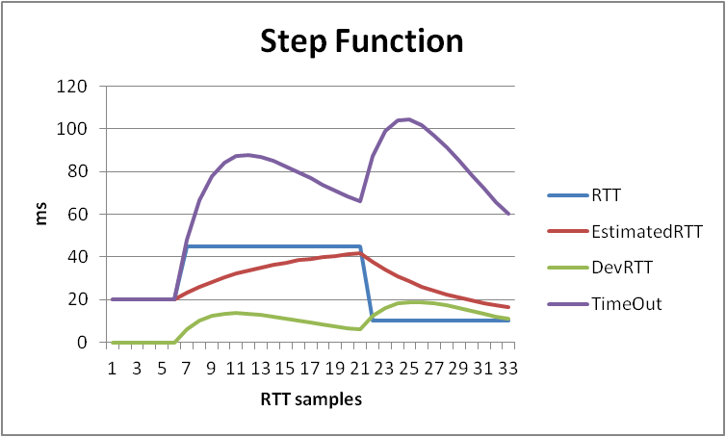
Example RTT estimation:

Slide 23
Fast Retransmit
Time-out period often relatively long
long delay before resending lost packet
Detect lost segments via duplicate ACKs
sender often sends many segments back-to-back
if segment is lost, there will likely be many duplicate ACKs
If sender receives 3 duplicate ACKs for the same data, it concludes that segment after ACKed data was lost:
fast retransmit: re-send segment before timer expires
Why wait for 3 duplicate ACKs?
since IP may deliver segments out-of-order, a duplicate ACK does not necessarily mean a lost segment
but, with 3 duplicate ACKs, a lost segment is likely

Slide 24
Fast Retransmit Illustration
Host A
Host B
X
timeout
resend 3rd segment
Acknowledges all packets received up to 6th segment

Slide 25
Fast Retransmit Algorithm
event: ACK received, with ACK field value of y
if (y > sendBase) {
sendBase = y
if (there are currently not-yet-acknowledged segments)
re-start timer
} else {
increment count of dup ACKs received for y
if (count of dup ACKs received for y == 3)
resend segment with sequence number y
(remember ACK y means y is next expected segment)
}
a duplicate ACK for
already ACKed segment
fast retransmit

Slide 26
Exercises
Socket clientSocket =
newSocket("hostname","port number");
Socket connectionSocket = welcomeSocket.accept();
Draw a space-time diagram showing the complete life-cycle of a TCP connection. Label the vertical line at the client with the client states. Label the vertical line at the server with the server states.

Slide 27
Exercises
Socket clientSocket =
newSocket("hostname","port number");
Socket connectionSocket = welcomeSocket.accept();
SYN(seq=x)
SYN sent
SYN rcvd
create new client socket
SYNACK(seq=y,ACKnum=x+1)
Draw a space-time diagram showing the complete life-cycle of a TCP connection. Label the vertical line at the client with the client states. Label the vertical line at the server with the server states.
Established
ACK(ACKnum=y+1)
.
.
.
Established
clientSocket.close()
FIN_WAIT_1
FIN(seq=z)
CLOSE_WAIT
ACK(ACKnum=z+1)
FIN_WAIT_2
DATA(seq=w)
ACK(ACKnum=w+1)
LAST_ACK
FIN(seq=w+1)
TIMED_WAIT
ACK(ACKnum=w+2)
2*max seg. lifetime ~ 30sec
CLOSED
CLOSED

Slide 28
Exercises
Draw a space-time diagram showing two hosts communicating with TCP. Suppose A sends 8 packets to B, each containing 8 bytes of data, and that the fourth and fifth packets are lost. Show these packets and the acks sent by B. Show the sequence numbers in the ACKs. Suppose that when A retransmits the fourth packet, it is also lost, but the fifth packet gets through. Show these packets and resulting ACKs. Finally, show what happens when the fourth packet is retransmitted the second time and successfully delivered to B. At what point in this scenario does the application at B receive the eighth packet?

Slide 29
Exercises
DATA(seq=x)
DATA(seq=x+8)
DATA(seq=x+16)
DATA(seq=x+24)
ACK(ACKnum=x+16)
Draw a space-time diagram showing two hosts communicating with TCP. Suppose A sends 8 packets to B, each containing 8 bytes of data, and that the fourth and fifth packets are lost. Show these packets and the acks sent by B. Show the sequence numbers in the ACKs. Suppose that when A retransmits the fourth packet, it is also lost, but the fifth packet gets through. Show these packets and resulting ACKs. Finally, show what happens when the fourth packet is retransmitted the second time and successfully delivered to B. At what point in this scenario does the application at B receive the eighth packet?
DATA(seq=x+32)
x
ACK(ACKnum=x+24)
DATA(seq=x+40)
x
DATA(seq=x+48)
DATA(seq=x+56)
ACK(ACKnum=x+24)
ACK(ACKnum=x+24)
ACK(ACKnum=x+24)
triple duplicate ack
DATA(seq=x+24)
x
timeout
DATA(seq=x+24)
timeout
ACK(ACKnum=x+32)
restart timer
timeout
DATA(seq=x+32)
ACK(ACKnum=x+64)

Slide 30
Exercises
Consider a TCP connection linking a residential client A to a remote server that is 2000 km away from A. Suppose the DSL link connecting A to its ISP has a download rate of 2 Mb/s and can store packets with a total length of 64 KB. Ignoring all other considerations, what is the minimum delay on the path from the server to A? If the queue is oscillating rapidly between being empty and full, what would you expect the estimated RTT to be? What about the DevRTT value? Compute the resulting timeout interval. Is this value “safe”? Is it too conservative?

Slide 31
Exercises
Minimum roundtrip delay is propagation delay.
2000km / (200,000 km/s) = 2x10³ km / (2x10⁵ km/s) = 1x10⁻² seconds
10ms one-way propagation delay.
Minimum round trip delay of 20ms.
If the queue alternates between empty and full, the RTT will toggle between 20ms and 20ms+(transmission delay of a full queue)
Full queue delay = (64,000Bytes*8bits/byte)/2 Mb/s
Full queue delay = (64,000Bytes*8bits/byte)/2x10⁶ bits/s
Full queue delay = 256 ms
RTT alternates between 20ms and 276ms

Slide 32
Exercises
RTT alternates between 20ms and 276ms
EstimatedRTT = (1-α)*EstimatedRTT + α*SampleRTT (α = 0.125)
DevRTT = (1-β)*DevRTT + β*|SampleRTT-EstimatedRTT| (β = 0.25)
Under those assumptions, EstimatedRTT alternates between 139.5ms and 156.5ms with DevRTT converging to about 120ms. (About 70 iterations to converge)
TimeoutInterval = EstimatedRTT + 4*DevRTT
TimeoutInterval = 139.5 ms + 4*119.5 ms = 617.5 ms
TimeoutInterval = 156.5 ms + 4*119.5 ms = 634.5 ms
This produces a time out value that will alternate between 617.4ms and 634.5ms.
This value is clearly safe, but much too conservative in that it far exceeds even the maximum possible RTT of 276ms

