Slide 1
Connect to DeltaV through a remote desktop
This procedure is used to allow the PC that does not have DeltaV programs installed to have access to the DeltaV server. Provided it is on the DeltaV high speed Ethernet highway.

Slide 2
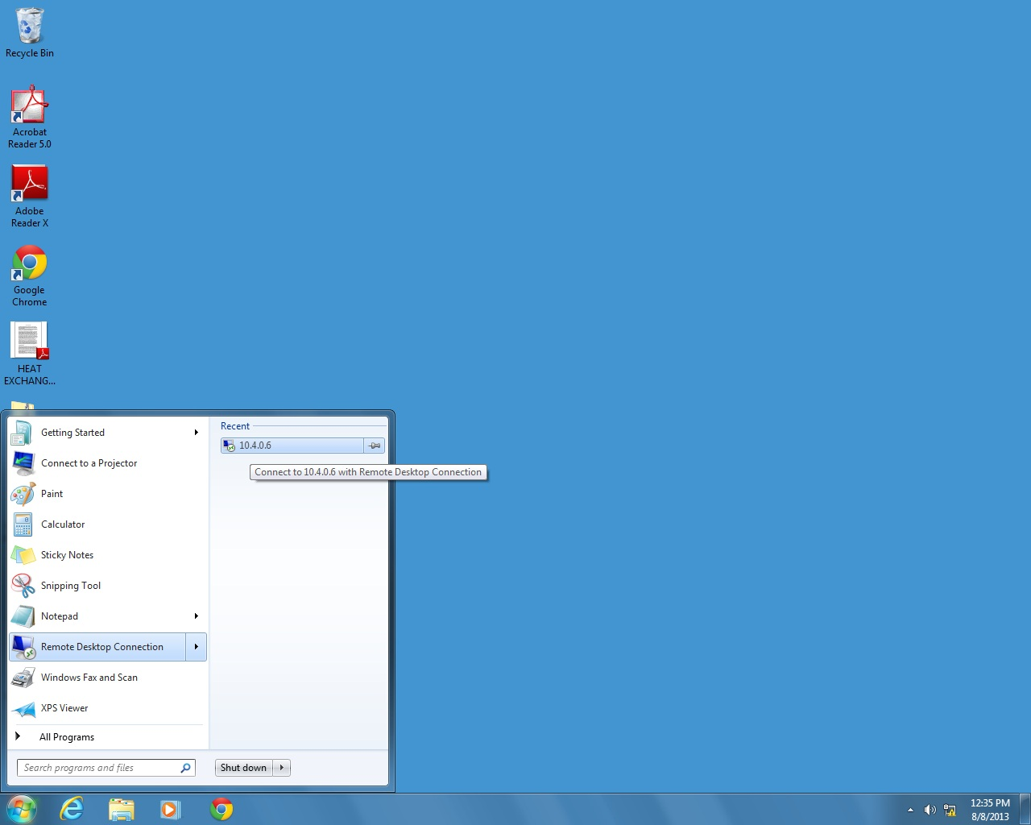
Start the Remote Desktop Connection.
Connect to 10.4.0.6 should be shown as Recent

Slide 3
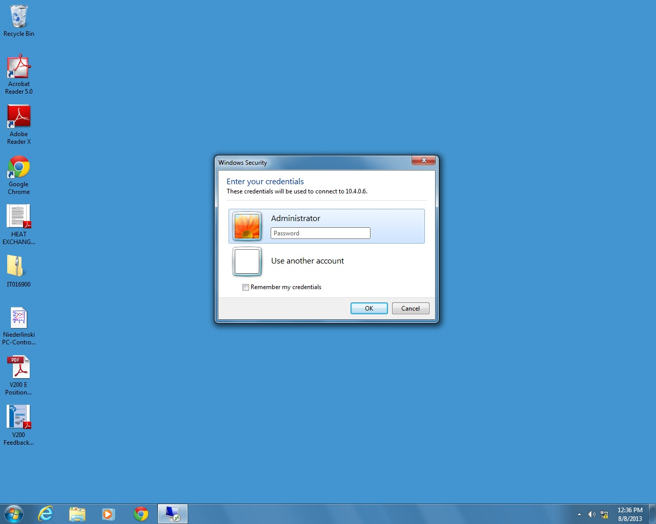
You will have to log in as Administrator.
The password is deltav lower case.

Slide 4
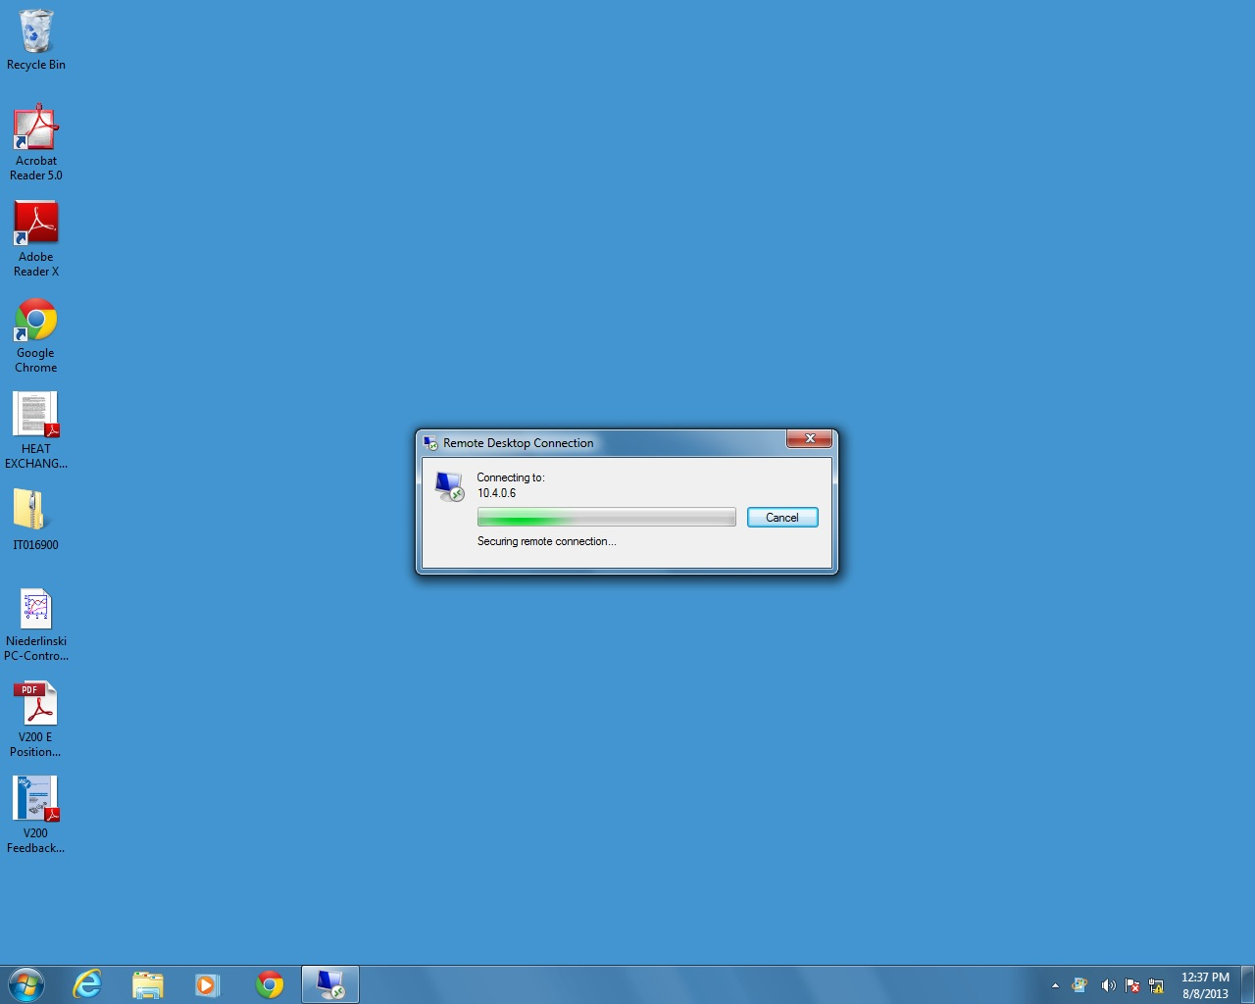
Takes a few seconds to connect …

Slide 5
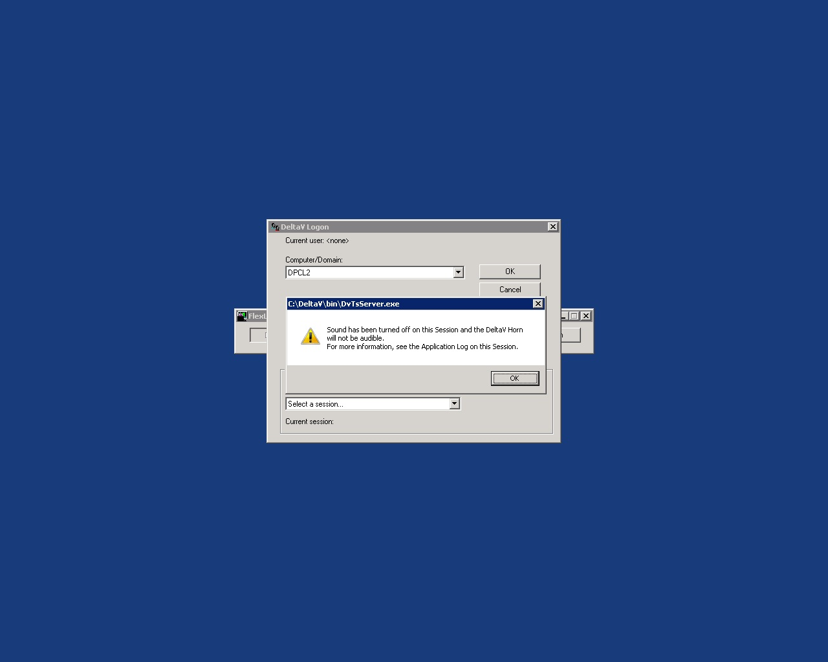
Acknowledge the horn message. We don’t do horns in this lab.

Slide 6
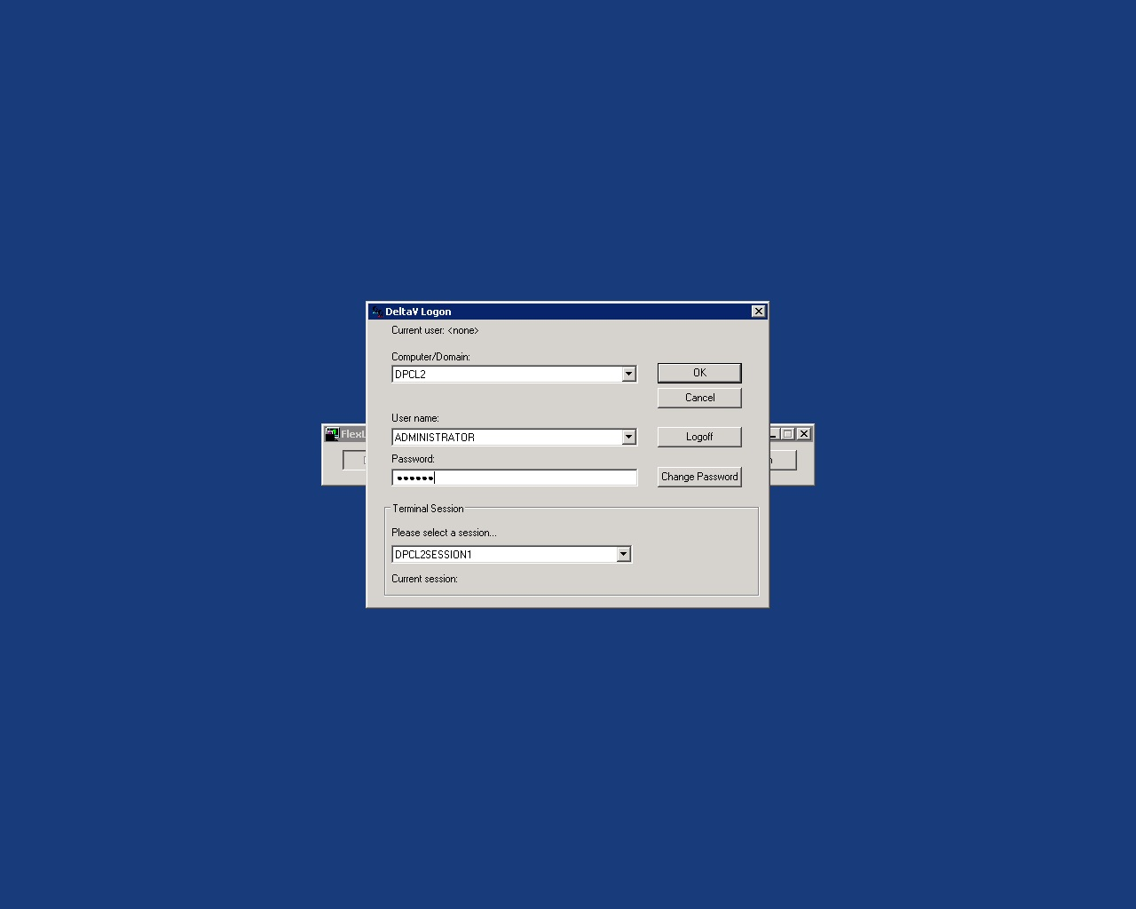
Select the session, we want DPCLSESSION1.
Here we are at the server, we need to enter the password again.

Slide 7
Now select Windows Desktop

Slide 8
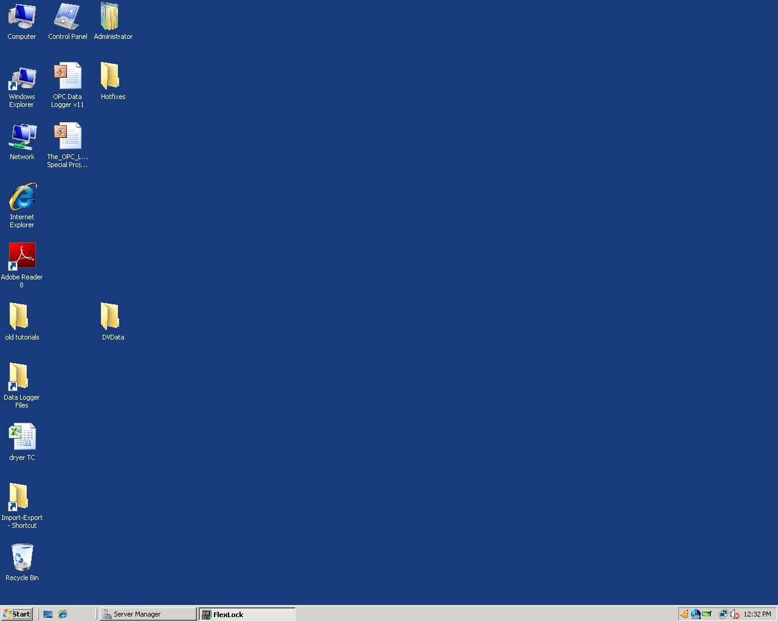
Here we are, now we have access to all the DeltaV programs.

Slide 9
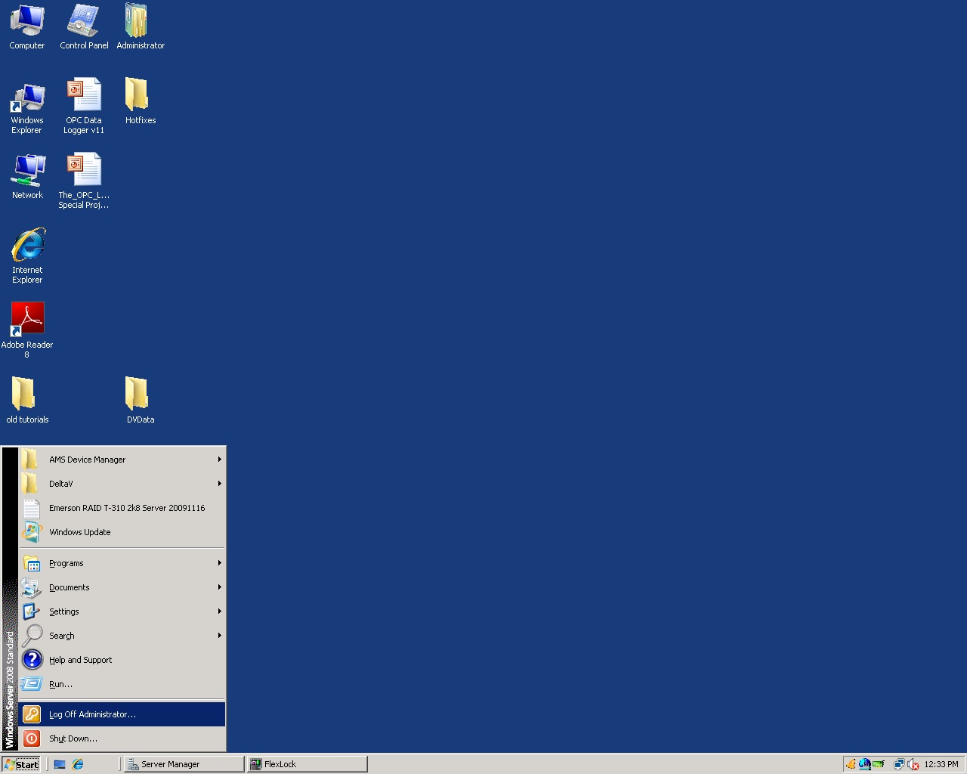
To get out, do a Start then Log Off Administrator.

