Slide 1
E81 CSE 522S: Advanced Operating Systems Spring 2022
Exam 2 Review
Marion Sudvarg Chris Gill
msudvarg@wustl.edu cdgill@wustl.edu

Slide 2
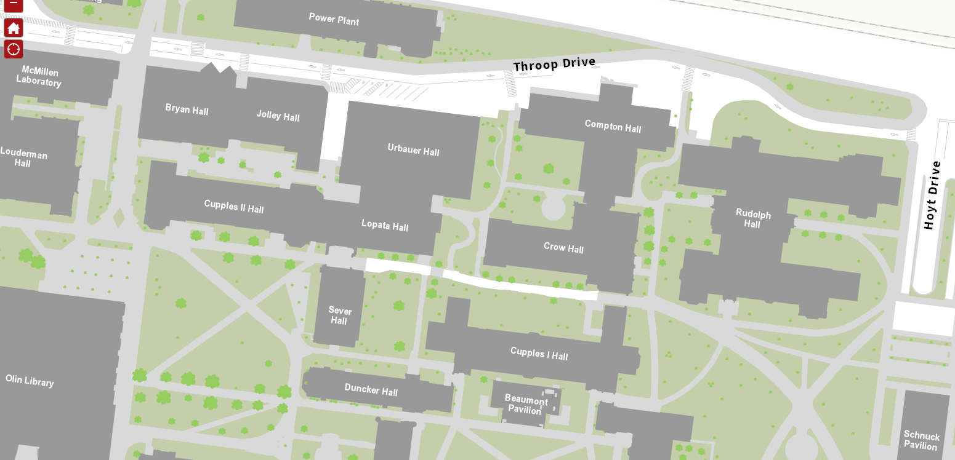
Exam Time and Location
Tuesday, April 19th 2:30-3:50PM
(usual class time) in Lopata 103 (not Urbauer 216)

Slide 3
Studios
Reminder: Studios 11-15 are due by Monday, April 18, at 11:59PM
One submission per team in Canvas, please
If you have a studio marked Incomplete please address the comment!
Let us know by email ASAP if you need an extension, and the reason for that request

Slide 4
Exam Format
Mostly short answer
Some matching of terms
Largely intended to test your understanding of concepts
What does this do?
When would you use this?
Where is this implemented?
Why was this important?

Slide 5
Materials Allowed
Open book, open notes
What is allowed:
Any handwritten or printed notes
Any textbooks
An electronic notebook without internet capabilities, if approved by instructor(s) in advance - please ask us
What is not allowed:
Internet-capable laptops, tablets, phones, etc.
We will have two extra copies of all textbooks
Recommendation: write a 1-2 sided notes page!
Writing it will help you study
Easier to access during exam than printing all notes!

Slide 6
Docker
Automates container creation
Provides container monitoring and management
Leverages namespaces and cgroups
Modular software architecture:
Client/Server
Docker Daemon provides API to clients
containerd supervises and controls state of running containers
runc launches a container
shim process retains minimal environment for each container to communicate with containerd after runc exits

Slide 7
Building Docker Images
Dockerfile → Image → Container
Docker images are layered
Layers are additive
A Dockerfile can inherit from a base image
Use multistage builds to improve efficiency (build time and image size)

Slide 8
Working with Docker Containers
Understand the following ideas:
Containers can run in the background
Entering, viewing, stopping containers
Container resource persistence and cleanup
Bind-mounting a host directory into a container
Using Docker named volumes
How Docker resource constraints correspond to cgroups

Slide 9
Network Namespaces
Network namespaces enable isolation of network resources
Isolate processes from the network
Create secure network applications
Create virtual network devices
veth: a virtual ethernet interface
bridge: a virtual switch
Connect isolated container networks with bridges, route and iptables rules
Use NAT or a bridge gateway to allow containers to reach outside networks
Use port forwarding with iptables to allow outside traffic to reach a container hosting a service

Slide 10
Docker Networking
Docker Network Drivers:
none: The container has no networking capabilities
host: The container is not placed in a new network namespace
bridge: The default network driver; the container is attached to a bridge
Port Forwarding:
Allows external traffic to access services provided by Docker containers
Traffic is forwarded by a docker-proxy process
Docker Compose automates the creation of applications with multiple networked containers

Slide 11
CPU Virtualization
Virtual machines provide strong isolation
Each VM hosts its own operating system kernel
Hypervisor Types
Type 1: hypervisor runs directly on hardware (no host operating system)
Type 2: hypervisor runs within host operating system
Instruction emulation
Guest OS runs as a user-mode process
All instructions are checked (and translated, if necessary)
Hardware virtualization
Typically more efficient than emulation
Introduces guest/supervisor mode, orthogonal to user/kernel mode
Allows instructions to run directly on hardware
Hypervisor can trap (intercept) certain privileged instructions

Slide 12
Memory Virtualization
We cannot allow guest kernels direct access to physical memory and page tables
Introduce an extra level of indirection:
Guest Virtual -> Guest Physical -> Host Physical
Shadow Page Tables:
Hypervisor maintains a shadow copy of guest page tables
Instructions to set CR3 or map a new page are trapped by hypervisor
High VM-exit overhead for guests that frequently context-switch or map memory
Nested/Extended Page Tables
Guest-physical addresses are themselves translated in hardware
A 4-level page table requires 24 nested lookups on TLB miss
Does not require VM-exit; page tables set up by hypervisor as guest boots

Slide 13
Device I/O
Device I/O ports, registers, and memory are addressed similarly to main memory
Some architectures (e.g., x86) use a different instruction to address I/O ports (still conceptually similar)
Architecture-specific kernel macros provide a wrapper façade
Map I/O memory (modify page tables) with ioremap
Use ioread/iowrite wrapper functions for access
Be mindful of compiler optimizations, instruction reordering, memory barriers, and caching!

Slide 14
I/O Virtualization
3 Primary Approaches
Device emulation
Hypervisor emulates a device
Typically slowest approach
Optimizations may provide better performance in certain scenarios
I/O paravirtualization
Hypervisor provides an explicit interface to underlying hardware
Modified guest kernel uses special drivers that make hypercalls
Simplifies instructions that guest kernel must make
Direct device assignment
Assign a hardware device directly to a VM
Device memory regions are mapped directly into the guest (via IOMMU)

Slide 15
Direct Memory Access (DMA)
Virtual Memory Areas are object-oriented (similar to VFS), allow drivers to define open and close functions
Peripheral devices can be given direct access to main memory, bypassing the CPU
Synchronous DMA
Driver’s read function allocates a DMA buffer, maps into process
Driver provides hardware with buffer address
Hardware writes data to buffer, raises interrupt
Interrupt handler in driver awakens process
Asynchronous DMA
Device writes data to buffer directly, even when no process is waiting
Commonly used in network cards
Bus Addresses
Devices address main memory using bus addresses!
Kernel provides platform-specific wrapper functions to portably convert physical/logical addresses to bus addresses

Slide 16
Exam Format
Mostly short answer
Some matching of terms
Largely intended to test your understanding of concepts
What does this do?
When would you use this?
Where is this implemented?
Why was this important?

Slide 17
Studios
Reminder: Studios 11-15 are due by Monday, April 18, at 11:59PM
One submission per team in Canvas, please
If you have a studio marked Incomplete please address the comment!
Let us know by email ASAP if you need an extension, and the reason for that request

Slide 18
Exam Time and Location
Tuesday, April 19th 2:30-3:50PM
(usual class time) in Lopata 103 (not Urbauer 216)

Slide 19
Good Luck!
That said, please also remember that
“Fortune favors the prepared mind.”
– Louis Pasteur
Any questions? …

