Slide 1
Network Namespaces
Marion Sudvarg, Chris Gill
CSE 522S – Advanced Operating Systems
Washington University in St. Louis
St. Louis, MO 63130

Slide 2
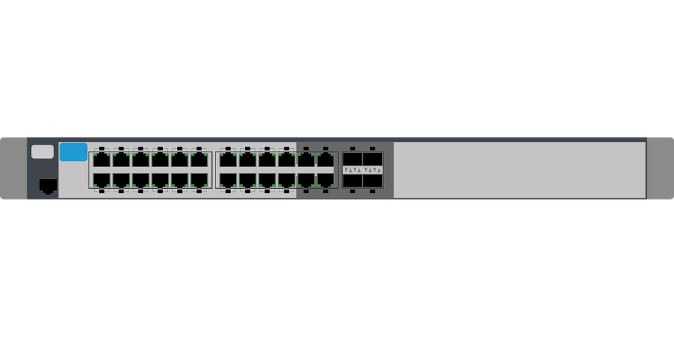
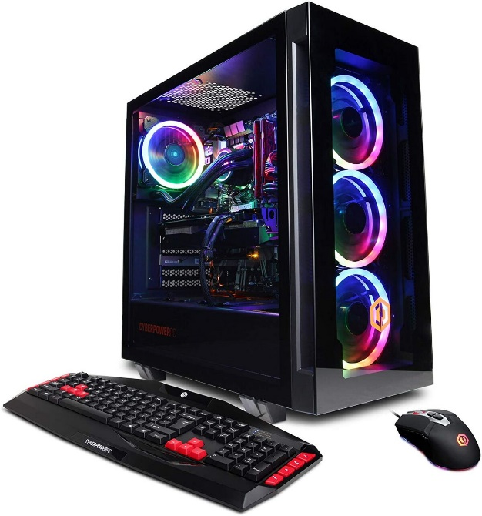
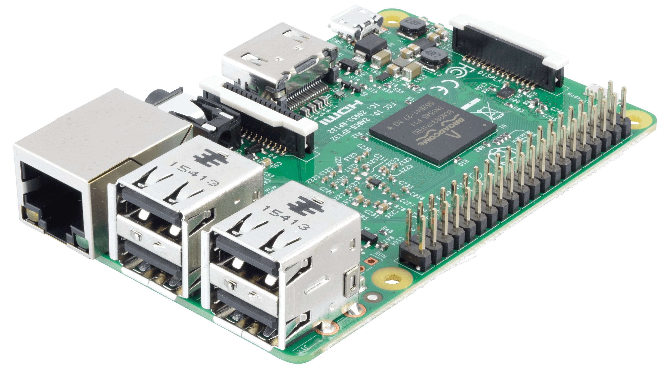
Networking Overview I
> ifconfig lo
lo: flags=73<UP,LOOPBACK,RUNNING>
inet 127.0.0.1
netmask 255.0.0.0
> ifconfig eth0
eth0: inet 192.168.1.12
netmask 255.255.255.0
> ifconfig eth0
eth0: inet 192.168.1.35
netmask 255.255.255.0
Notes:
This is not a networking class! This provides only a very basic overview
Say you have your Raspberry Pi
And you want to connect to it from your computer
You can connect them both to a switch
Because they are on the same network (see inet and netmask), they don’t have to go through a router
The Pi can listen on a socket for outside requests (e.g. ssh, VNC, etc.)
Processes can also communicate over a network socket within the same host over the loopback IP

Slide 3
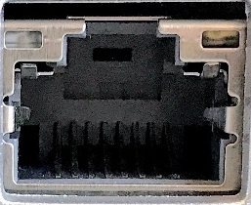
Network Namespaces
Network namespaces enable isolation of network resources
ip netns add ns1
Creates a named bind mount: /var/run/netns/ns1
This allows the network namespace to persist without processes
Allows setup and manipulation of the namespace before processes are launched
netns ns1
PID 1
PID 1
PID 317
lo
eth0
192.168.1.12/24

Slide 4
Uses for Network Namespaces
Isolate processes from the network
Secure network applications:
A process with a socket connection clone()s into a new network namespace
Child inherits socket file descriptor but establish other network connections
Instead of clone()ing, a networked process can send a socket fd to an isolated process via a UNIX socket
Create virtual network devices, e.g. containers or virtual machines that appear as separate devices on the network

Slide 5
Container Networking I
A new network namespace has no communication
Even local loopback must be explicitly enabled!
netns ns1
lo
Execute command in namespace
ip netns exec ns1 bash
ip link set dev lo up
lo
eth0
Enable namespace’s loopback interface
192.168.1.12/24
Can also run command directly, e.g.:
ip netns exec ns1 ip link set dev lo up

Slide 6
Container Networking II
We can create virtual network interfaces to connect container to host
ip link add veth0_1 type veth peer name veth1_0
Establishes two virtual ethernet ports, connected by a virtual cable
ip link set veth1_0 netns ns1
ip netns exec ns1 ifconfig veth1_0 10.1.1.1/24 up
ifconfig veth0_1 10.1.1.2/24 up
Can similarly connect two containers
All veth interfaces are on the same subnet, allowing communication between both containers and the host
This seems inefficient … for n containers, we need 2*$\left({n+1 \atop 2}\right)$ virtual interfaces
Is there a better way?
Question: if we have several physical devices, how do we connect them?
netns ns1
netns ns2
lo
lo
veth1_1
veth2_1
10.1.1.5/24
10.1.1.6/24
10.1.1.1/24
10.1.1.3/24
veth2_0
veth1_0
veth0_1
veth0_2
10.1.1.2/24
10.1.1.4/24
lo
eth0
192.168.1.12/24
Notes:
Ask students! If we have several physical devices, how can they be connected instead of pairwise ethernet cables (and a ton of ports on each one)?

Slide 7
Container Networking III
Answer: we use a switch to connect devices!
A veth is like a virtual ethernet port
A bridge is like a virtual switch
ip link add name br0 type bridge
ip link set br0 up
ip link set veth1br master br0
Now for n containers, we need 2(n+1) veths, 1 bridge
netns ns1
netns ns2
lo
lo
10.1.1.1/24
10.1.1.2/24
veth1
veth2
veth1br
veth2br
br0
veth0br
lo
eth0
veth0
10.1.1.3/24
192.168.1.12/24
Notes:
May need to do the following so container traffic over bridge is not filtered by iptables.
Add to /etc/sysctl.conf:
net.bridge.bridge-nf-call-arptables = 0
net.bridge.bridge-nf-call-ip6tables = 0
net.bridge.bridge-nf-call-iptables = 0
Apply with sysctl -p

Slide 8
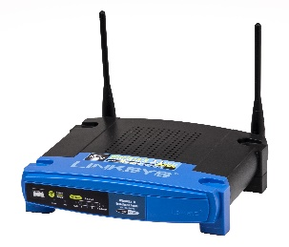
Networking Overview II
Q: How can we isolate separate networks?
A: Use multiple, isolated switches.
10.1.1.0/24
10.1.2.0/24
Q: How can we enable communication between these networks?
A: Connect them via a router/gateway
Use firewall rules to restrict traffic between networks based on port, IP, etc.

Slide 9
Container Networking IV
Q: How can we create multiple, isolated networks of containers?
A: Use multiple bridges
Q: How can we enable communication between these networks?
A: Connect them via route(8) rules
Use iptables(8) rules to restrict traffic between networks based on port, IP, etc.
ns11
ns12
ns21
route
br0
iptables
br1
ns13
ns22
lo
eth0
192.168.1.12/24

Slide 10
Container Networking V
How can a container reach the outside world?
Option 1: host network address translation (NAT) with a veth as a gateway
Add a route from ns1 to outside networks using veth0 as the gateway
ip netns exec ns1 \
ip route add default via 10.1.1.10
Enable IP traffic forwarding
cat /proc/sys/net/ipv4/ip_forward
Enable NAT so traffic from the ns1 subnet appears to come from the host subnet
iptables --table nat -A POSTROUTING \
-s 10.1.1.0/24 –j MASQUERADE
Allow incoming and outgoing traffic to be forwarded over veth0
iptables -A FORWARD -i veth0 -j ACCEPT
iptables -A FORWARD -o veth0 -j ACCEPT
Option 2: Use a bridge as a gateway
Assign an IP address to the bridge, use that as the gateway address
netns ns1
lo
10.1.1.11/24
veth1
veth0
10.1.1.10/24
br0
10.1.1.20/24
lo
eth0
192.168.1.12/24

Slide 11
External Access to Containers
What if the container hosts a service that needs to be accessible from the outside world?
Option 1: Port forwarding
iptables can be used to forward inbound traffic on a specified port to a container
The physical network interface can be provided multiple IP addresses
Use port forwarding rules to forward traffic to different containers based on requested IP
Useful for multiple containers providing services on the same port
Option 2: Use a Macvlan Bridge
Allows a virtual interface to present its own MAC address to the external network
Communication with the associated container (even from the host) traverses the physical network switch

Slide 12
Complex Container Networks
Putting this all together enables composition of complex container networks
Consider a container running a web application on port 8080
The web application uses a database server and log server
A second web application, on the same port, is added
We can assign a second address to eth0
Then forward it with iptables to the second application
db
log
db
log
br1
10.1.20.100/24
br1
10.2.20.100/24
webapp1
webapp1
veth1_1
veth1_1
10.1.20.10/24
10.2.20.10/24
10.1.10.11/24
10.2.10.11/24
veth1_0
veth1_0
veth0_1
veth0_1
10.1.10.10/24
10.2.10.10/24
eth0
lo
Forward
8080
192.168.1.12/24
192.168.1.13/24

Slide 13
Reading Assignments
Namespaces in operation, part 7: Network namespaces
man 7 network_namespaces
man 8 ip-netns: An overview of network namespace management
man 4 veth: An overview of creating virtual Ethernet devices
man 8 route: An overview of establishing routes between subnets
We provide condensed PDFs focusing on relevant sections of these man pages:
man 8 ip-link: Network device configuration
man 8 bridge: Configuration and inspection of virtual bridge devices
The linked libvirt wiki page: While libvirt is a virtual machine toolkit, not a container platform, it also uses network namespaces. This article contains helpful information about the interaction between bridges and iptables
(optional) man 8 iptables: An overview of iptables, a powerful service providing firewall, packet forwarding, traffic shaping, etc.

Slide 14
No Studio Today!
Next time:
Docker container networking: how Docker automates the procedures we discussed today
Docker Compose: creating multi-container applications
A studio to tie these concepts together

