Slide 1
File System Monitoring and Events
Chris Gill, James Orr, Brian Kocoloski, Marion Sudvarg
CSE 522S – Advanced Operating Systems
Washington University in St. Louis
St. Louis, MO 63130

Slide 2
CSE 422S Review: Linux VFS Layer
Virtual Filesystem (VFS)
Subsystem of the kernel that implements the file and filesystem-related interfaces provided to user-space programs (LKD pp. 261)
Enables programs to use standard Unix syscalls (open/close/read/write) on any underlying filesystem
Block layer
Enables different filesystems to operate on different physical storage media

Slide 3
CSE 422S Review: The Virtual Filesystem (VFS)
Application
Open/close/read/write/etc.
VFS layer
Filesystems
NTFS
ext3
FAT
xfs
sysfs (/sys)
HDD
USB
SSD
RAM

Slide 4
CSE 422S Review: Linux VFS Layer
4 key data structures (LKD pp.265)
struct super_block
struct inode
struct dentry
struct file
Superblocks: global filesystem metadata
Maintains lists of all inodes and all dentries in the filesystem
Dentries: directory entries
Created on the fly when requested by user programs
/bin/ls has 3 dentries: /, bin/, and ls
Dentries linked together to create hierarchical filesystem structure
Inodes: file metadata
Permission/dirty bits, etc.
One for each file in the system
Files: represents open file associated with specific process

Slide 5
CSE 422S Review: Why VFS?
Simplification
Processes have a single, unified view of the whole system
Use open(), close(), read(), write() for
IPC (FIFOs)
Process details (/proc filesystem)
Devices (/dev filesystem) and drivers
Booting the operating system (/boot directory)

Slide 6
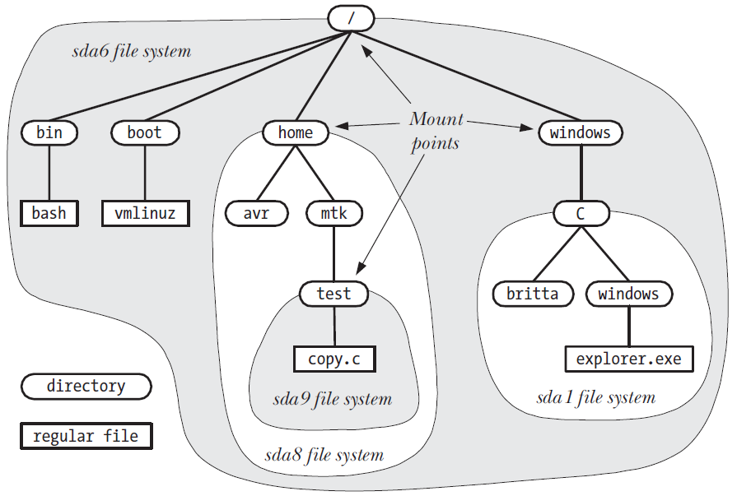
Global Unified Namespace
LPI Figure 14-4: Example directory hierarchy (namespace) showing file-system mount points
Mount namespaces (covered later) enable isolation to a different view of this hierarchy
Leveraged by containers and Docker (covered later in the semester)

Slide 7
File Metadata
inodes (index nodes) contain file metadata, including:
Ownership and Permissions
File type, e.g.
“real” file on block device
FIFO/Socket
Block device information and operations
Create/Access/Modify times
Extended attributes, in the following namespaces:
System: For implementing kernel features (e.g. ACLs)
Security: For implementing security modules (e.g. security.capability for file capabilities, requires CAP_SETFCAP to set, presented later!)
User: Attributes defined by userspace applications
Trusted: Secure userspace attributes (requires CAP_SYS_ADMIN)
Note: Think of these as variable name collections (like namespaces in C++/Python/Java). These are not the isolation namespaces we will present in a later lecture!

Slide 8
Directories and Links
Directories contain lists of filenames mapped to inode numbers
File names are decoupled from the files themselves!
directory
name | inode
. | 5601
.. | 1237
cat photos | 5602
notes.txt | 6094
wallpaper.jpg | 10952
directory
Here are some notes.\nOn disk
a09c73b1e394f
Allows multiple hard links to a single file (must reside on same filesystem)
Symbolic links (symlinks or soft links) are a special type of file that point to a target path

Slide 9
Mounting Filesystems
External hard drive
How do we mount a filesystem?
A filesystem must be mounted to an existing directory: mount /dev/sdb /data (or with mount() syscall)
Unmount: umount /dev/sdb (or with umount() syscall)
Requires CAP_SYS_ADMIN
Persist after reboot with an entry in /etc/fstab
Any existing files in the directory will be hidden (not overwritten) – mounting changes the view of the filesystem
Notes:
TODO

Slide 10
Bind Mounts
Bind mounts allow an existing directory to be mounted at another location in the filesystem
Can also bind mount a file to another file location – leaves the target file intact in the directory, but changes the view of the filesystem
Unlike a hard link, can cross filesystem mount points
Unlike a hard link, establishing a bind mount does not write to the backing filesystem, and so does not persist across reboots
Useful for exposing files/directories in a chroot jail, mount namespace, or container (discussed later)
mount --bind /lib /containers/myapp/lib
(or using the mount() syscall with the MS_BIND flag)
Make a read-only view with the MS_RDONLY flag

Slide 11
Commands and Events
mkdir: Uses mkdir() syscall
rm: Uses remove() C library function
Calls unlink() syscall for files
Calls rmdir() syscall for directories
ls: Uses a directory stream (similar to a file stream) with opendir() and readdir() C library functions
cp: Copy a file src to dest
mv: Calls rename() syscall
Several of these commands change filesystem state.
How can we monitor for corresponding events?
open(src)
open(dest,O_CREAT)
src
dest
read()
buf
write()

Slide 12
Inotify: File Event Monitoring
Inotify (inode notify) provides an interface for monitoring file events.
Initialize with inotify_init() – creates a file descriptor (everything is a file!)
Add files and directories to watch with inotify_add_watch()
Read from fd with read()
Data formatted as array of inotify_event structs
Some events are coupled, e.g. mv
Creates one event with IN_MOVED_FROM mask
Creates one event with IN_MOVED_TO mask
Both events have matching inotify_event cookie

Slide 13
Inotify: Constraints and Isolation
What if a system generates lots of file events?
Estimate size of event queue with FIONREAD ioctl
A large queue consumes lots of memory!
Constrain with /proc/sys/fs/inotify interfaces:
max_queued_events: Limits queued events in a single inotify instance
max_user_instances: Limits queued events per user
max_user_watches: Limits the number of watches registered per user
Isolation: paths outside of a process’s mount namespace (covered later) can’t be monitored!

Slide 14
Special Commands
Device nodes are special files to interface with device drivers, e.g.
/dev/zero: reads generate infinite stream of 0-bytes
/dev/random: read from kernel’s entropy pool
/dev/cdrom: CD-ROM drive
What if we want to control hardware, separately from reading or writing to it?
ioctl to the rescue!
System call for I/O control
Example: Eject CD-ROM
int flags = O_RDONLY | O_NONBLOCK;
int fd = open(“/dev/cdrom”, flags);
ioctl(fd, CDROMEJECT, 0);

Slide 15
C Programming Nuances
inotify_event.name: filename relative to watched directory
This is a zero-length array
Points to optional variable-length data contiguous with the struct
include/uapi/linux/inotify.h
struct inotify_event {
_s32 wd;
_u32 mask;
_u32 cookie;
_u32 len;
char name[0]
};
Static Allocation:
struct line {
int id;
char txt[];
};
struct line line1 = { {1}, “Hello” };
Dynamic Allocation:
struct line * line2 = malloc(
sizeof(struct line)+strlen(line1.txt));
Alignment:
Because of the zero-length array, an inotify fd should be read into a buffer with the same alignment as the inotify_event structure:
char buf[BUF_LEN] __attribute__ ((aligned(__alignof__(struct inotify_event))));

Slide 16
Reading Assignments
Some assignments are familiar from 422! Repetition of focused selections will improve depth of understanding.
LSP chapter 8: Details file and directory management
LKD pp. 58-61: See how the kernel uses wait queues in inotify_read()
LKD pp. 93-95: See how the kernel uses linked lists to traverse inotify watches
LKD pp. 261-266: A brief overview of VFS
man 1 df: Coverage of the df utility, which reports disk and file system information
man 1 ln: Coverage of the ln utility to create links
man 2 link: Coverage of the underlying link system call
We provide condensed PDFs focusing on relevant sections of these man pages:
man 8 mount: Coverage of the mount utility to mount filesystems and bind mounts
man 2 mount: Coverage of the underlying mount system call
man 7 inotify
(Optional) LPI 14: In-depth coverage of the Linux API for file systems
(Optional) LPI 18.1 and 18.3: Additional coverage of directories and hard links
(Optional) LPI 19: In-depth coverage of the inotify API

Slide 17
Studio Exercises Today
See filesystems, and their mount points in the global directory hierarchy, with df
Create multiple hard links (with matching inodes) and bind mounts to a single file
Create a single inotify instance
Add watches for different filesystem objects
Multiplex on the inotify instance’s file descriptor using select(), poll(), or epoll()
Read events as they occur due to terminal window commands like ls, touch, mv, or mkdir
Explore what you see in each of those cases
What is each command doing at the filesystem level?
How can you configure different watches, and how do different watches inter-relate?
How do different watches on different directories that contain pointers to the same inode behave?

